Slide 1
ANDREW JACKSON
March 4, 1829 – March 4, 1837

Slide 2
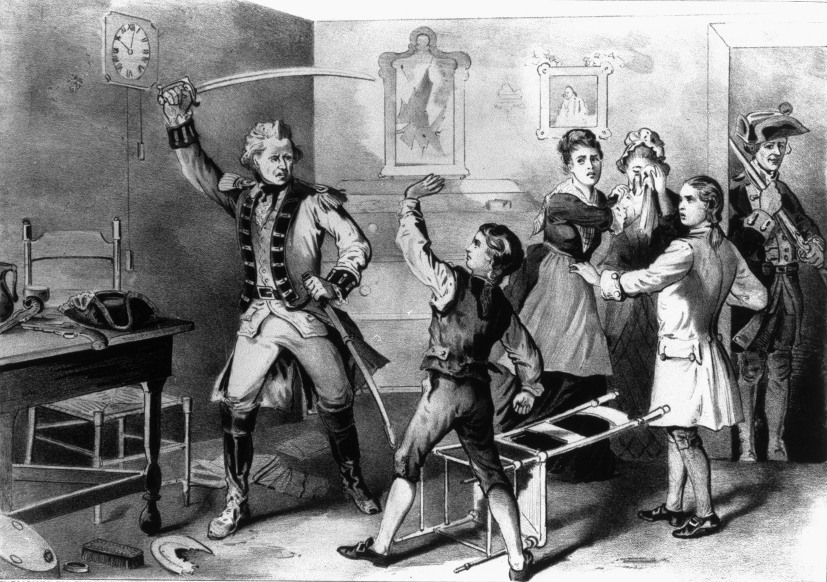
Andrew Jackson- Background
Born in a log cabin on the frontier
His parents were immigrants from Ireland
They died by the time he was 15
He grew up tough

Slide 3
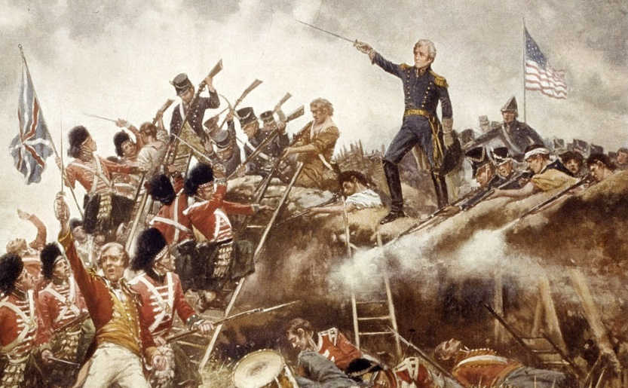
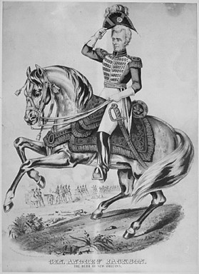
A Military Man
Joined American Revolution at age of 13
Creek War Victory
  Indian battle during the War of 1812
War of 1812
  Victory at Battle of New Orleans
1818 Seminole Victories
  Helped regain Florida

Slide 4
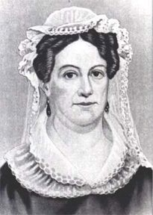
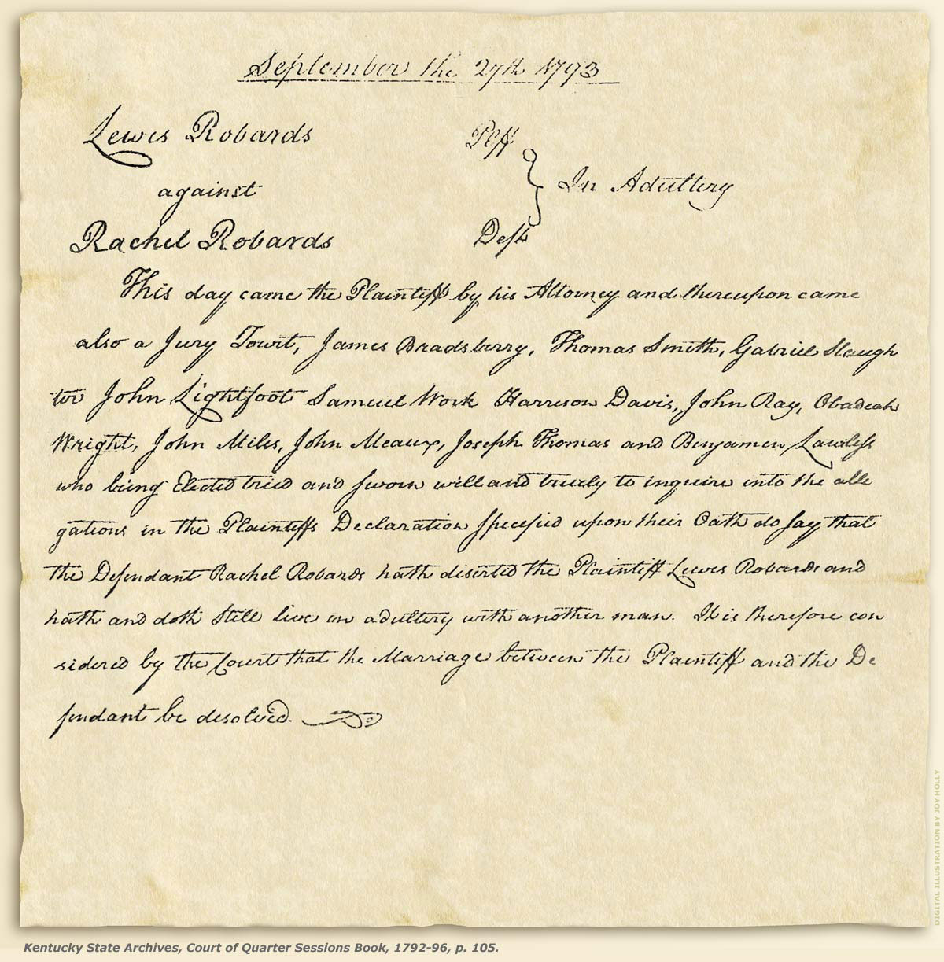
Personal Life
Studied Law at North Carolina
  Practiced in Tennessee
Made money in real estate
  Buying and selling in Georgia & Alabama
Married Rachel Robards
  Recently divorced woman
  Controversy surrounding their marriage
Final Divorce Decree

Slide 5
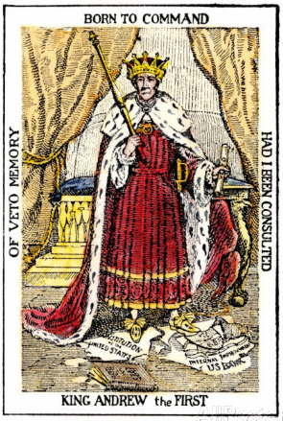
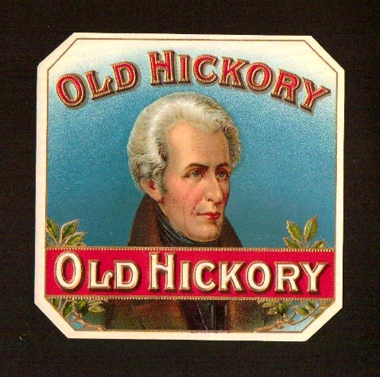
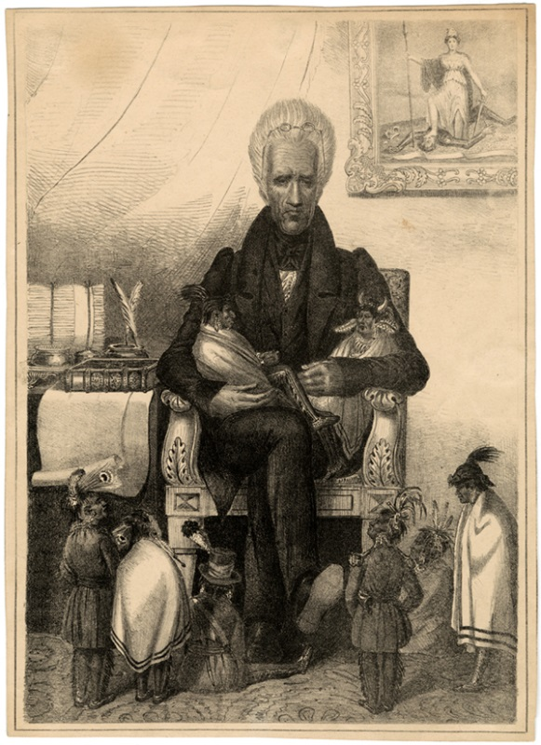
Nicknames for Jackson
“Old Hickory”
  Given to him by soldiers he commanded
  Meant he was as tough as the wood on a hickory tree
“King Jackson”
  Given to him by his political opponents
  They thought he was trying to take over the country
“Sharp Knife”
  Given by Native Americans
  He was ruthless in dealing with them

Slide 6
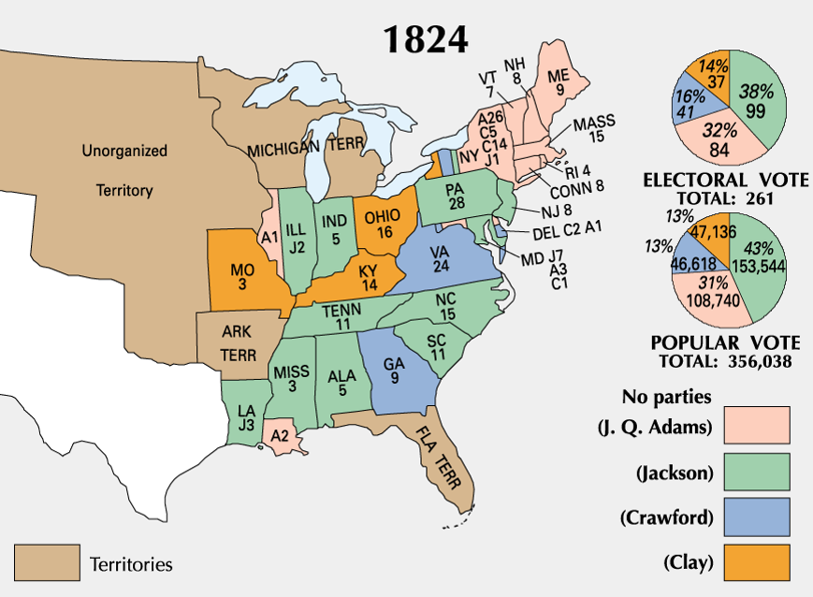
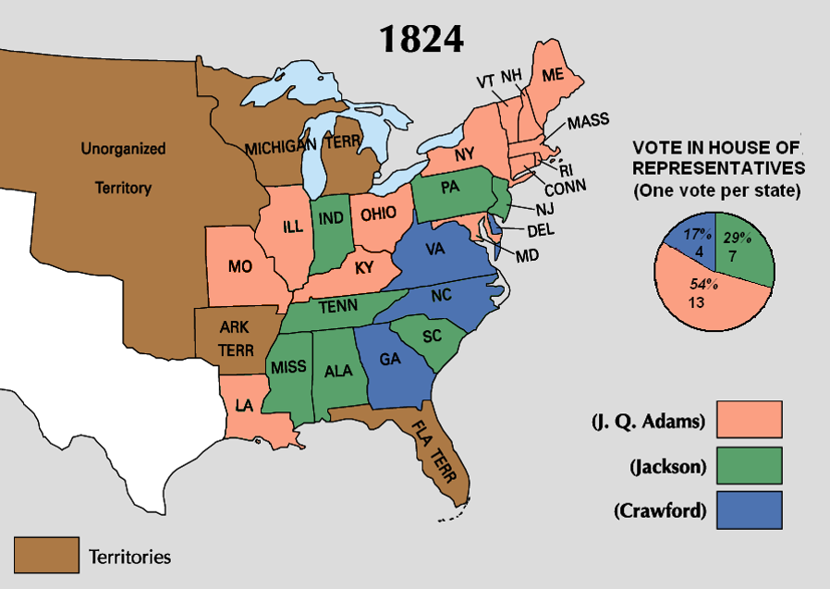
Election of 1824
Disputed Election
He received the most popular votes
  But not a majority of the electoral votes
Went to Congress
  They elected John Quincy Adams
A few issues existed that Jackson was angry about
  Called it a “Corrupt Bargain”
  “…there was cheating and corruption and bribery, too.”
  His anger damaged Adams efforts as president

Slide 7
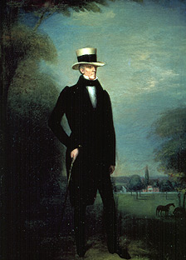
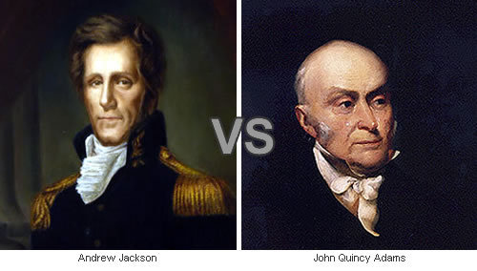
Election of 1828
Rematch between Adams and Jackson
“Corrupt Bargainer” vs. “Military Chieftain”
Jackson won easily and became president a few months later
John C Calhoun became Jackson’s Vice President
His wife died before he became president however
  He blamed Adams

Slide 8
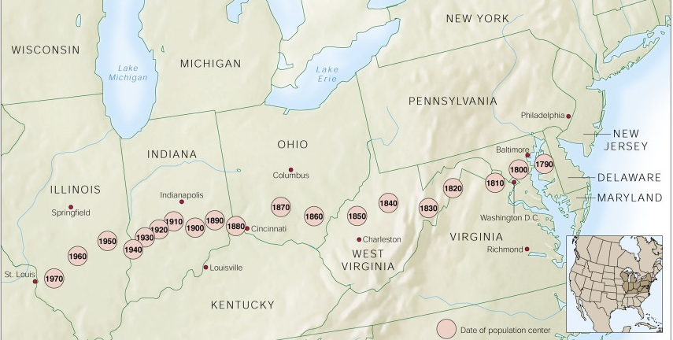
Spoils System
After the election, he fired many government employees
  He hired many of his supporters
“The duties of all public offices are…so plain and simple…”
A supporter said, “To the victor goes the spoils”
  Very few of his supporters were qualified
Unofficial advisors were referred to as his “Kitchen Cabinet”
  He paid little attention to cabinet – politicians.
  Only there for themselves
  He relied on friends around the country who were closer to the people.
Notes:
Jackson’s Style of President: The Kitchen Cabinet • Jackson would go to his trusted friends and political supporters for advise on how to run the government, instead of his official cabinet – They met in the White House kitchen so they were known as the “kitchen cabinet” • The Republicans felt that Jackson was getting poor advise and would made bad decisions for the country because of it.

Slide 9
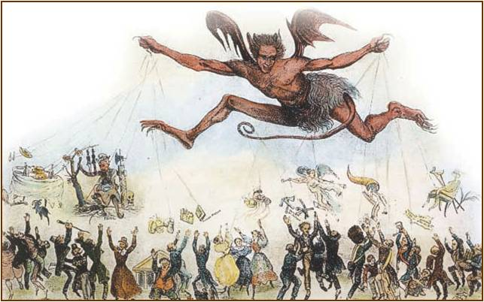
Jackson as Satan Dangles the Spoils of Victory over his Supporters
Notes:
“Office Hunters for the Year 1834”: Black and white print of a winged demon with the head of Andrew Jackson, hovering in the sky holding strings connected to symbols and objects representing political offices. Below are a crowd of people attempting to reach out for the "political plumbs." This cartoon depicts the "spoils system" of rewarding the politically faithful with offices and thereby changing staff with each election. Additional dialog and phrases appear on the print.

Slide 10
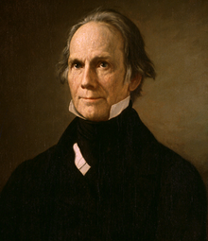
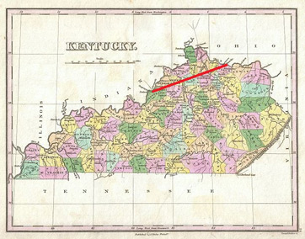
Veto of Maysville Road
Clay pushed for the construction of Maysville Road in Kentucky.
Clay “Pet Project”
Jackson: Why build a road to only help out a few states?
This move ended any “cordialness” between President and Clay.
Alienated many of Jackson’s Western Supporters.

Slide 11
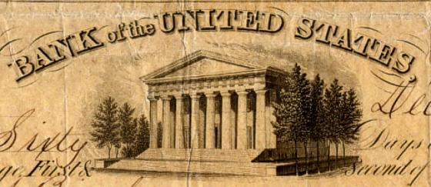
The Bank War
1829–1837

Slide 12
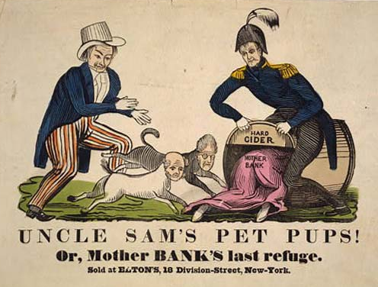
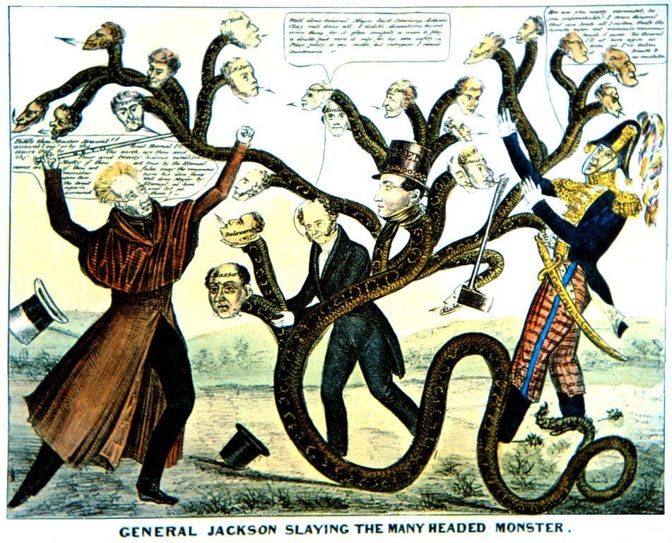
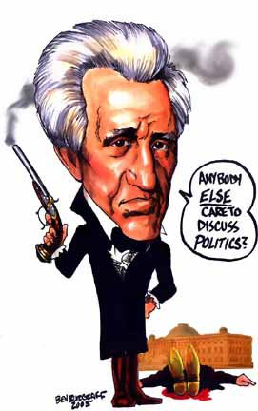
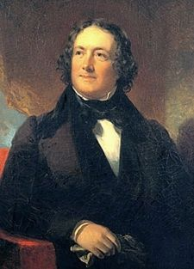
Dealing with the 2nd
Bank of the United States
Jackson hated the federal bank
  He let them know!
“The bank…is trying to kill me, but I will kill it!”
He felt the National Bank was only helping the rich
  Issue dealing with farmers and merchants
He vetoed a renewal of the bank
  Ended the National Bank and sent money to state banks
Those who opposed Jackson's banking policy viewed it as going beyond the constitutional authority of the President and seemingly empowering the Presidency into a dictatorship.
Nicholas Biddle:
President of the
Bank of the US
Notes:
“Uncle Sam’s Pet Pups”: A crude woodcut satire showing Harrison luring "Mother Bank," Jackson, and Van Buren into a barrel of "Hard Cider." Jack Downing chases Jackson and Van Buren toward the barrel as Mother Bank crawls into it. While Jackson and Van Buren sought to destroy the Bank of the United States, one of Harrison's election campaign promises was to reestablish it, hence his providing "Mother Bank" a refuge in this scene.
“General Jackson Slaying the Many headed Monster”: A satire on Andrew Jackson's campaign to destroy the Bank of the United States and its support among state banks. Jackson, Martin Van Buren, and Jack Downing struggle against a snake with heads representing the states. Jackson (on the left) raises a cane marked "Veto" and says, "Biddle thou Monster Avaunt!! avaount I say! or by the Great Eternal I'll cleave thee to the earth, aye thee and thy four and twenty satellites. Matty if thou art true...come on. if thou art false, may the venomous monster turn his dire fang upon thee..." Van Buren: "Well done General, Major Jack Downing, Adams, Clay, well done all. I dislike dissentions beyond every thing, for it often compels a man to play a double part, were it only for his own safety. Policy, policy is my motto, but intrigues I cannot countenance." Downing (dropping his axe): "Now now you nasty varmint, be you imperishable? I swan Gineral that are beats all I reckon, that's the horrible wiper wot wommits wenemous heads I guess..." The largest of the heads is president of the Bank Nicholas Biddle's, which wears a top hat labeled "Penn" (i.e. Pennsylvania) and "$35,000,000." This refers to the rechartering of the Bank by the Pennsylvania legislature in defiance of the adminstration's efforts to destroy it.

Slide 13
The “Monster” Is Destroyed!
1832 → Jackson
vetoed the
extension of the 2nd National Bank of the United States.
“Pet Banks”
1836 → the charter expired.
1841 → the bank went bankrupt!

Slide 14
The Nullification Crisis
Jackson wanted to the eliminate the federal debt.
Jackson’s View:
  Tariff for short term to pay off debt, but it would be repealed after the debt is paid off.
Debate: Use of Tariffs to pay off the debt?
  North supported the Tariffs – protected merchants.
  South opposed the Tariffs – higher prices on equipment and loss of profits.

Slide 15
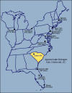
Nullification Crisis
In 1828 congress passed the Tariff Act of 1828 (The Tariff of Abominations) which imposed taxes on imported goods.
  Although supported by Northern manufacturers, the Southern states opposed the tariff as it discouraged trade among nations.
  Southern states now paid more for European goods
President Jackson lowered the tax in 1832 but met continued resistance from Southern leaders such as South Carolina Senator John C. Calhoun.
  Calhoun said that states could nullify (refuse to comply) with laws that went against the interests of the individual states.
  S.C. talked about seceding (Leaving the Union)
Jackson didn’t like this!
  He thought it would lead to civil war
NULLIFICATION:
  States had the power over the Constitutionality of laws, not supreme court. If one state said a law is unconstitutional, then Congress must repeal the law. The federal government would need to amend the Constitution.

Slide 16
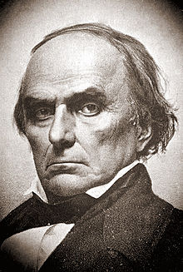
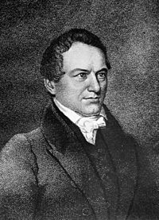
VIEWS OF THE TARRIFF
Daniel Webster, Senator from Mass., argues that nullification is the same as treason.
Senator Haynes, Senator from SC, pushes for the West to join the fight with SC.
Most of Congress speaks out against nullification.
Jackson, seeing the power play by VP Calhoun, fires most of his supporters within the government.
Calhoun resigns from office and gets appointed to the US Senate from SC.

Slide 17
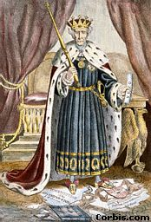
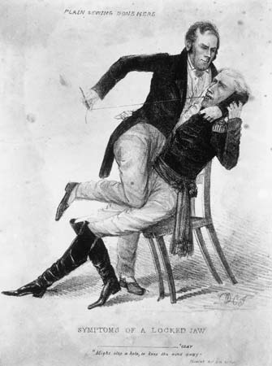
President Jackson sends warships to Charleston Harbor and threatens to hang Calhoun for treason.
SC calls a state convention and declares the Tariff of 1832 invalid and refuses to collect it.
Congress introduces a “force bill” to force SC to pay with force.
  Force Bill: the United States government would use force to impose federal laws.
Henry Clay offers compromise: Tariffs would be reduced over a period of nine years.
  South Carolina backed down but seeds of secession were now planted into the politics of the nation.
Notes:
“Symptoms of a Locked jaw: An outraged and outmaneuvered Henry Clay vainly tries to Sew Up Jackson’s Mouth, after Jackson’s stinging message vetoing the bill to recharter the Bank of the US (1834)

Slide 18
Jackson on Secession
“If one drop of blood be shed there in defiance of the laws of the United States, I will hang the first man of them I can get my hands on to the first tree I can find.”
“If we get in a war over this I will kill anyone responsible for starting the war.”
View Of The Southern States
If the gov. could place Tariffs on states, what could an anti-slavery president do?

Slide 19
Missouri Compromise
1820

Slide 20
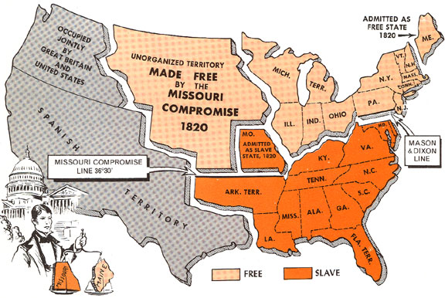
The Missouri Compromise
of 1820
It marked the beginning of the
prolonged sectional conflict over
the extension of slavery that led
to the American Civil War.

Slide 21
In 1819, Missouri wanted to enter the Union. However, there were already 11 free states and 11 slave states.
Why did Missouri create a problem?

Slide 22
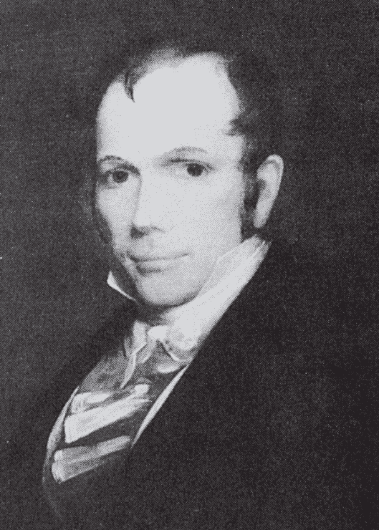
Solution:
Senator Henry Clay suggested drawing a line at the 36º-30' N. latitude.
Slavery would be banned everywhere north of this line.
Missouri would join as a slave state, Maine as a free state.

Slide 23
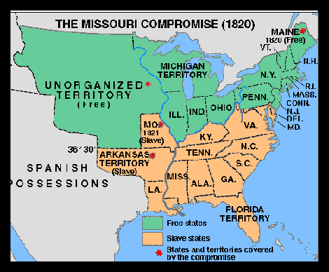
The Missouri Compromise
36° - 30’ Line
Balance slave and free states in the future.
South has eyes on Texas.

Slide 24
Indian Removal Act
1830

Slide 25
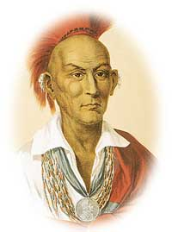
Black Hawk War
1827 - US govt says all Native Americans must leave Illinois
Chief Black Hawk of the Sauk refuses, saying no one can own land
US settlers moved into village when they were away hunting
After Sauk attacks, US troops drive out Indians

Slide 26
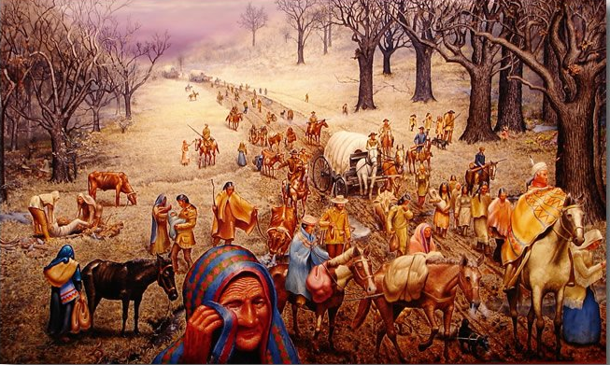
Indian Removal Act-1830
President Jackson pushes Congress to force Indians to move west of the Mississippi
Congress established Indian Territory (now Oklahoma) as the new Indian homeland
US govt creates Bureau of Indian Affairs

Slide 27
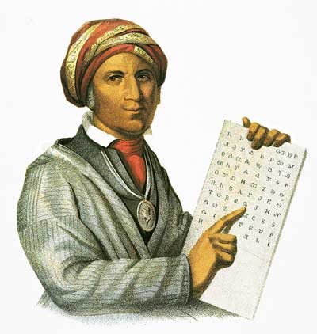
Cherokee Indians
Lived peacefully in the Appalachian Mountains of Georgia and Tennessee
Adopted culture of whites - wrote and spoke English
Had own written language and newspaper
Based their government on the U.S. Constitution

Slide 28
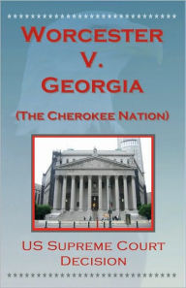
Cherokee Sue For Land
Cherokee sued the government of Georgia for taking their land
Worcester vs. Georgia - Supreme Court rules Georgia’s actions are illegal and that the Cherokee can stay
“Chief Justice John Marshall has made his decision. Now let him enforce it.”
President Andrew Jackson

Slide 29
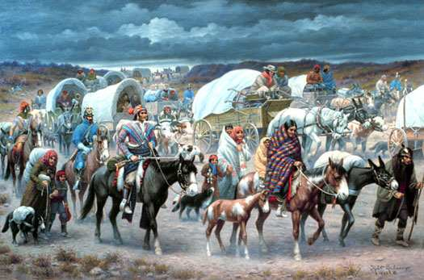
Trail of Tears
Georgia govt. smashes in Cherokee printing press
US troops move 18,000 Cherokee at gunpoint 800 miles from 1838-1839
25% of Cherokee died - most elderly and children
This happened under President Van Buren’s term in office

Slide 30
Positions on the Key Issues of 1832
WHIGS
DEMOCRATS
Less concerned about the widening gap between rich and poor.
Opposed “liberal capitalism” because they believed it would lead to economic chaos.
Strong national govt. to coordinate the expanding economy was critical.
Opposes Indian removal.
Favored tariffs.
Supported a National Bank.
Felt the widening gap between rich and poor was alarming.
Believed that bankers, merchants, and speculators were “non-producers” who used their govt. connections to line their own pockets.
Govt. should have a hands-off approach to the economy to allow the little guy a chance to prosper.
For Indian removal.
Oppose tariffs.
States’ rights.
Oppose federal support for internal improvements.
Opposed the National Bank.

Slide 31
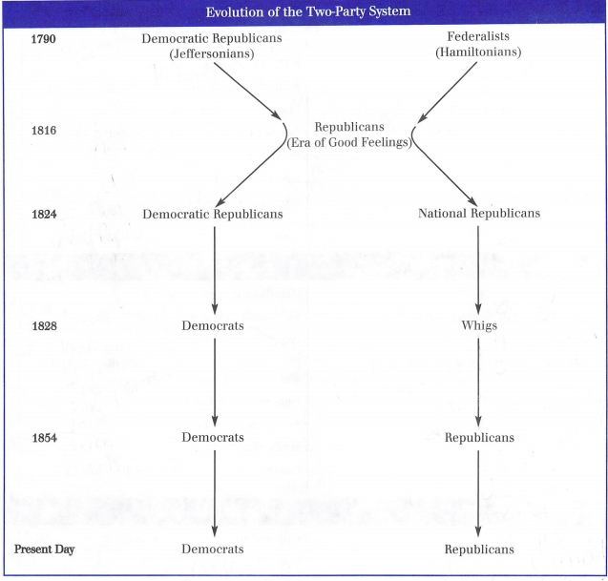
Political Split

Slide 32
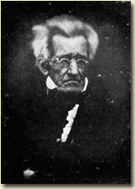
Photo of Andrew Jackson in 1844
(one year before his death)
1767 - 1845

