Slide 1
Religion & Reform
APUSH

Slide 2
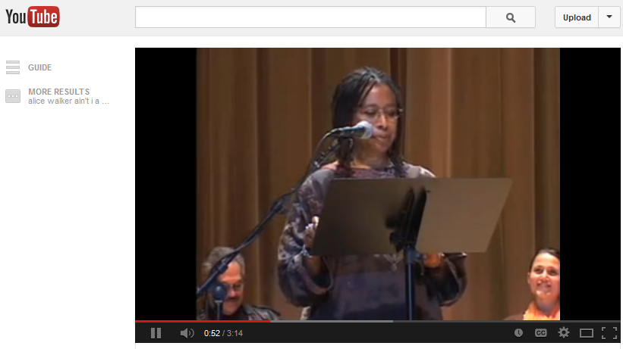
Alice Walker Reads Sojourner Truth

Slide 3

“Perfectionism”
New nation
Democratization
Political & moral reform movements
Religious revivals
Millenarianism & Utopianism

Slide 4
Essential Questions
How did 19th century religious and reform movements redefine American concepts of freedom, equality and morality?
How successful were these movements?
What role did women play?

Slide 5
Your Notes
Movement
Leaders
Goals & Impact

Slide 6
Second Great Awakening

Slide 7
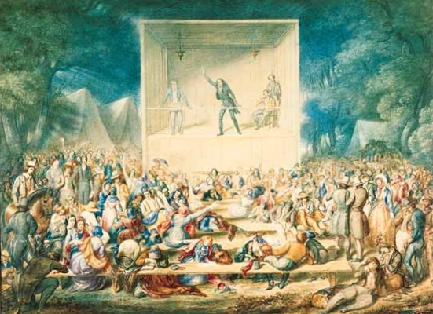
Second Great Awakening
New York frontier
Protestant revivalism
Religion for the common man
Encouraged moralistic reform

Slide 8
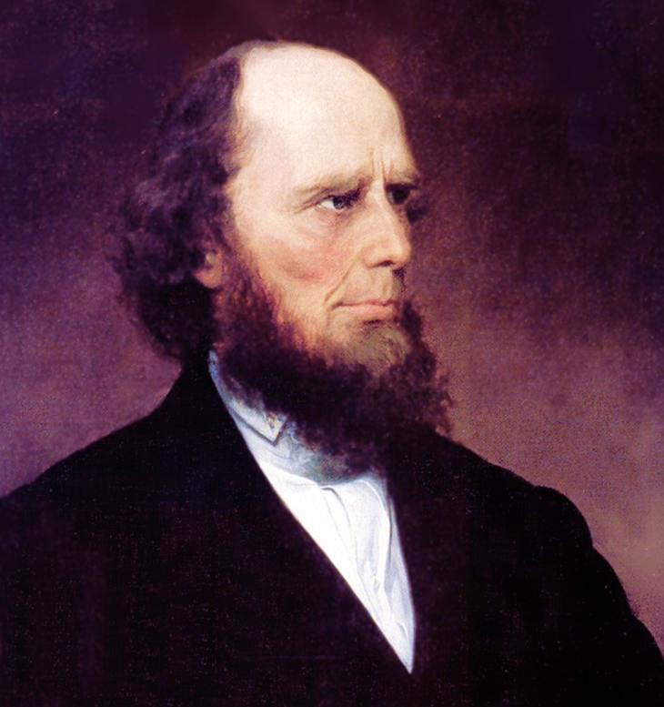
Charles G. Finney
Traveling revivalist preacher

Slide 9
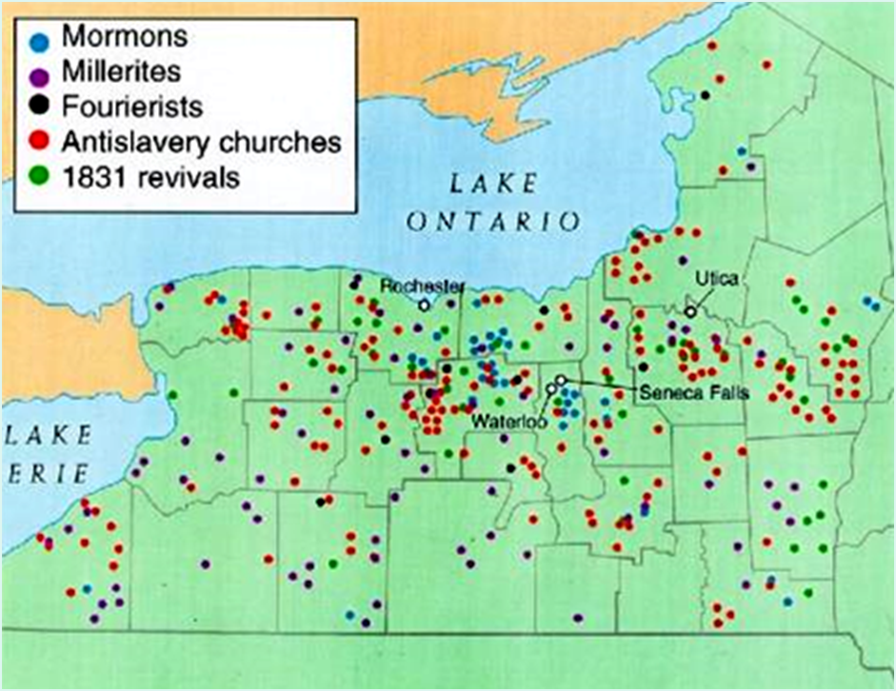
“Burned-Over” District of N.Y.

Slide 10
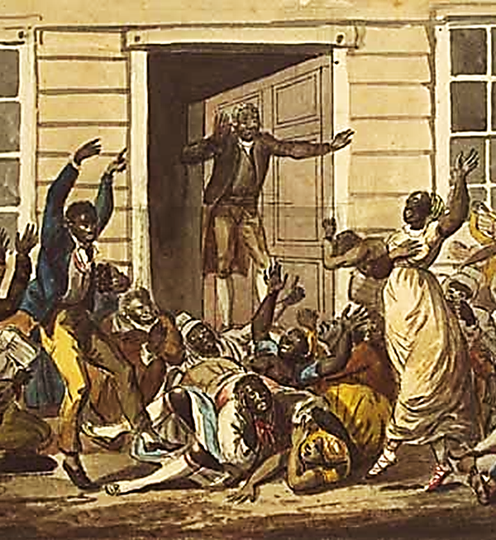
African-American Religion
Church was center of community
Call-and-response
Exodus story
Some female preachers

Slide 11
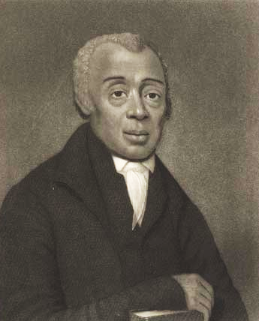

A.M.E. Church (African Methodist Episcopal)
Richard Allen

Slide 12
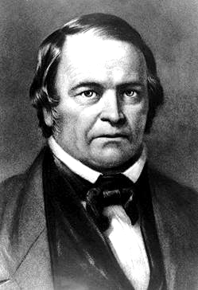

Millerites
William Miller
Millenarianism
  Expected “Second Coming” in 1843

Slide 13

Unitarianism
Rejected the Trinity as theologically unsound
Liberal Christianity

Slide 14
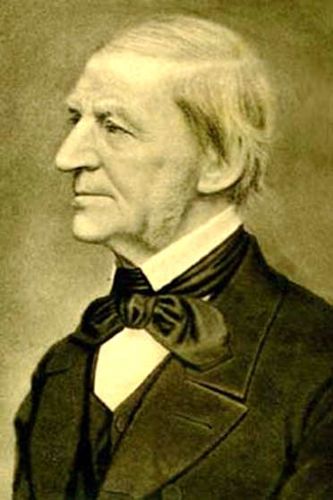
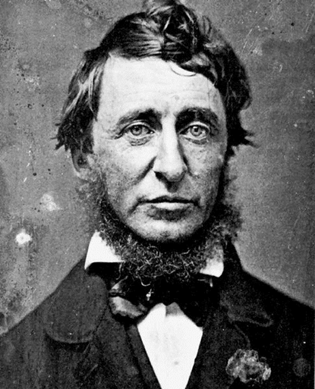
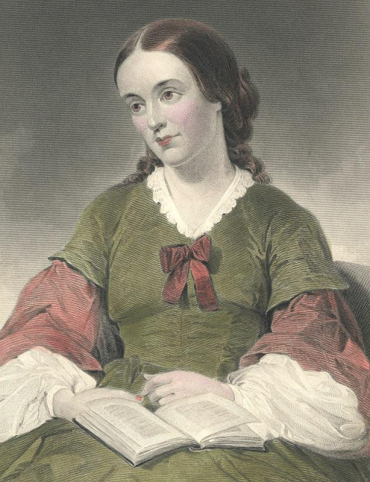
Transcendentalism
“Oversoul”
Transcendentalist Agenda
  Freedom to the slave.
  Well-being to the poor & miserable.
  Learning to the ignorant.
  Health to the sick.
  Peace & justice to society.

Slide 15
Mormonism

Slide 16
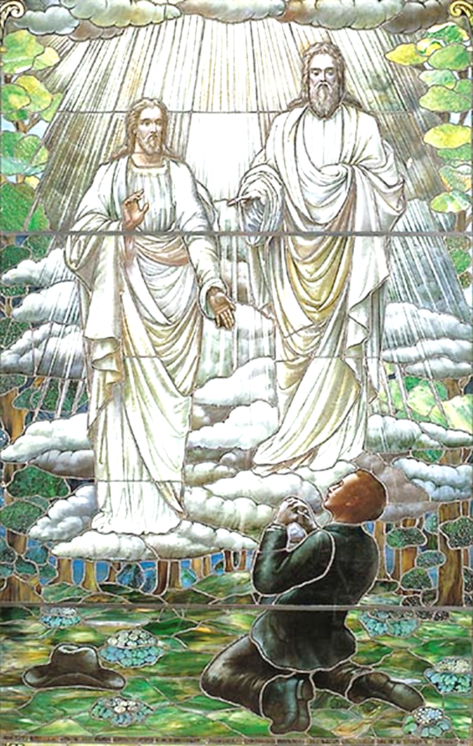
Joseph Smith
“Burned-Over District” of N.Y.
Vision & golden plates
Book of Mormon
“Latter-Day Saints”

Slide 17
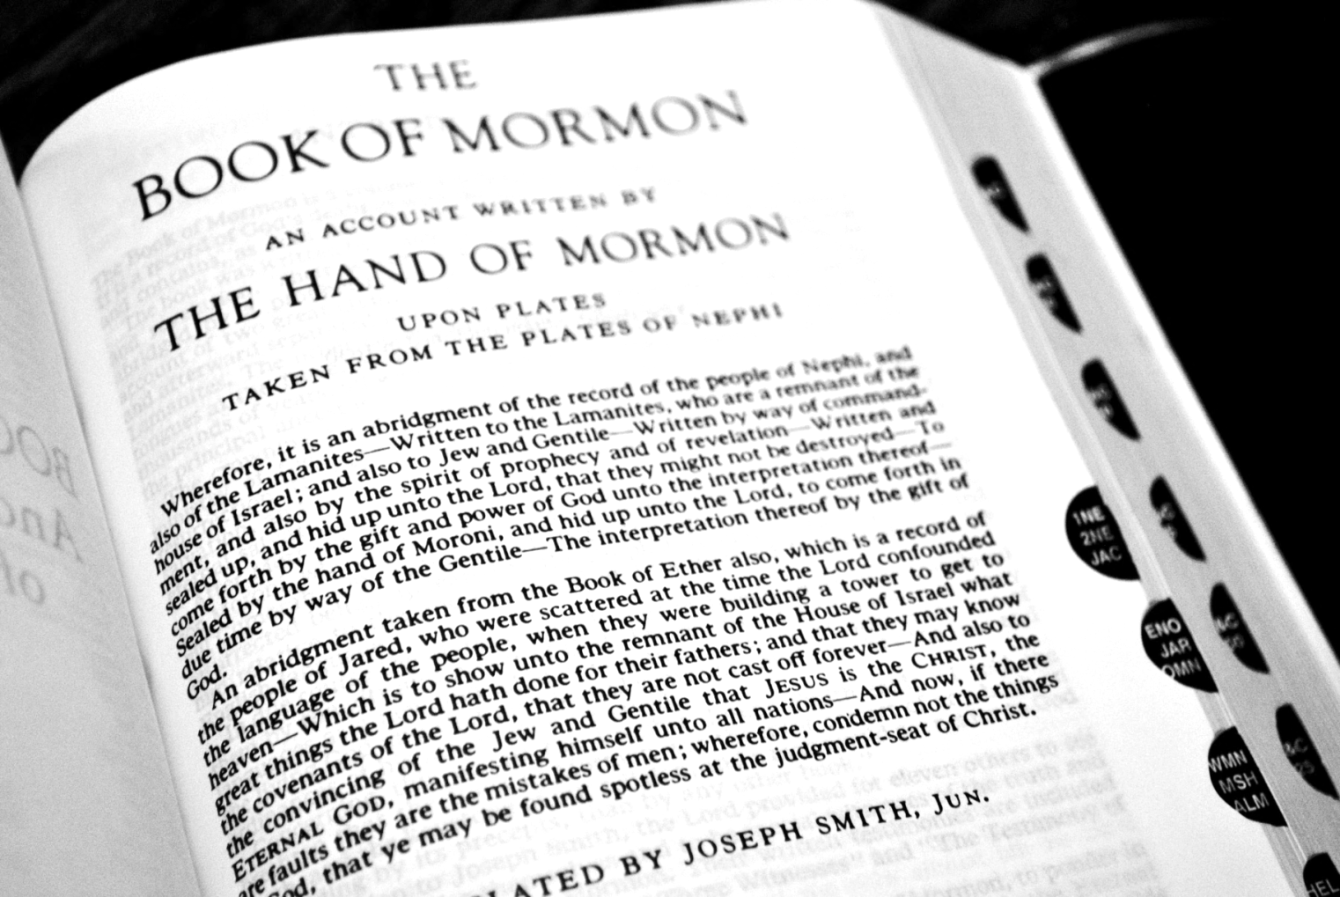
Book of Mormon

Slide 18
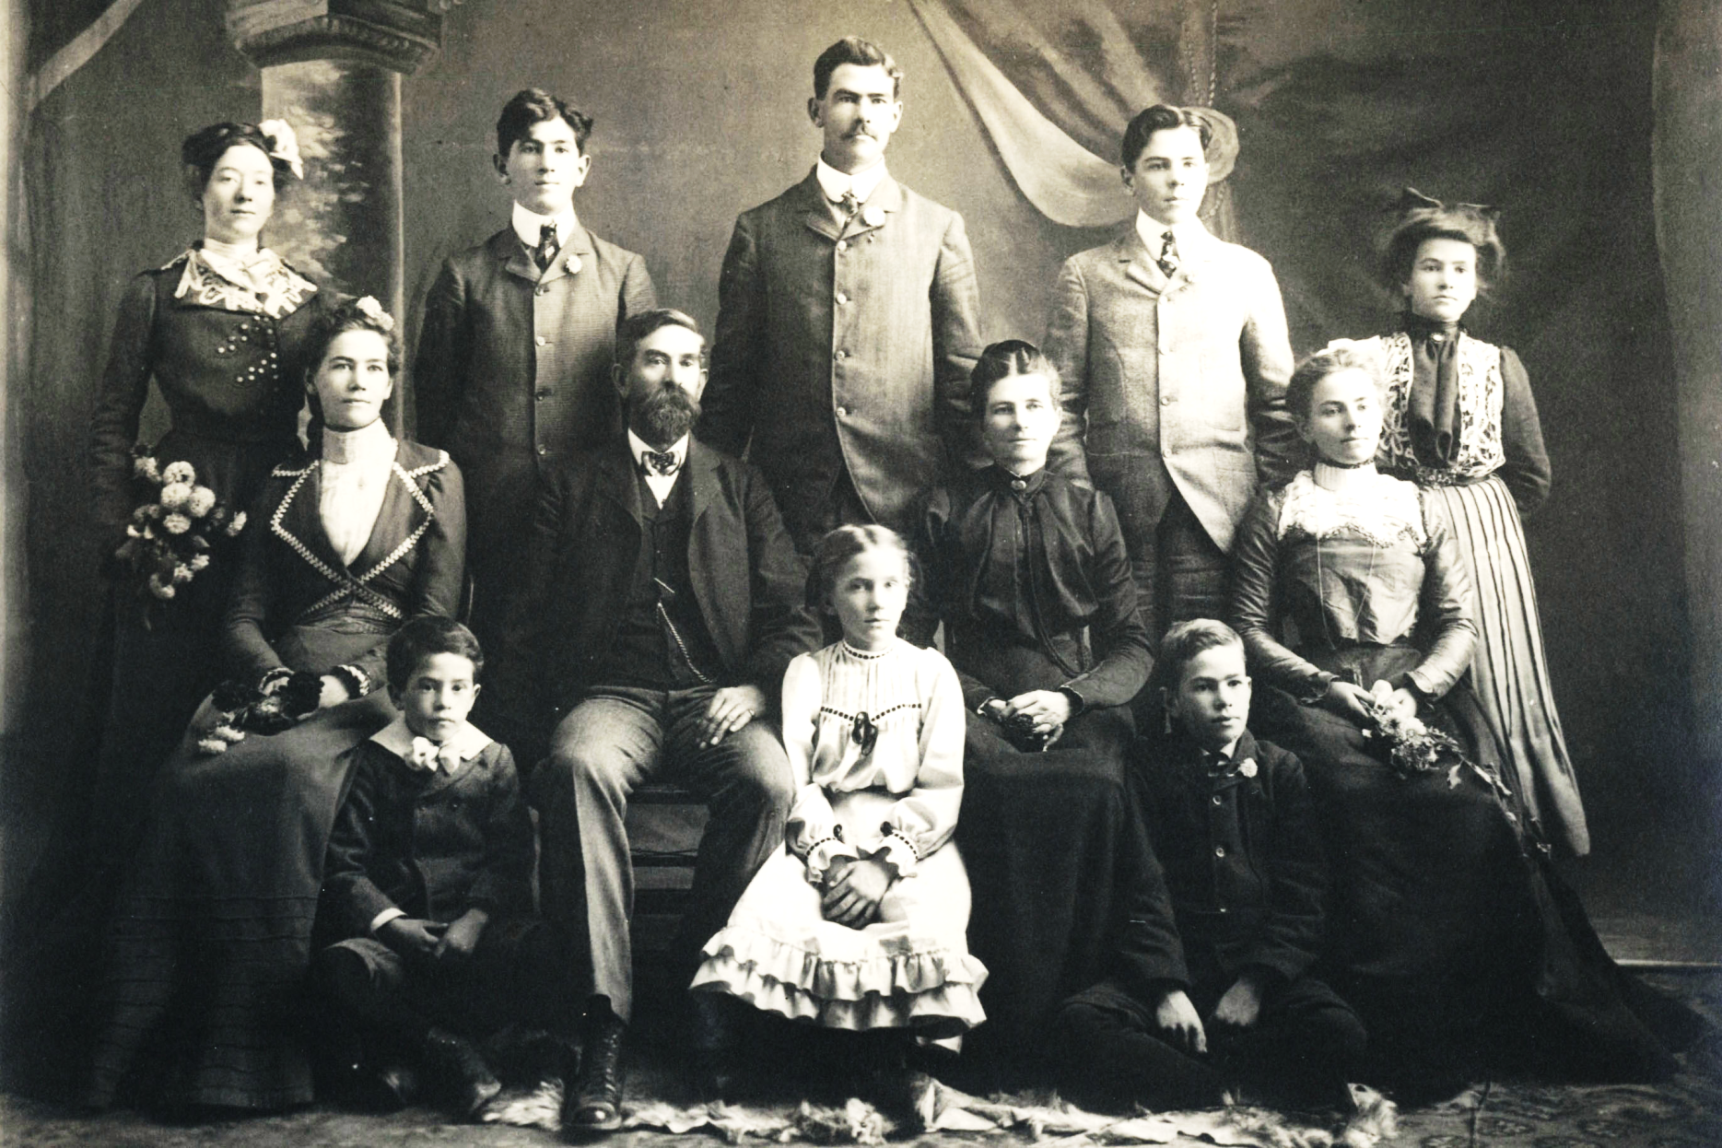
Polygamy

Slide 19
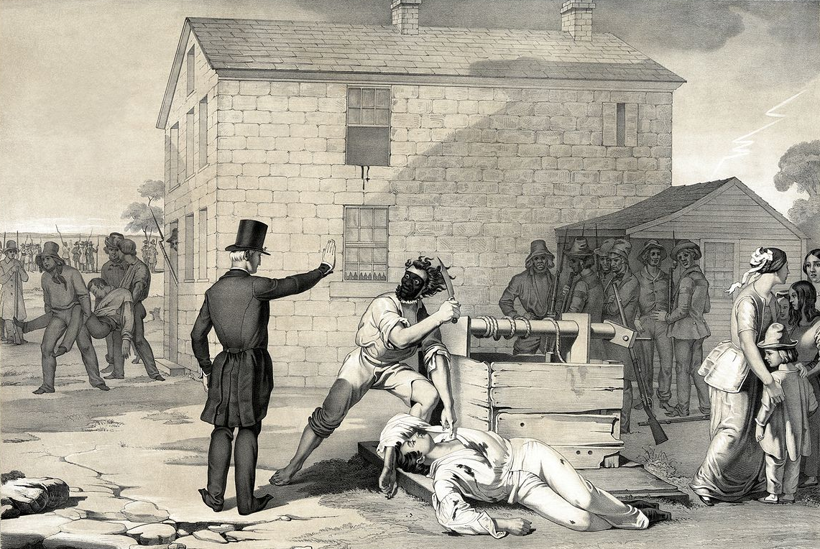
Persecution of Mormons

Slide 20
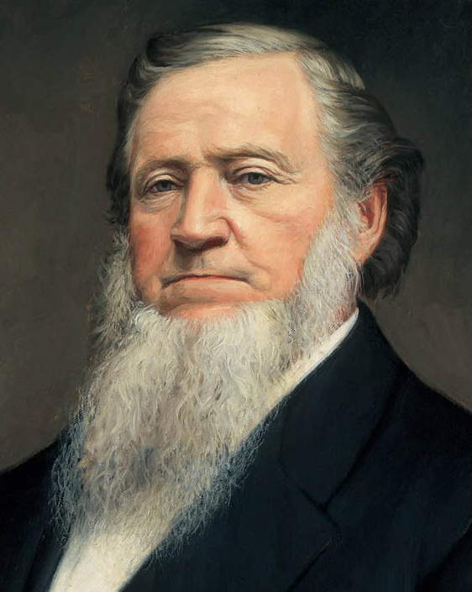
Brigham Young
Successor to Joseph Smith
Leader of Mormon exodus
First governor of Utah

Slide 21
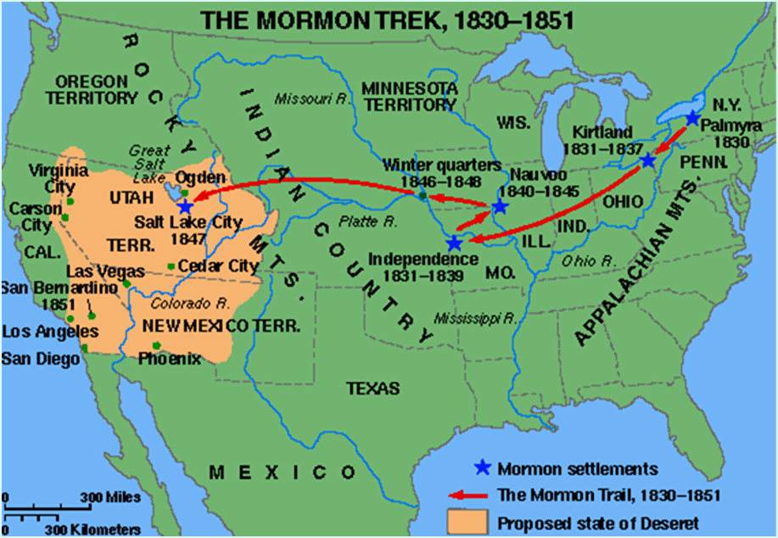
Mormon Exodus

Slide 22
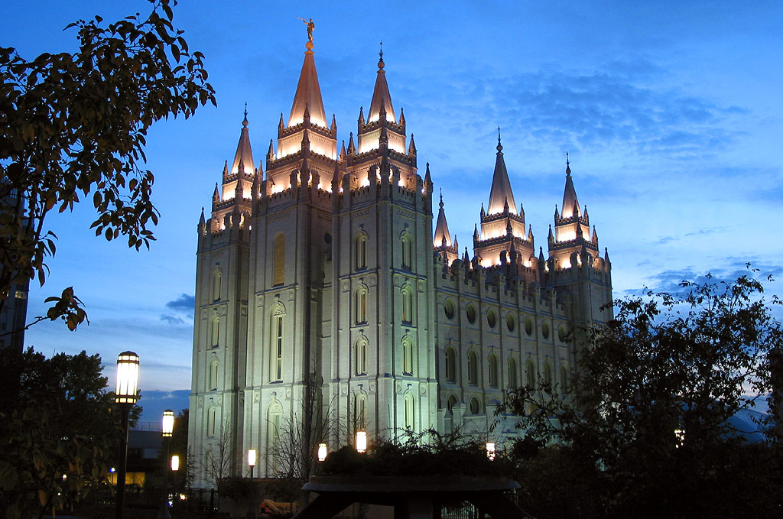
Salt Lake Temple

Slide 23
UTopianism

Slide 24
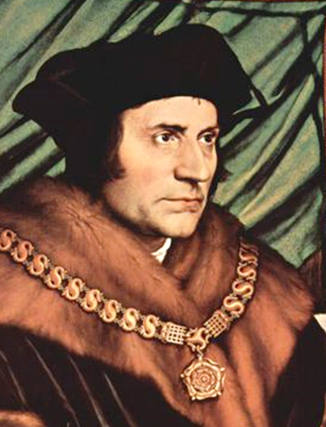
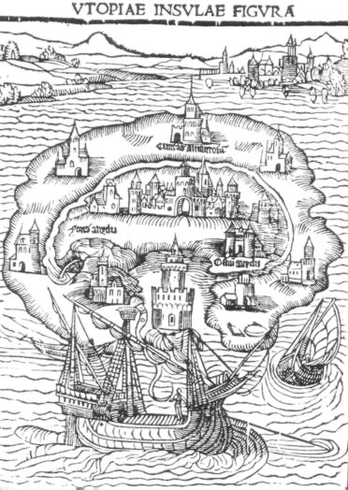
Utopia by Thomas More
Ideal society
Isolated from outside world
Shared property & values

Slide 25
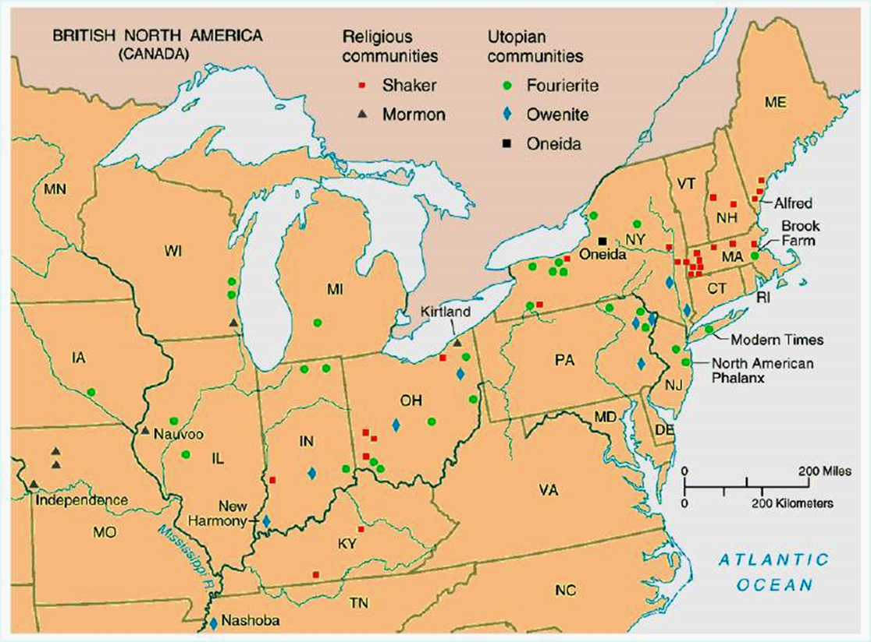
Utopian Communities

Slide 26
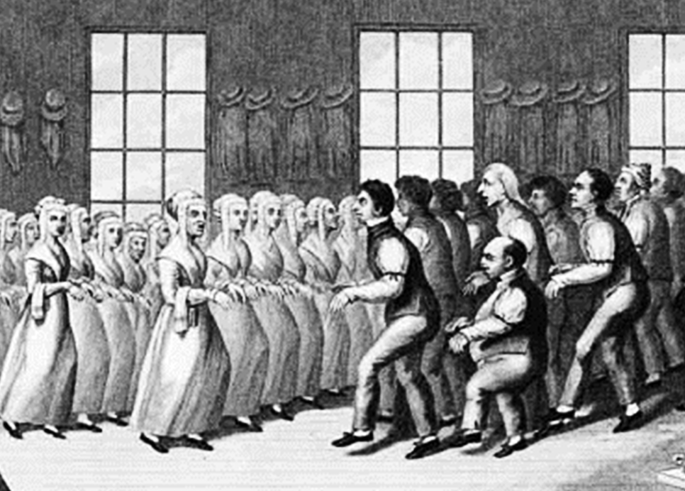
Shakers
Mother Ann Lee
Simple life
Gender separation
Celibacy

Slide 27
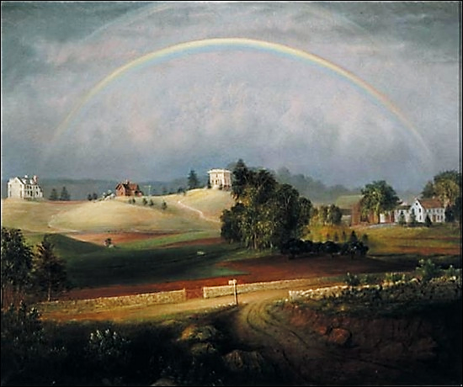
Brook Farm
George Ripley
Transcendental utopian agriculture

Slide 28
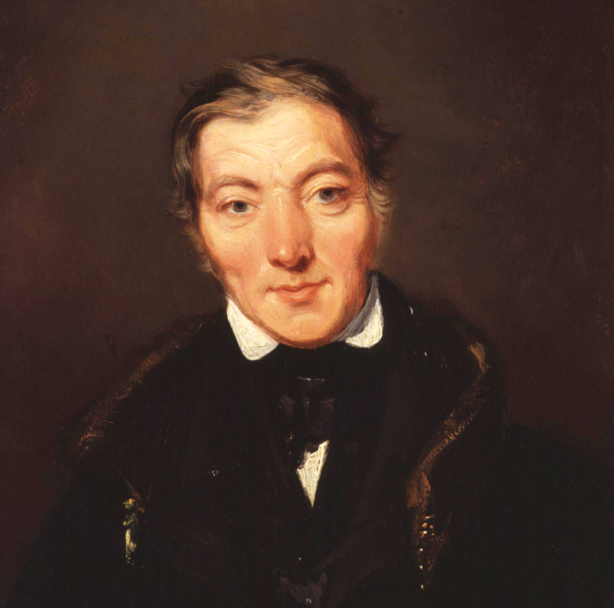
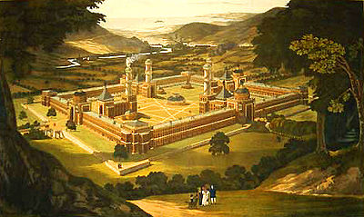
New Harmony
Robert Owen
Utopian socialism
Heterogenous community

Slide 29
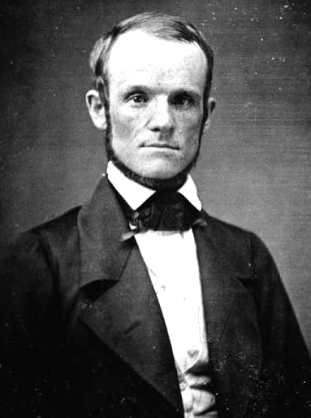
Oneida
John Humphrey Noyes
“Complex marriage” & “free love”
Artisans
  Oneida Company

Slide 30
Deseret: Mormon Utopia

Slide 31
The
Women’s Movement

Slide 32
Women
Abolition
Temperance
Education
Asylums & Prisons
Women’s rights

Slide 33
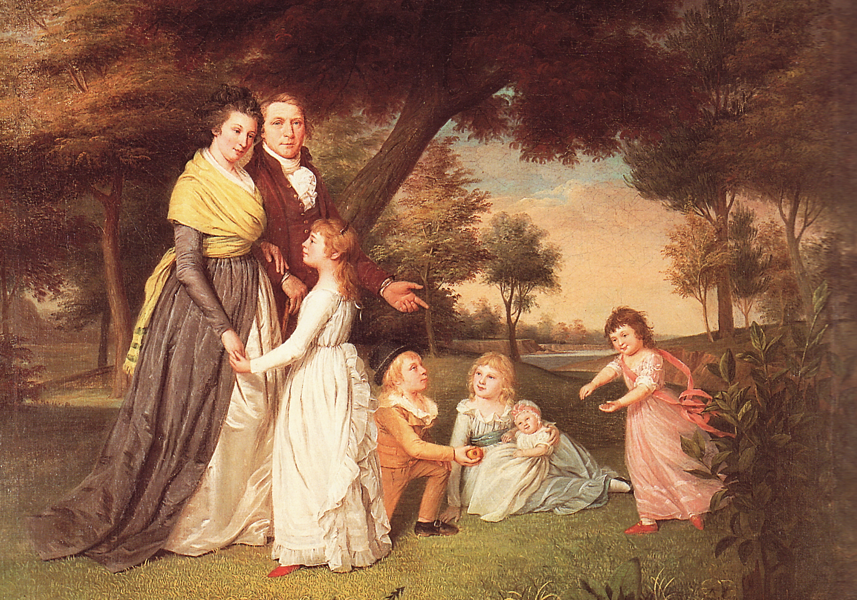
Republican Motherhood

Slide 34
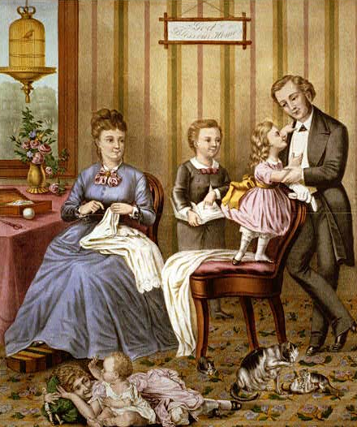
Cult of Domesticity
Home is a “haven in a heartless world”
Woman’s “sphere”
  Piety
  Purity
  Domesticity
  Submissiveness
Women play a “civilizing” role on husbands

Slide 35
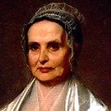
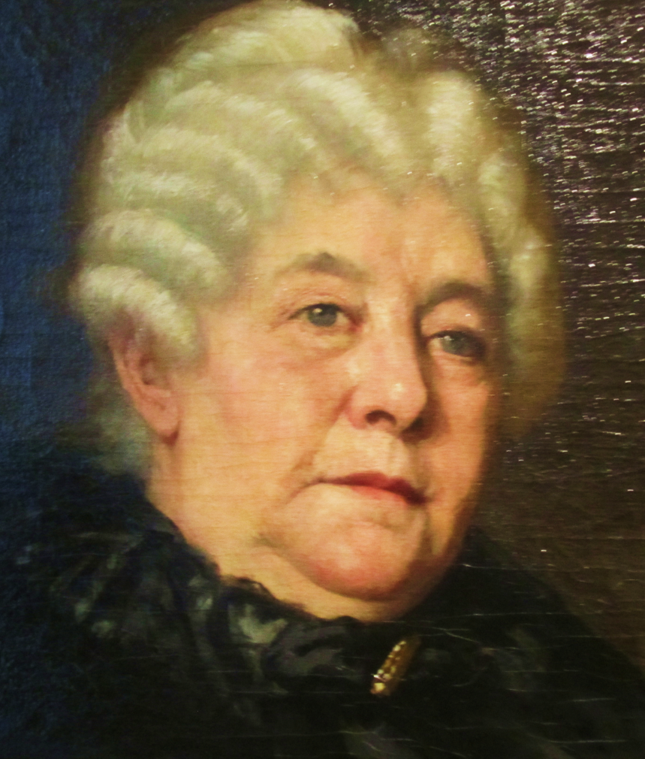
Elizabeth Cady Stanton &
Lucretia Mott

Slide 36
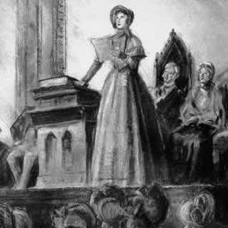
Seneca Falls Declaration of Sentiments
Mott & Stanton
Modeled on Declaration of Independence
“All men and women are created equal”
List of grievances against patriarchal society

Slide 37
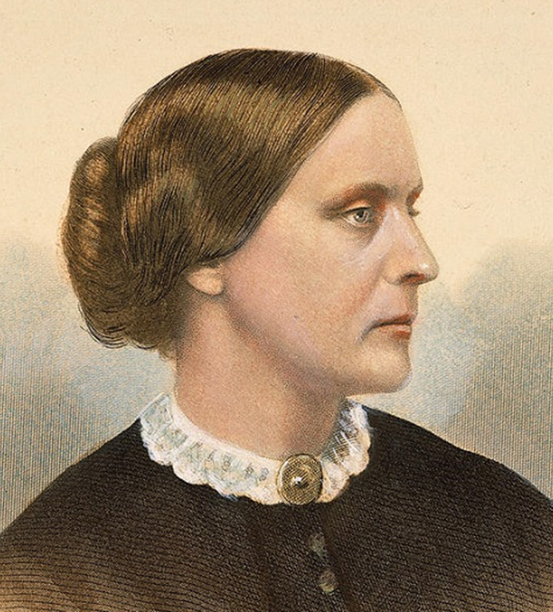
Women’s Suffrage
Susan B. Anthony
Civil disobedience
Some sponsors of the 15th Amendment (1870) feared inclusion of women’s suffrage would prevent ratification

Slide 38
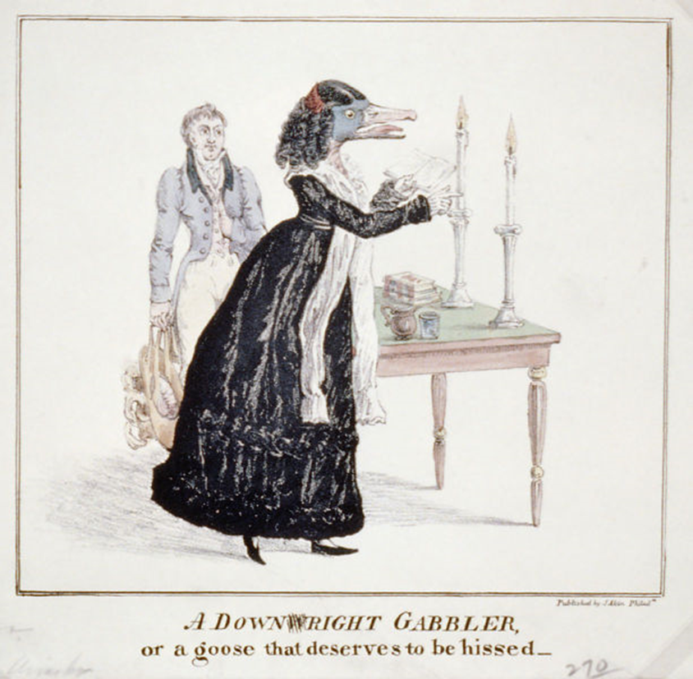
“A Goose that Deserves to be Hissed”

Slide 39
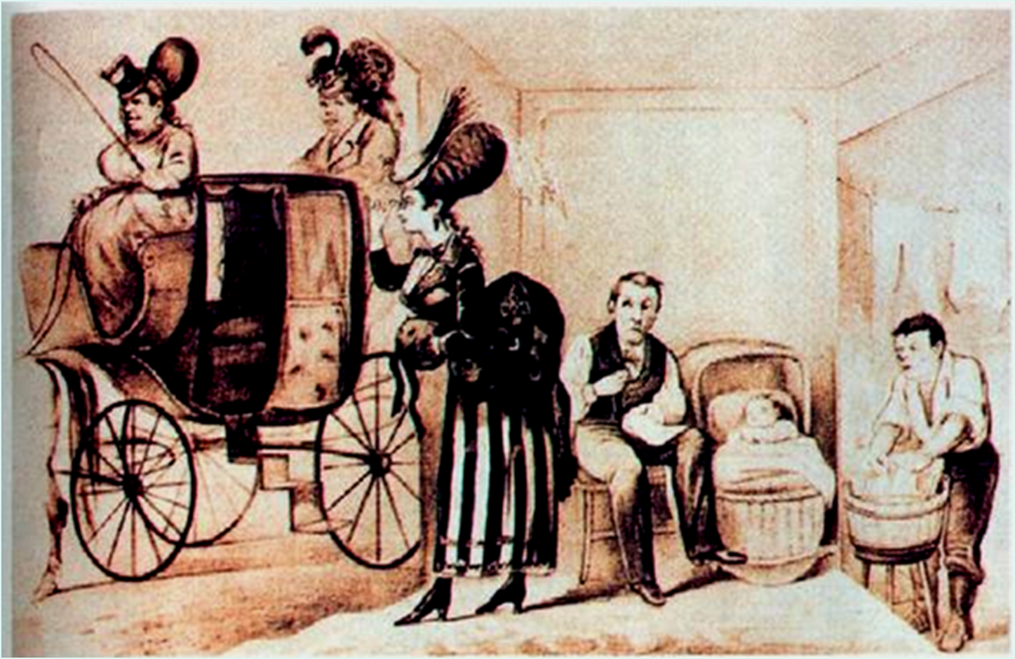
“If the Ladies Had Their Way”

Slide 40
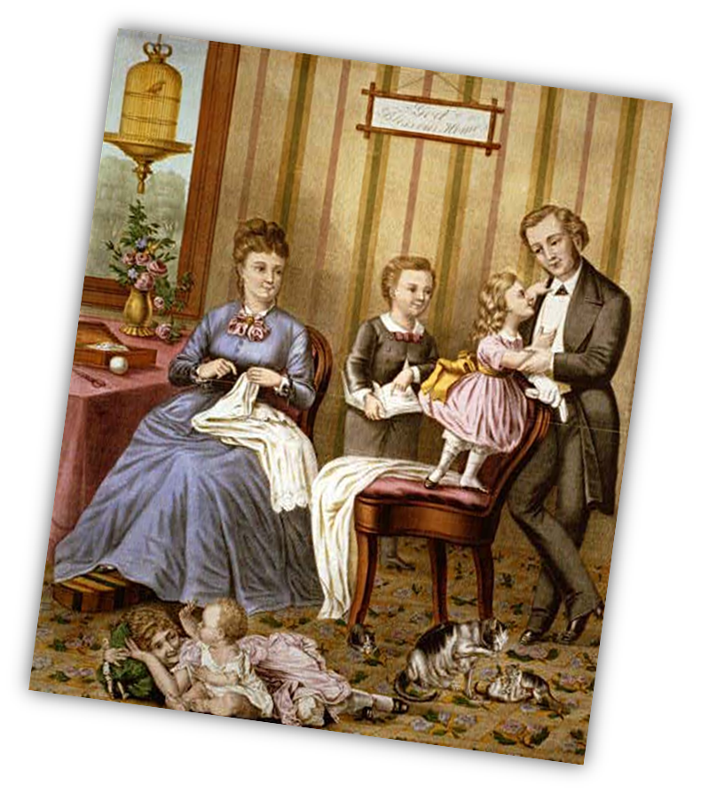
Domesticity the Same as Slavery?
Voting?
Juries & courtrooms?
Marriage & divorce?
Property & wages?

Slide 41
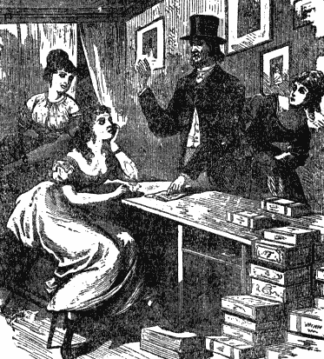
“White Slavery”
Prostitution
Campaigns targeted pimps and johns

Slide 42
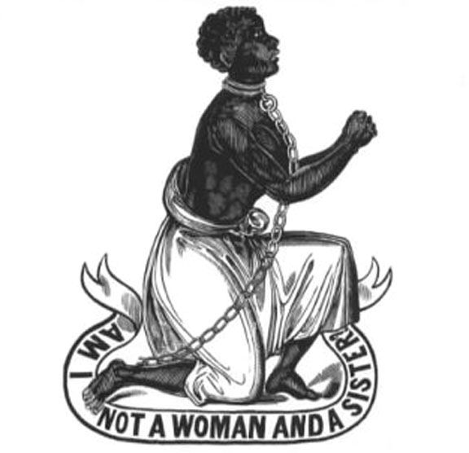
Women & Abolitionism

Slide 43
The Temperance
Movement

Slide 44
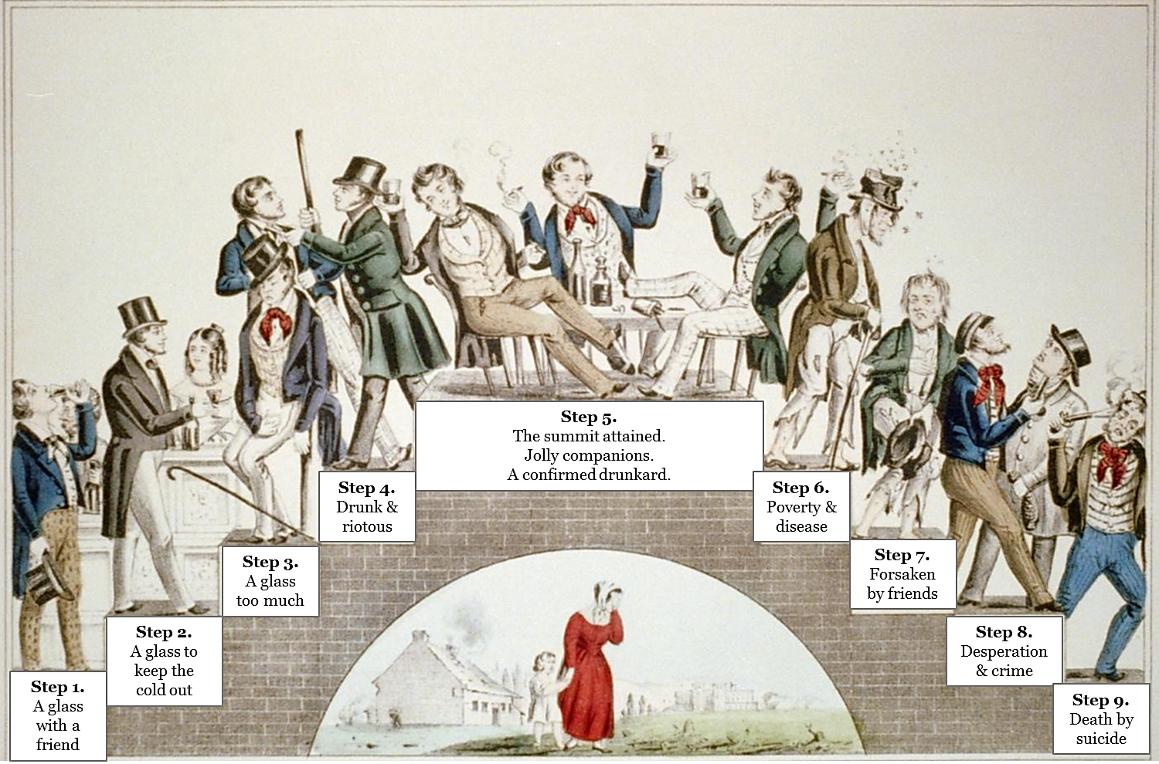
“The Drunkard’s Progress”

Slide 45
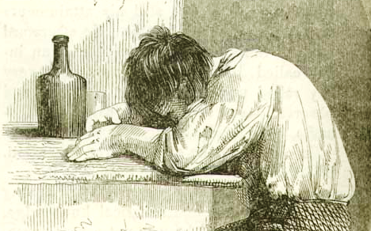
Ten Nights in a Bar-room, 1854

Slide 46
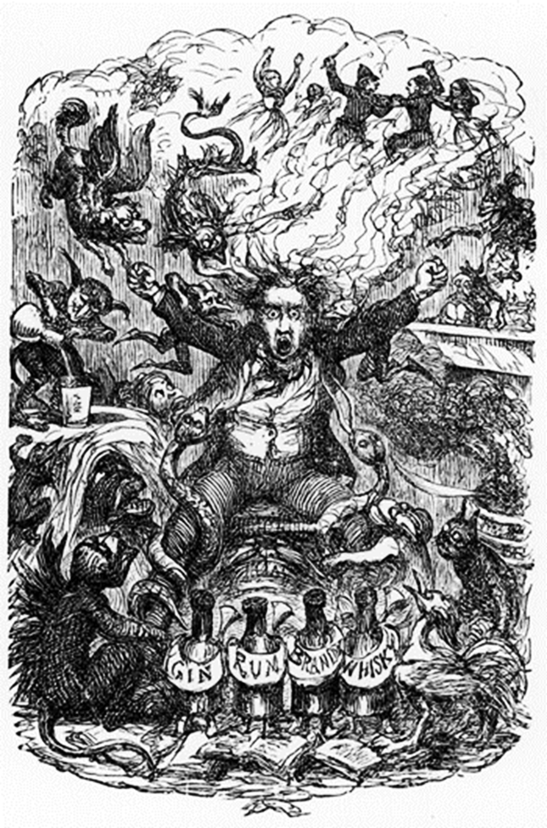
Temperance & Women
Domestic neglect & abuse
Infidelity & disease
Lost wages
Abstinence pledges

Slide 47
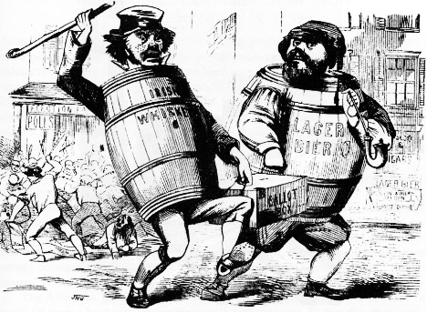
Temperance & Immigration
Nativist issue
  Irish whisky
  German beer
  Italian wine, etc.

Slide 48
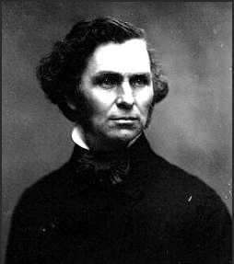
Maine Law of 1851
Neal S. Dow
“Napoleon of Temperance”
Prohibition spread to 12 states, but was soon repealed

Slide 49
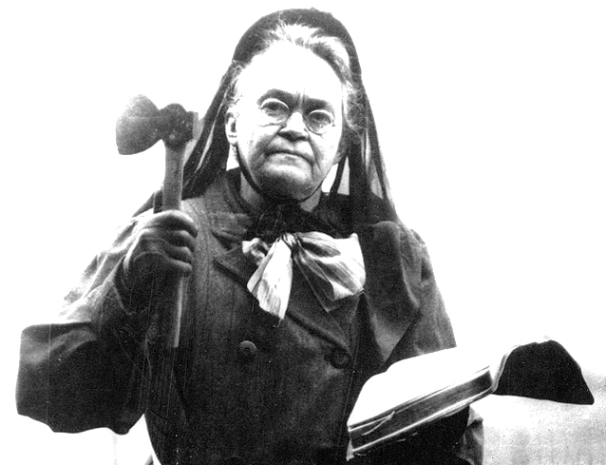
Carrie Nation

Slide 50
Educational Reform

Slide 51

Educational Reform
Enlightenment philosophy
  Tabula rasa: blank slate
Political philosophy
  Civic virtue & informed citizenry
Socio-economic factors
  Industrialization & child labor

Slide 52
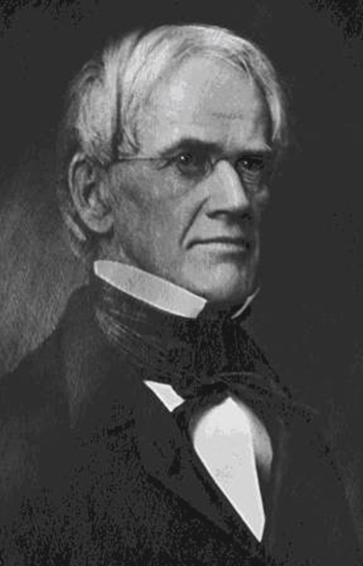
Educational Reform
Horace Mann
  Public schools
  Longer school year
  Teacher education
  Discouraged corporal punishment
Rising literacy rate

Slide 53
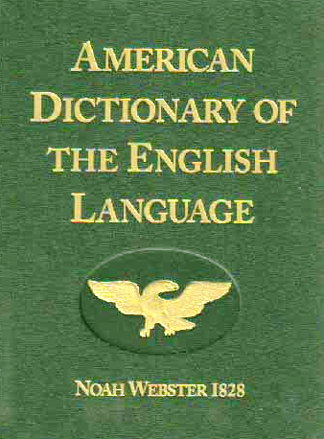


Rising Literacy Rate

Slide 54
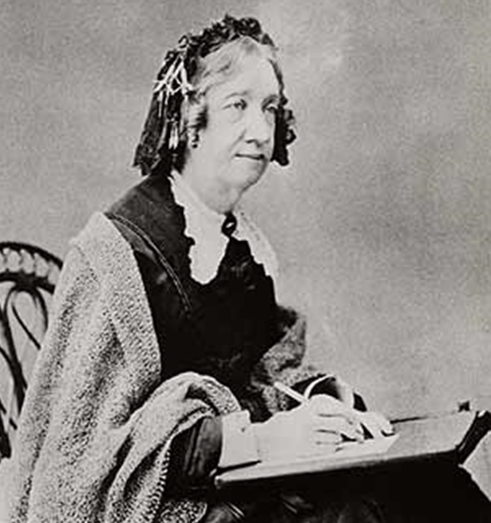
Women & Education
Catharine Beecher
  Kindergarten
  Physical education
  Music education
Emma Willard
  Women’s education
Elizabeth Blackwell
  Medicine

Slide 55
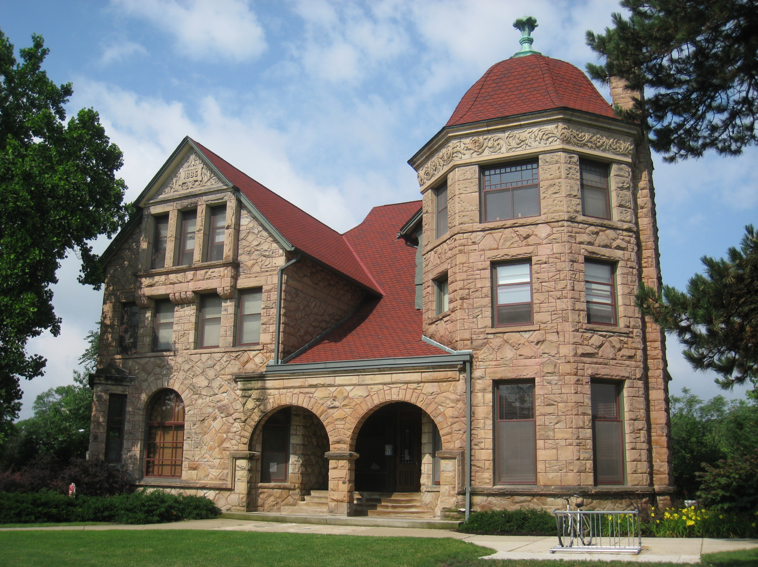
Oberlin College

Slide 56
Penal & Mental Health Reform

Slide 57
Penal & Mental Health reform
“The degree of civilization in a society can be judged by entering its prisons.”

Slide 58
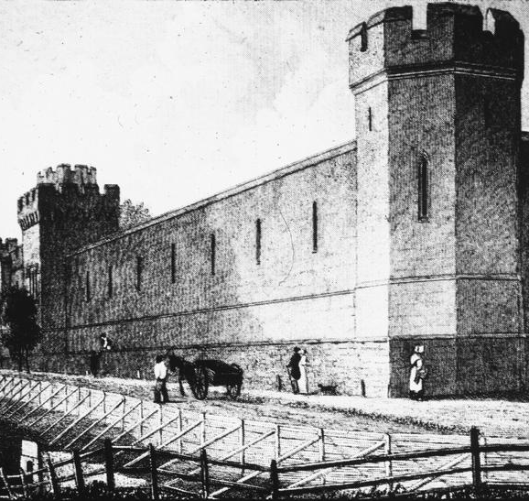
Penal reform
Harsh, punitive treatment…
  …humane treatment & rehabilitation, less use of death penalty
Prisons…
  …penitentiaries & reformatories

Slide 59
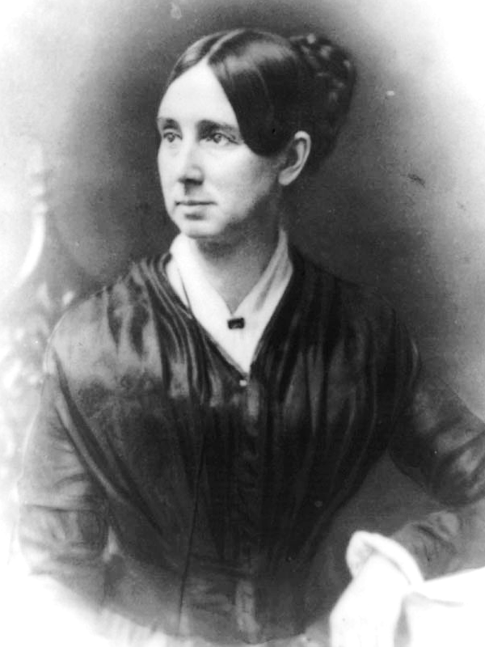
Mental Health reform
Dorothea Dix
Asylum movement
  Demon possession… mental illness
  Permanent problem… treatable condition

Slide 60
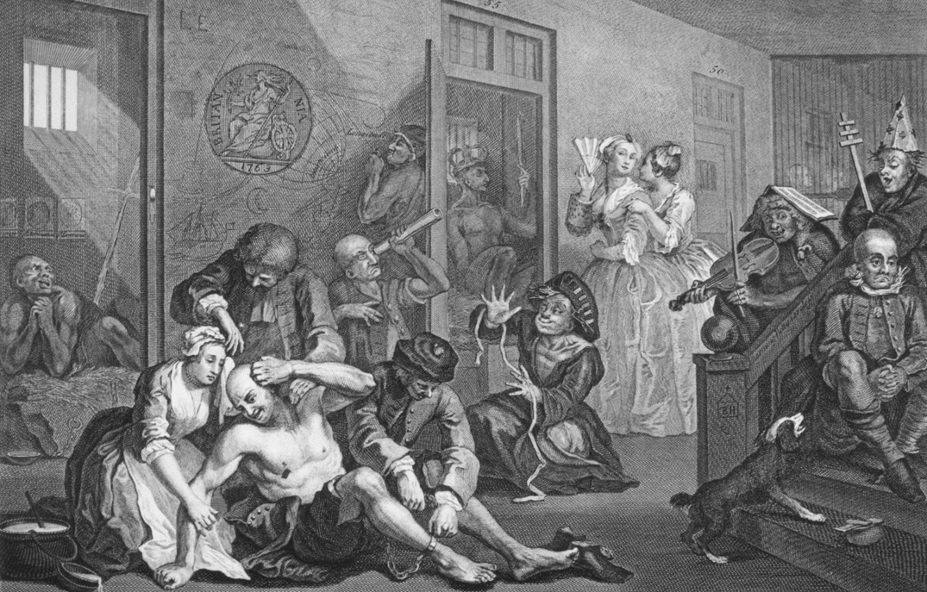
Bethlem Hospital in England

Slide 61
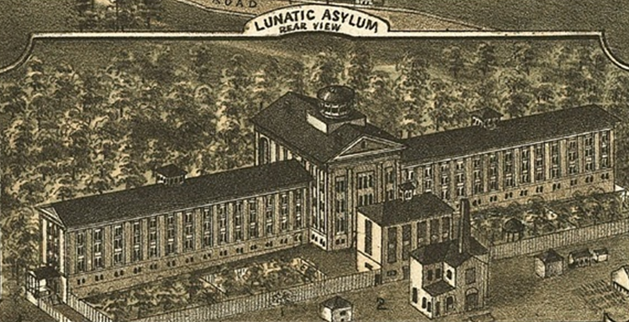
Dorothea Dix Asylum

Slide 62
The Abolition Movement

Slide 63

Quakers
“Inner light”
Equality of all human beings

Slide 64


Grimke Sisters
Daughters of wealthy slaveholder
Manumission

Slide 65


American Colonization Society, 1816

Slide 66

Christian Abolitionism
2nd Great Awakening
“Slaveholding is sinful”

Slide 67

Christian Abolitionism

Slide 68

Radical Abolitionism

Slide 69

David Walker’s Appeal, 1829
Critique of American hypocrisy
  Ideals of the Declaration of Independence
Call to arms

Slide 70

Nat Turner’s Rebellion, 1831

Slide 71

Nat Turner’s Rebellion, 1831

Slide 72
Slavery Gets Worse?
NC
N.C. v. Mann, 1830
  “The power of the master must be absolute, to render the submission of the slave perfect”
Virginia Slave Code, 1831
  “All meetings of free Negroes… for teaching them reading or writing… shall be considered an unlawful assembly…”
  “If any white person for pay shall assemble with any slaves for the purpose of teaching them to read or write, he shall for each offense be fined…”
VA

Slide 73

William Lloyd Garrison
The Liberator, 1831
  “I do not wish to think or speak or write with moderation.”
“Personal liberty” laws
  Counteracted fugitive slave acts

Slide 74

Gag Rule, 1836

Slide 75

Elijah P. Lovejoy
Abolitionist publisher
Killed by pro-slavery mob, 1837

Slide 76



Abolitionist Newspapers
Garrison
Lovejoy
Douglass

Slide 77

Slavery Apologism

Slide 78

Southern Baptist Convention
Broke away from anti-slavery National Baptists, 1845

Slide 79

George Fitzhugh
Sociology for the South, 1854
Paternalism
  [The Negro] is but a grown up child, and must be governed as a child… The master occupies towards him the place of parent or guardian.”

Slide 80

Harriet Beecher Stowe
Uncle Tom’s Cabin, 1852
  Story of fugitive slave
  Best-selling novel of the 1850s
  Inflamed northern abolition sentiment

Slide 81

Hinton R. Helper
The Impending Crisis of the South, 1857
  Southern aristocracy exploits poor whites as well as black slaves
  Slavery discourages southern economic development

Slide 82

John Brown at Pottawatomie, 1856
Massacre of five pro-slavery men
“Bleeding Kansas”

Slide 83

John Brown at Harpers Ferry, 1859
Failed attempt to incite slave revolt
Southern militias
  South fears northern abolitionist aggression

Slide 84

John Brown’s Execution

Slide 85

Frederick Douglass
“I appear before you this evening as a thief and a robber. I stole this head, these limbs, this body from my master and ran off with them.”

Slide 86

Frederick Douglass
Runaway slave
Narrative of the Life of Frederick Douglass
The North Star
Organized black regiments during Civil War

Slide 87


Underground Railroad

Slide 88

Underground Railroad

Slide 89

Harriet Tubman
“Moses”
Aided 300+ fugitive slaves

Slide 90

Sojourner Truth
“Ain’t I a Woman?” speech

Slide 91
Conclusion

Slide 92
Essential Questions
How did 19th century religious and reform movements redefine American concepts of freedom, equality and morality?
How successful were these movements?
What role did women play?

