Slide 1
DBQ’S

Slide 2
Background
60 minutes
Worth Seven Points
25% of test
Your chance to show you can think like an historian

Slide 3
Strategies
To ensure outside information- read question first, then make a list of things you know about that time period
  Take your stance NOW, modify after seeing documents if you need to
Documents must drive essay
  Analyze each one
  Figure out where it fits your thesis
  Know where they’re going before you start writing!!!
Remember, AP recommends 15 minutes of planning and 45 minutes of writing- take advantage of this!!!
  Try not to go over time! LEQ is not separate section

Slide 4
Contextualization (1 point)
“God Bless America”
-Irving Berlin (1918)

Slide 5
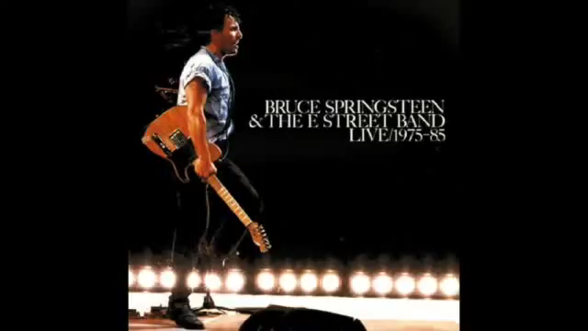
Contextualization (1 point)

Slide 6
Contextualization (1 point)
Give background to the event
Lead in to your thesis (3-4 sentences)
Answer the question: What’s the big picture that sets the scene for your essay?
Think Star Wars scroll.

Slide 7
Thesis (1 point)
Located in intro paragraph
Establish line of reasoning
Address all parts of prompt
Don’t just restate prompt
Restate in conclusion

Slide 8
Evidence (3 points)
1 point: Analysis of outside examples to support thesis/argument
  DOCUMENTS- 8
  Plausible analysis of historical examples outside of documents
  Must help support stated thesis
  ACE it!!!
  Do it twice!!!

Slide 9
Evidence (3 points)
One point: Use 3 documents to address topic of prompt
  NO QUOTING!!! EVER!!!
  Simply describe the content
Two points: Use 6 documents to support an argument in response to prompt
  Always tie back to topic sentence in paragraph.
    Topic sentence ties back to thesis
  Can’t just summarize documents

Slide 10
Document Analysis (2 Points)
1 point (HIPP Point)
  Historical Context
  Intended Audience
  Point of View (Author’s)
  Purpose (Author’s)
  For at least 3 Documents (you will do it for 5!)

Slide 11
Document Analysis (2 points)
1 point- Complex Understanding (try for two of these!)
  Explain nuance of issue by discussing multiple angles
    Look at “gray areas” of history
    Show you think outside the box
  Make counterclaims
    Point out irregularities (Jefferson as strict and loose constructionist)
  Make connections within and across time periods
    Connect back to thesis
    Spend 3-4 sentences here
  Bring in multiple course themes
    If political essay spend time on economics
  Address multiple points of view throughout the essay

