Slide 1
Industrialization

Slide 2
Key Factors to Industrialization
Natural Resources: coal, oil, iron ore
Innovation in Technologies: (inventions & innovation)
Improved Transportation: railroad (RR), mechanized farming equipment
Growing Labor Force: Immigration
  “Social Darwinism” philosophy
Laissez-Faire Government Policies: no income tax, no environmental controls

Slide 3
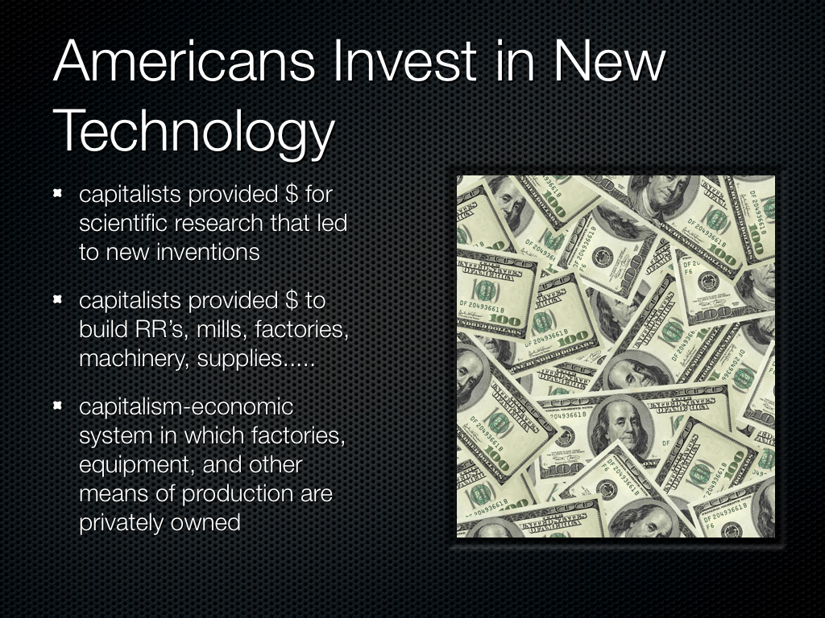

Slide 4
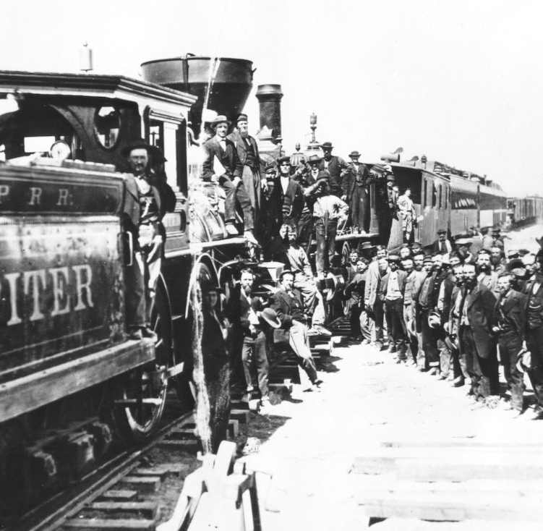
Consolidated Rail lines
Inexpensive and faster shipping
RR companies laid track side by side so traffic could move in both directions
Caused time zones to be created
Telegraph lines helped increase communication speed

Slide 5
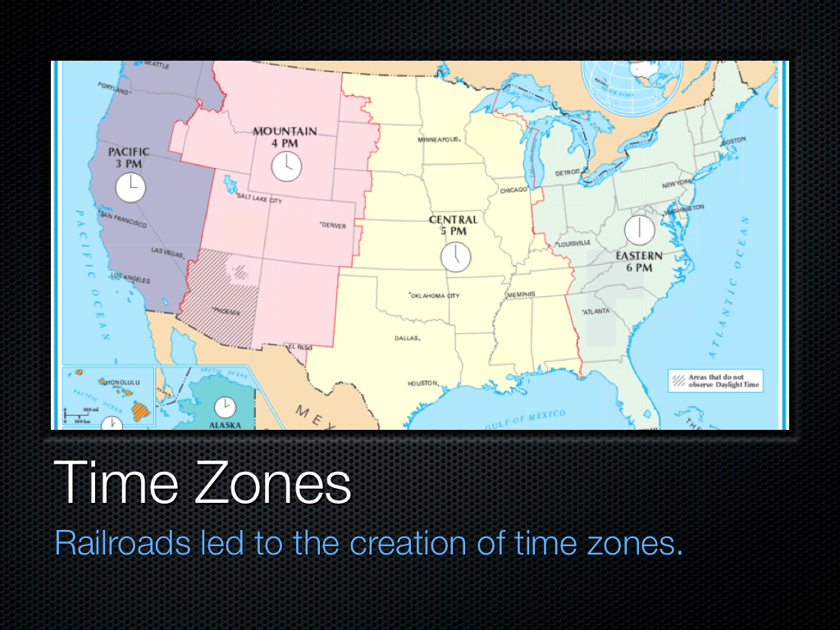

Slide 6
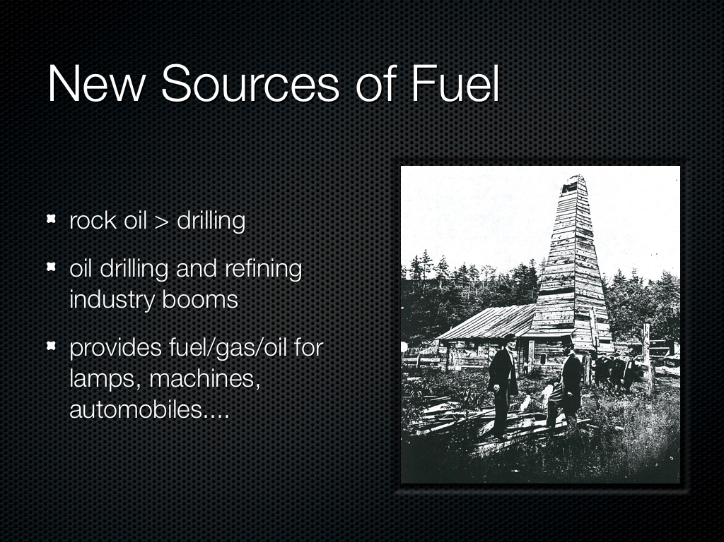

Slide 7
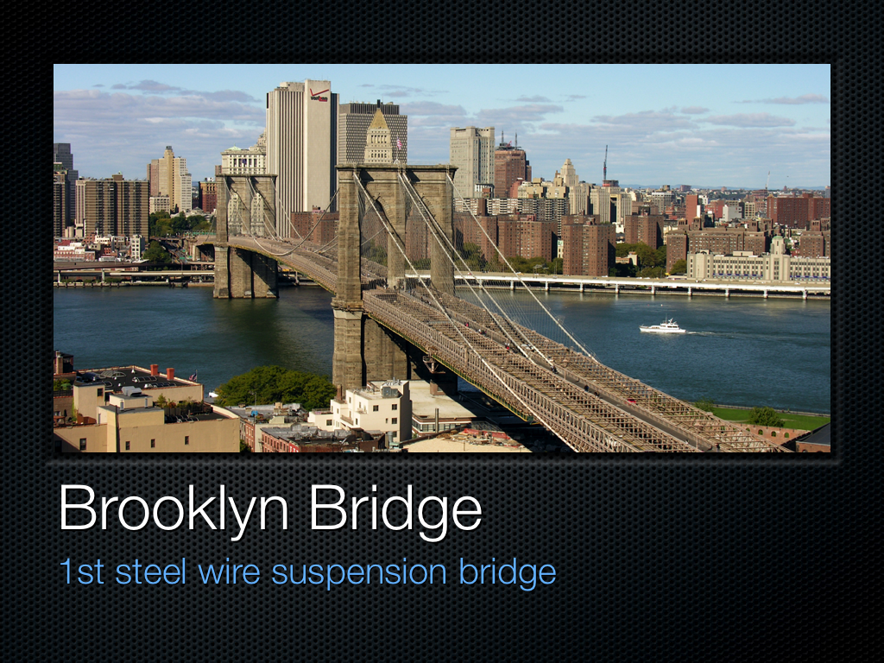

Slide 8
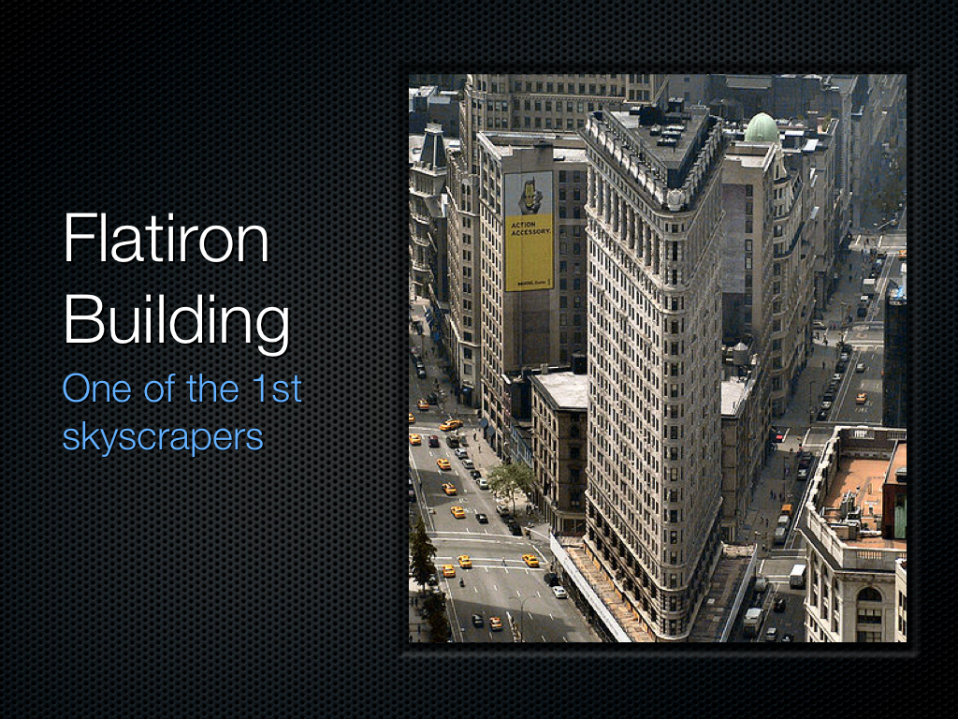

Slide 9
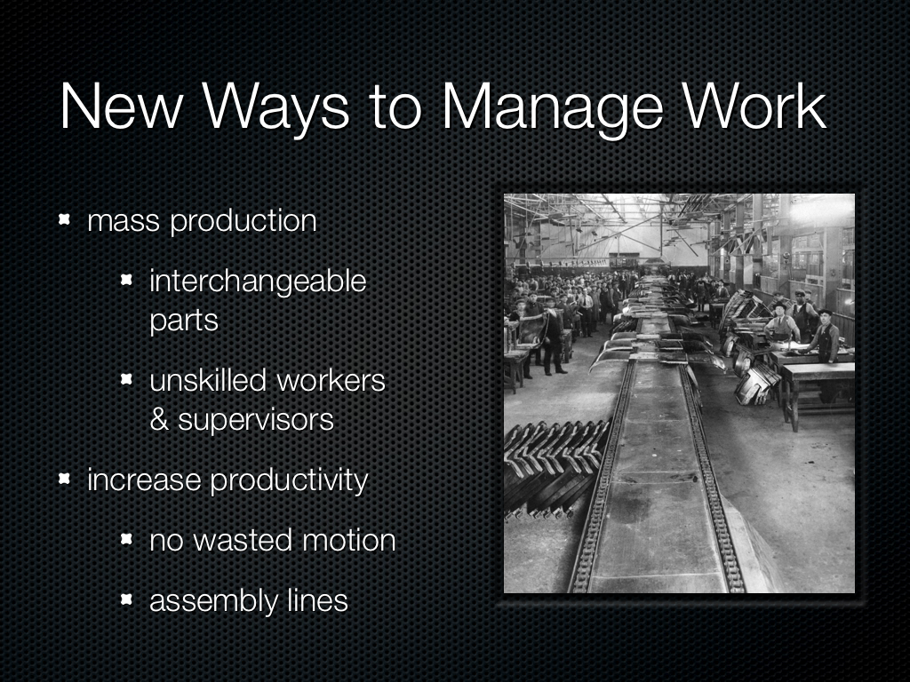

Slide 10
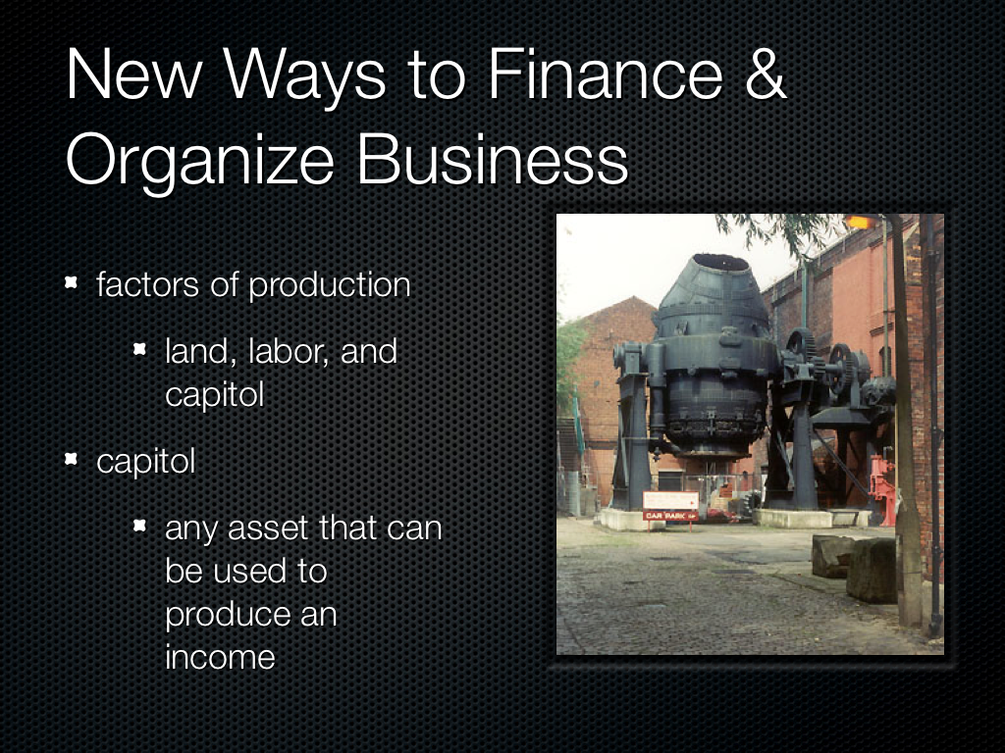

Slide 11
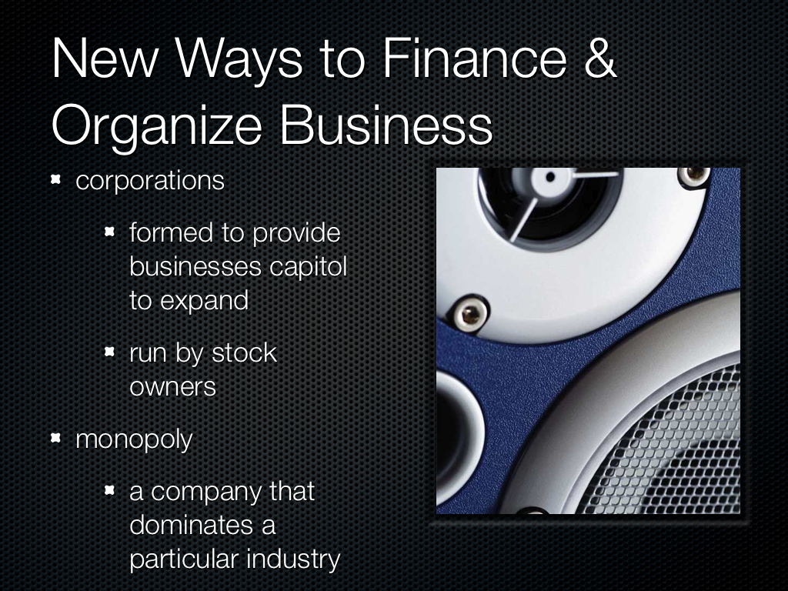

Slide 12
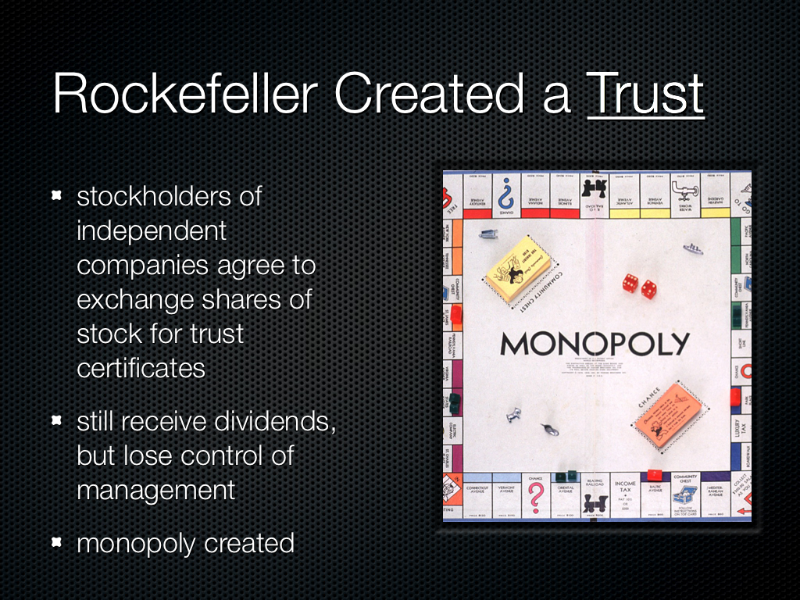

Slide 13
“Big Business” (image pg. 171)
horizontal integration
    joining firms together from the same field
    Rockefeller & oil=bought other companies
vertical integration
    taking control of every step in production and distribution
    Carnegie & steel=raw materials > manufacturing > storage > distribution

Slide 14
Laissez-faire
“allow to do”
the market’s supply and demand will regulate itself without gov. interference
HOWEVER, big business was limiting competition, which hurt consumers

Slide 15
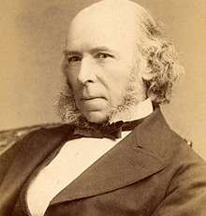
Social Darwinism
Based upon Charles Darwin’s Theory of Evolution-Created by philosopher Herbert Spencer
The best run business with the best leaders would prosper
Survival of the Fittest

Slide 16
What did laissez-faire and Social Darwinism have in common?
They both discouraged the government from regulating business practices.

Slide 17
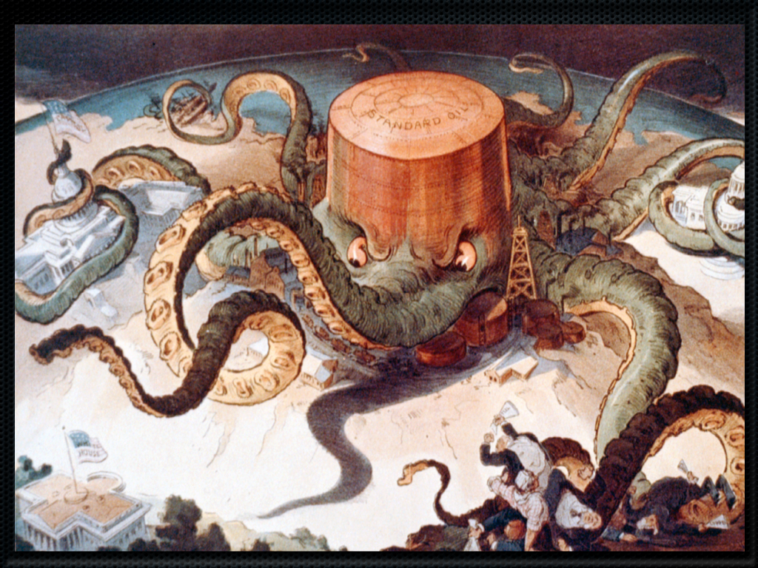

Slide 18
Sherman and Clayton Antitrust Acts
Sherman Anti-Trust Act 1890
outlawed trusts, monopolies, and forms of business that restricted trade
vague language left the law hard to enforce
courts interpreted in favor of big business
Clayton Antitrust Act 1914
Closed loopholes in Sherman Anti-Trust Act
Prohibited certain actions that led to anti-competitiveness

Slide 19

The Gilded Age-1870’s-1900
-
Coined by Mark Twain
Meant the period was glittering on the surface but corrupt underneath

Slide 20
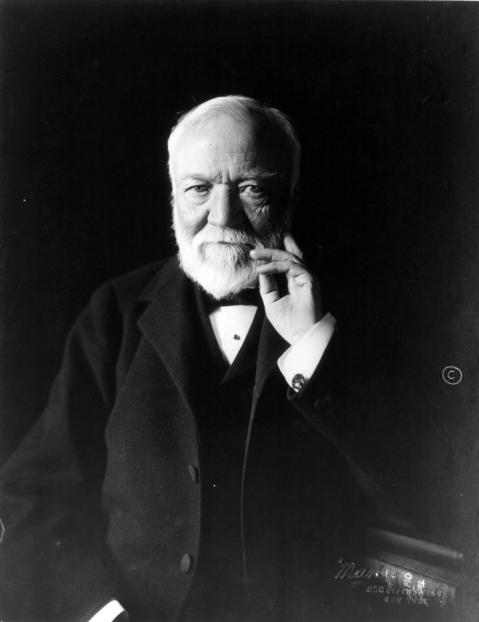
Andrew Carnegie- Steel
1870-1900 steel production increased from 77,000 tons to 11 million tons
Dominated the steel industry with Vertical Integration
1890, Carnegie made 25 million when the average worker made $440 per year

Slide 21
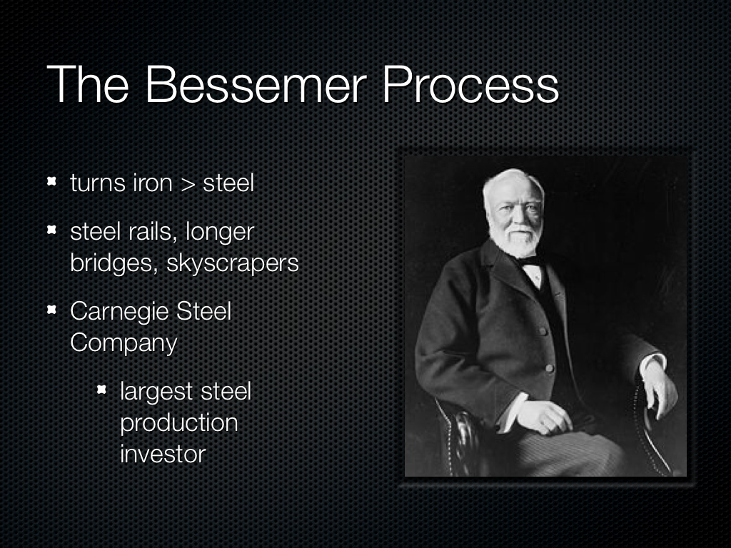

Slide 22
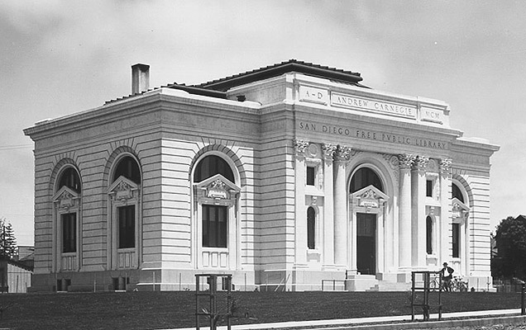
Carnegie’s Philanthropy
“A man who dies rich dies disgraced.”
Carnegie Corporation of NY
    offered grants to support education
    built more than 2,500 public libraries
    San Diego library 1899, $60,000

Slide 23
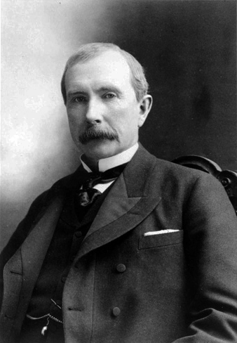
John Rockefeller-Standard Oil
Used ruthless business tactics
Bought out and merged oil companies to form a trust and later a monopoly using horizontal Integration
Became America’s 1st billionaire and owned 90% of oil production

Slide 24
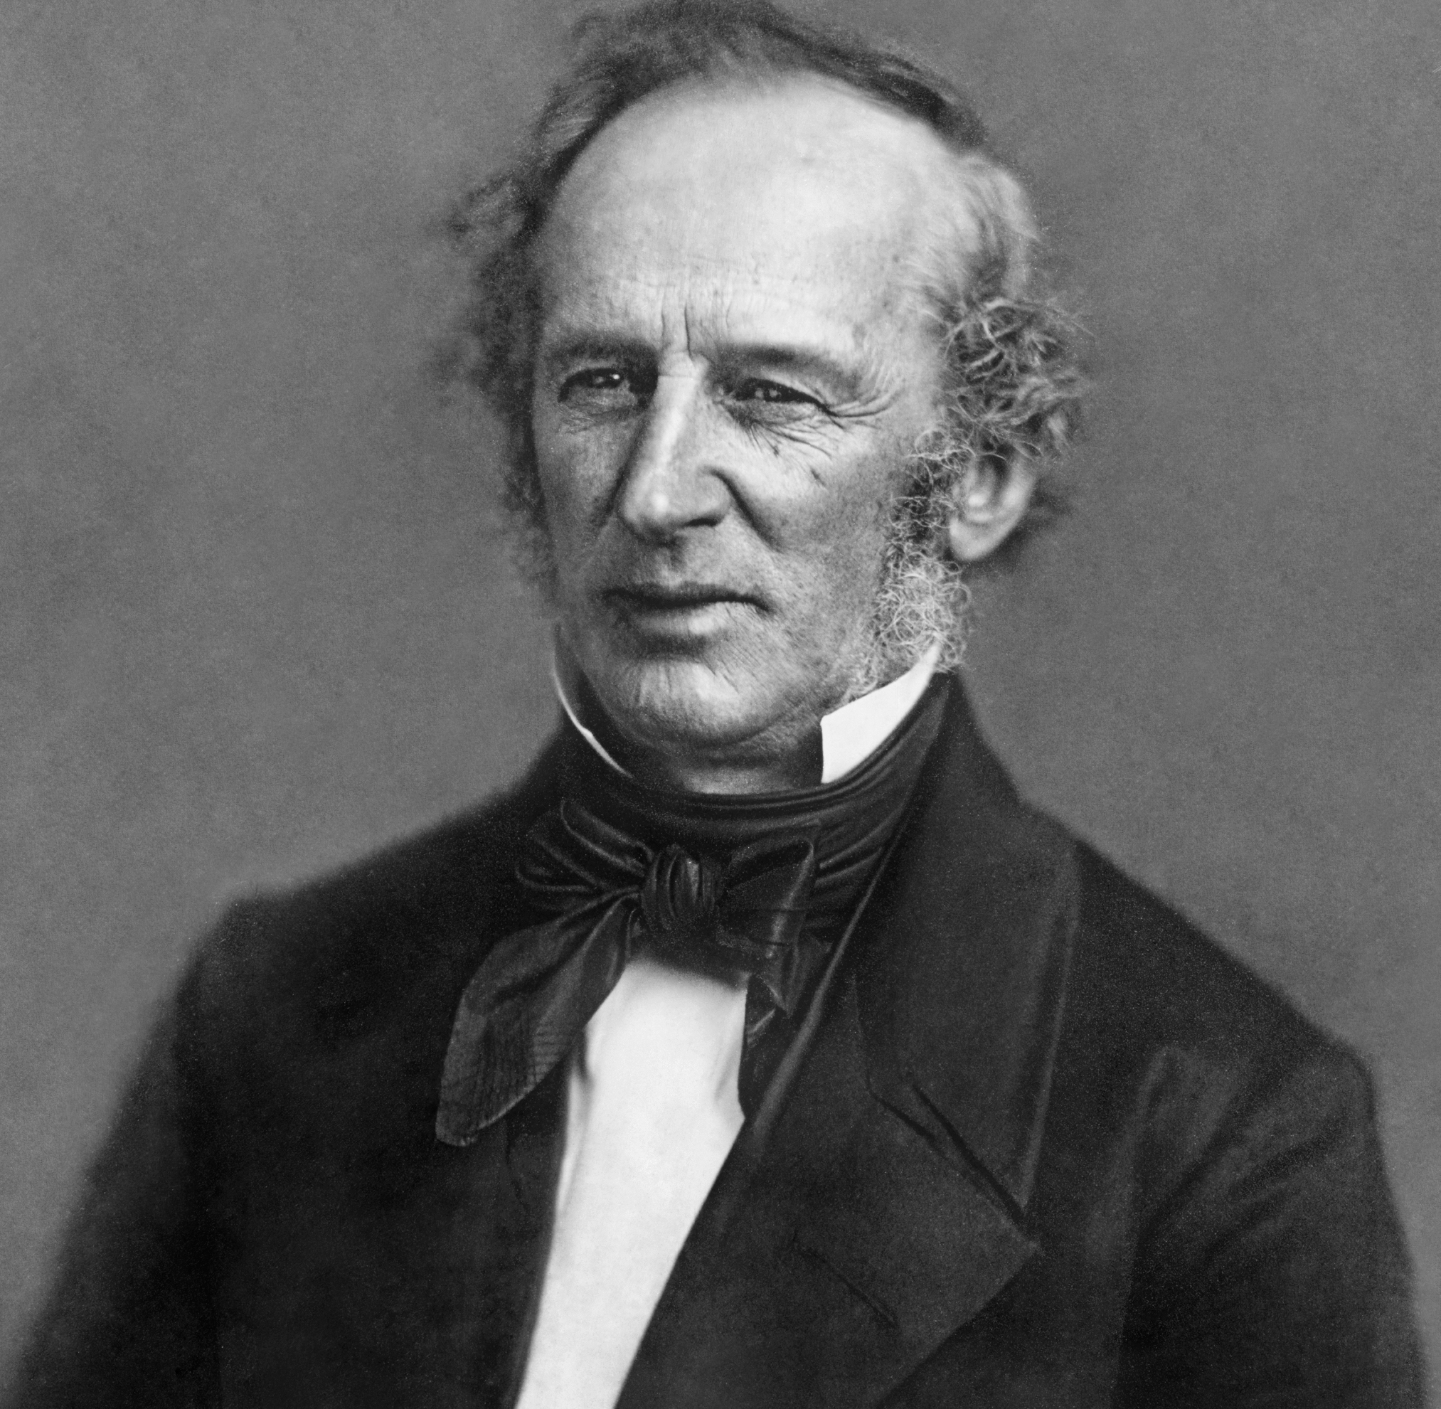
Cornelius Vanderbilt-Railroads
Nicknamed “The Commodore”, at 16 he started his first business running steamships
Invested in railroad stock
Owned the first direct line from Chicago to New York
Gave little in terms of philanthropy, except $1 million to start Vanderbilt University

Slide 25
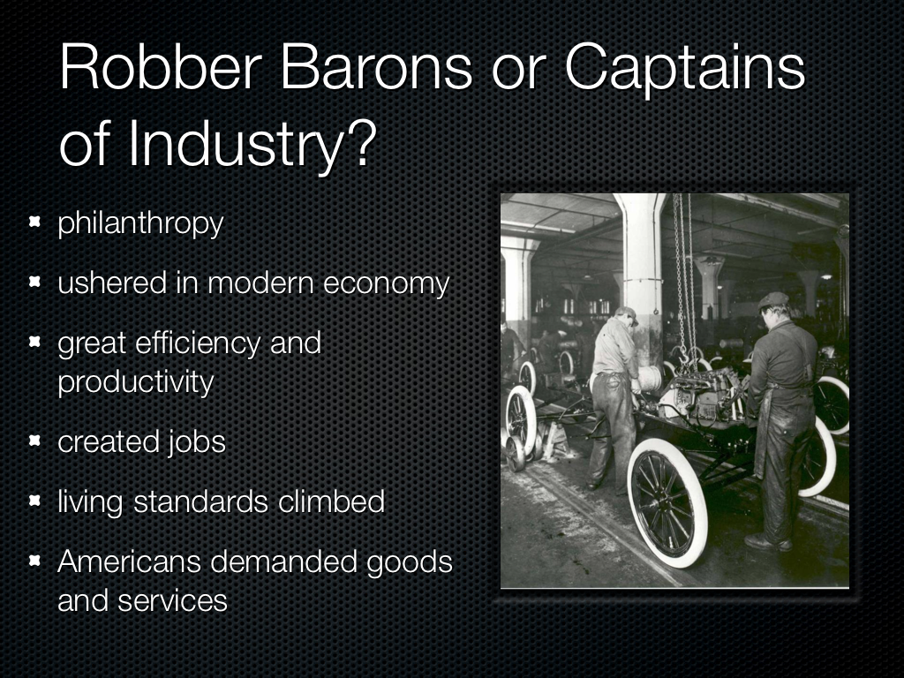

Slide 26
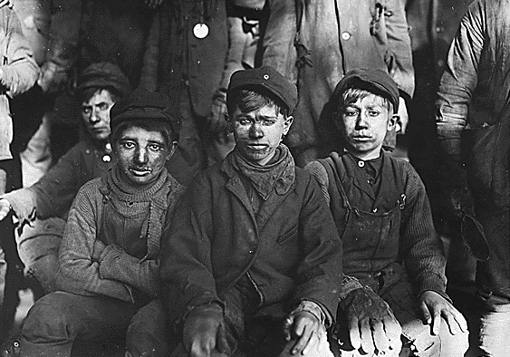
Labor Problems
Terrible working conditions
Long hours, low pay, 6-7 days a week
Unequal pay: 1899 women $269 a year, men $498
Carnegie $23 million no taxes
Many injuries/death
Child labor (2 million in 1910)

Slide 27

Triangle Shirtwaist Factory Fire

Slide 28

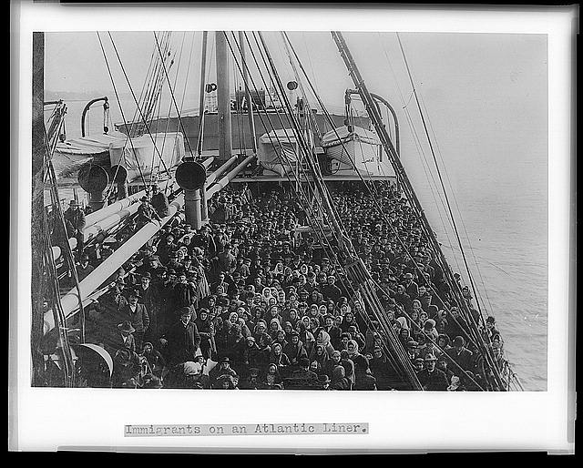
Immigration:
What was it like to be an immigrant in the United States as the nation was expanding across North America?

Slide 29
Push/Pull Factors:
Why they came to the United States
Push
population growth
hunger & poverty (Irish potato famine)
arable land scarcity
religious persecution
Pull
free and democratic society
natural resources
  mines, farming, lumber
Jobs
America letters
  “streets are paved with gold”

Slide 30
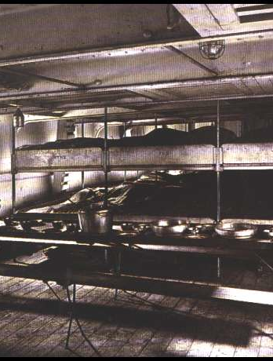
The Journey to America:
How they got here
2 week passage by steamship
steerage compartment
  area below deck
  one large room with bunks
  filthy conditions

Slide 31
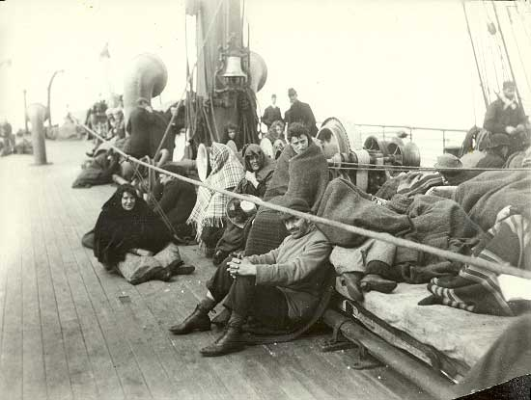
The Journey to America:
How they got here cont.
By 1870’s almost all traveled by steamship
Rarely allowed above deck
No room or fresh air
Louse infected bunks
Diseases spread quickly

Slide 32

The Journey to America:
How they got here cont.

Slide 33
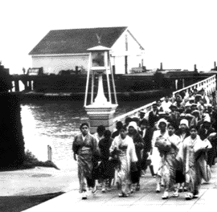
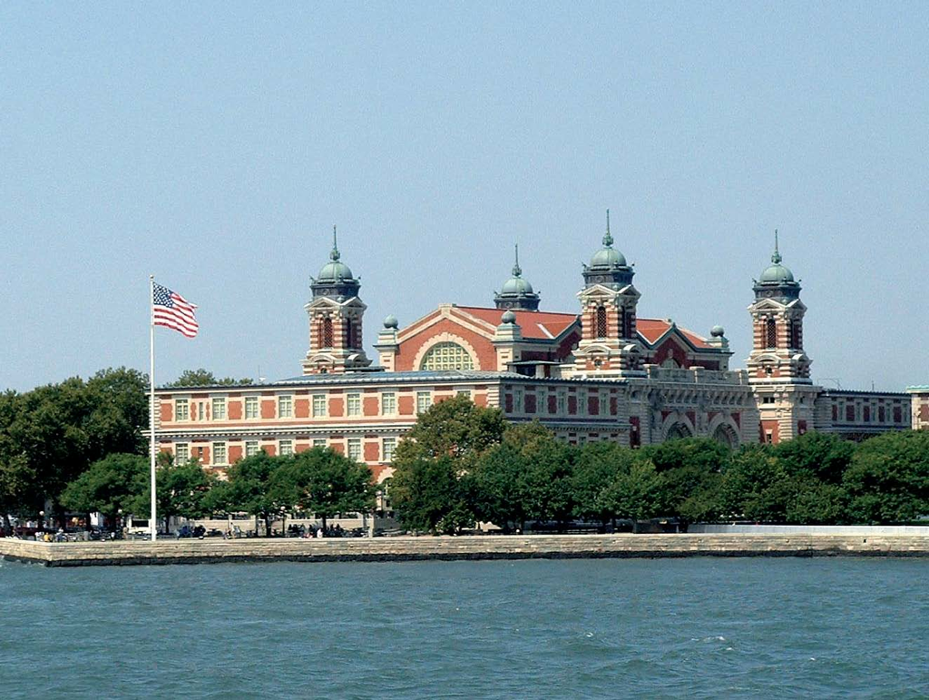
The Journey to America:
Where they arrived
Ellis Island in New York
Angel Island in San Francisco

Slide 34

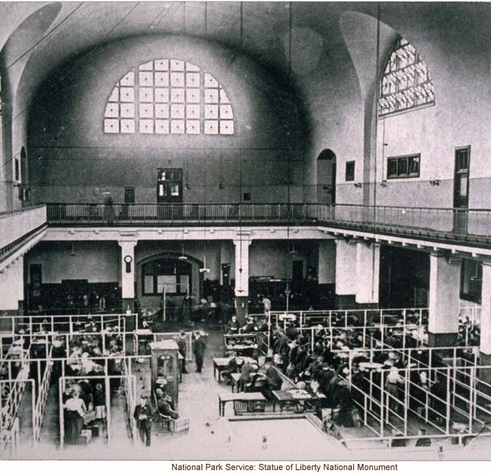
The Journey to America:
When they arrived-Legal Interviews
asked 29 questions
“Do you have work?”
  Foran Act of 1885, illegal to import foreigners as contract laborers
2% deported

Slide 35

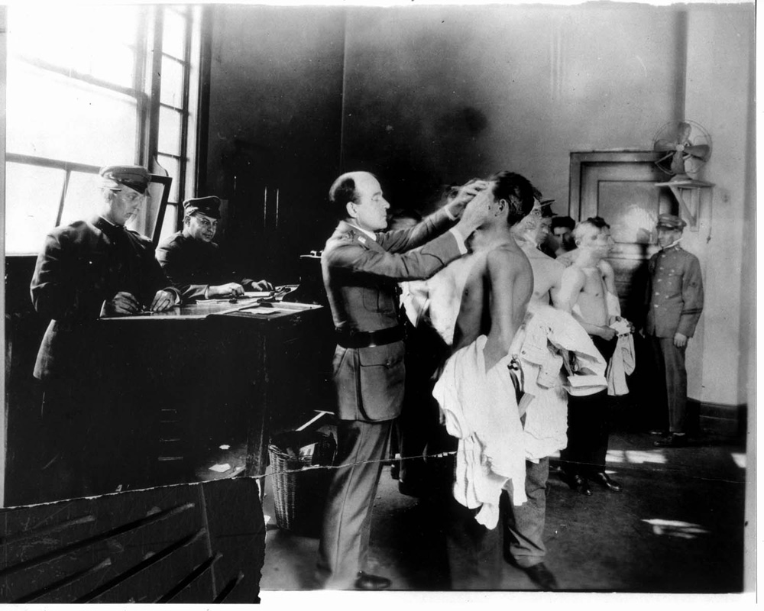
The Journey to America:
When they arrived cont.-Medical Inspections
“six-second exam”
Those with obvious problems would be inspected closer
Marked with chalk symbols for suspected problems
Deportation- those with incurable conditions forced home

Slide 36
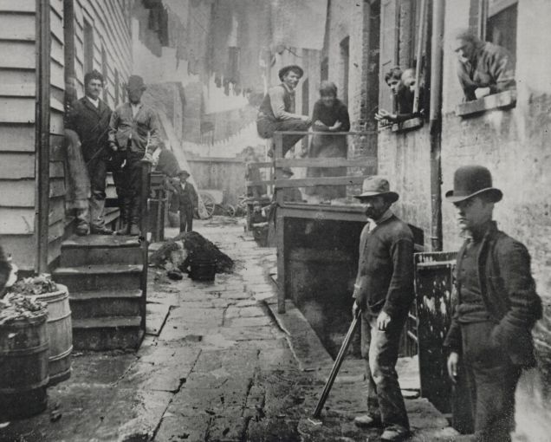
The Journey to America:
Life in the Cities-Living Conditions
most jobs in big cities
from 1870-1920 urban pop. jumped from 25% > 50%
tenements and slum housing
Diseases flourished
Tended to group by ethnicity. Often sought out people who spoke the same language, religion, and customs

Slide 37
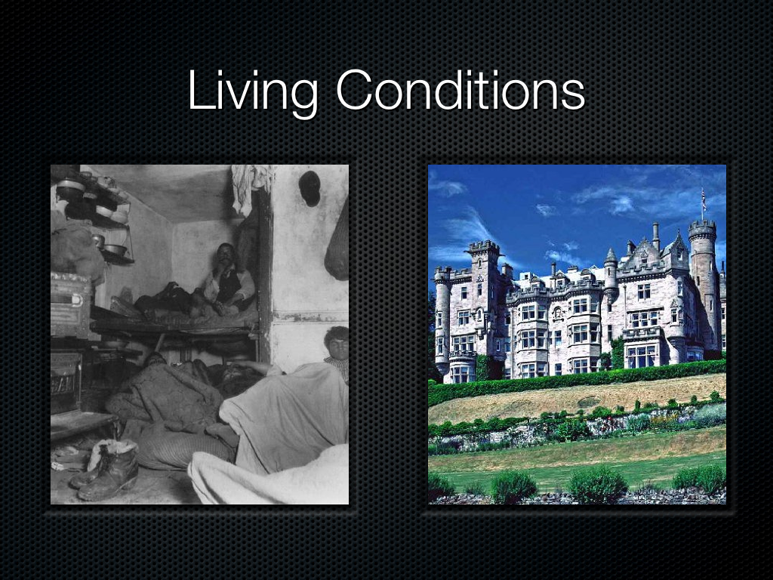

Slide 38
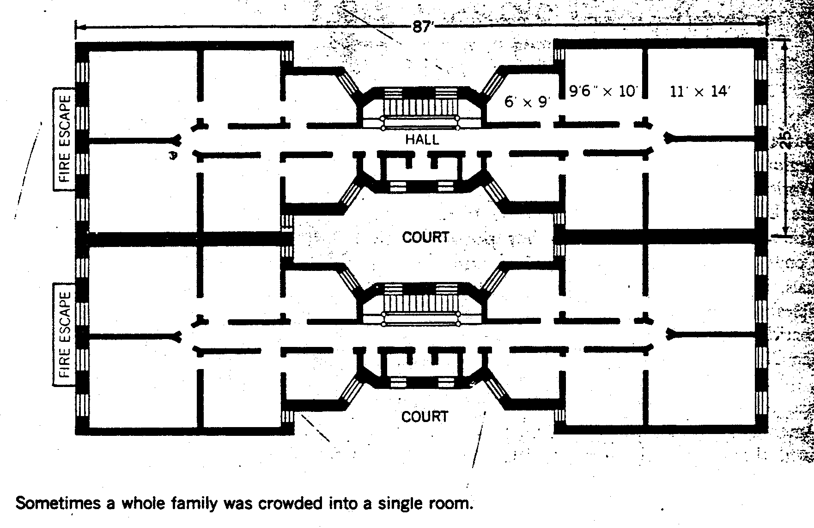
Living Conditions: Dumbbell Tenement

Slide 39

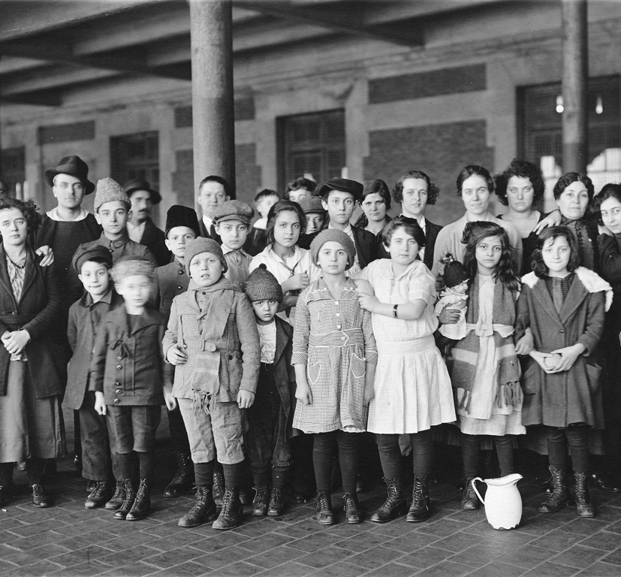
Culture Shock &Assimilation
Confusion and anxiety in America
Dealt with finding a job, place to live, and trying to understand a foreign language and custom
Americanization: promoted loyalty to American values

Slide 40
Race vs. Ethnicity
Race
Indication of the heritage with which you were born, regardless of location or learned behavior
It cannot be altered
Ethnicity
is learned cultural behaviors celebrated throughout regions the around the world
It can be altered or mimicked through choice and beliefs

Slide 41
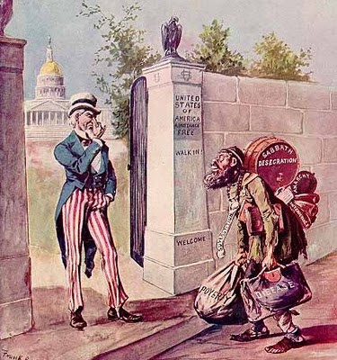
Not all Americans accepted Immigrants
Nativism
Immigration Restriction League: wanted to limit immigration with literacy test
Chinese Exclusion Act-prohibited immigration for 10 years and prevented them from becoming citizens
Gentleman’s Agreement-between US + Japan to curb immigration/emigration of Japanese

Slide 42
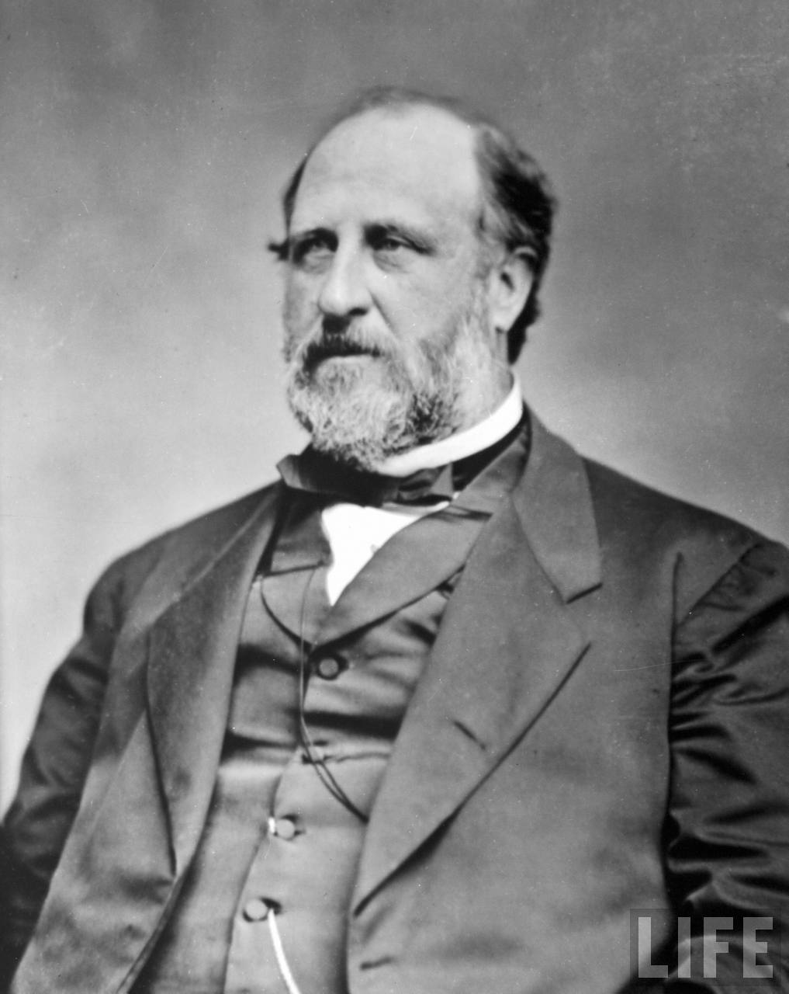
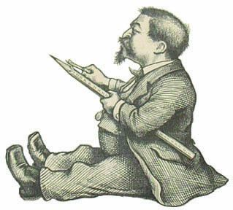
Problems in Politics
Political Machines”-Controlled jobs, licenses, bought votes, kickbacks, bribery, hired friends
Took advantage of immigrants to gain votes
Most famous: Tammany Hall and Boss Tweed in New York
Thomas Nast-Political Cartoonist and muckraker exposed Tweed’s wrongdoings and contributed heavily to the downfall of Boss Tweed

Slide 43
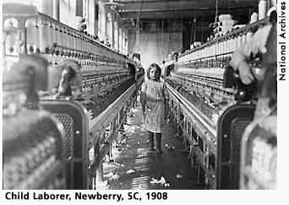
The Origins of Progressivism
An early 20th century reform movement that sought to correct injustices in American life

Slide 44
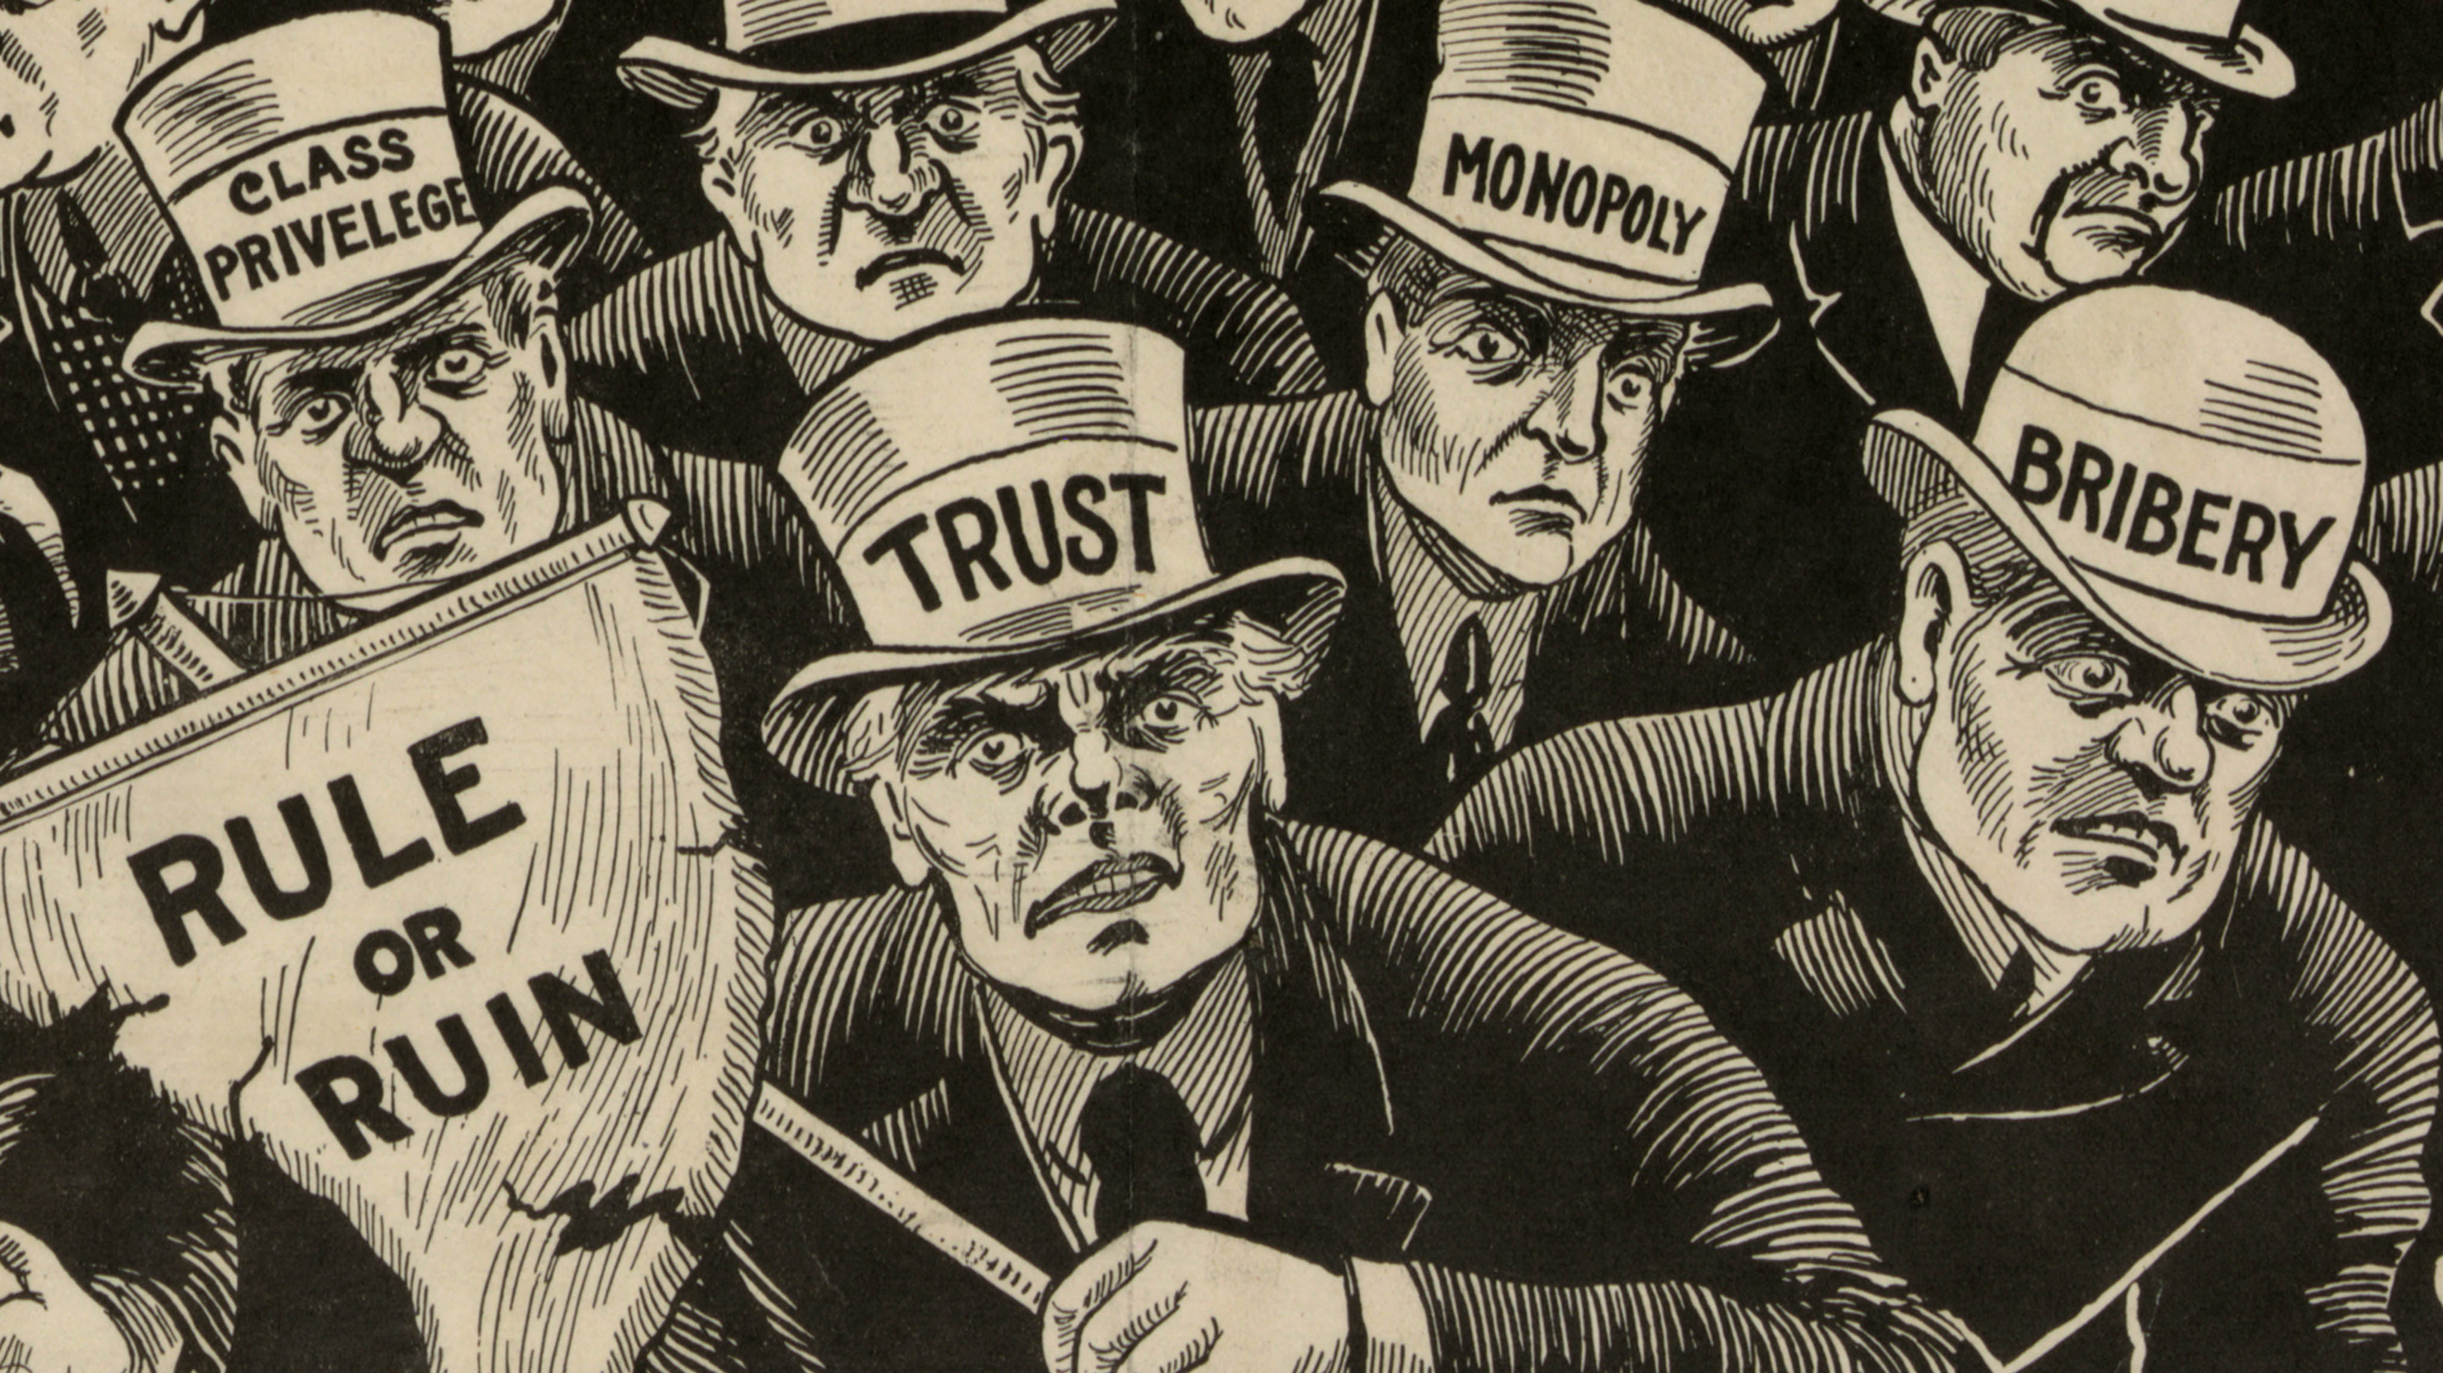
Goals of Progressives
Return control of gov’t to the people
Restore economic opportunity
Correct injustices
Moral improvement

