Slide 1
SAQ Practice Prompts

Slide 2
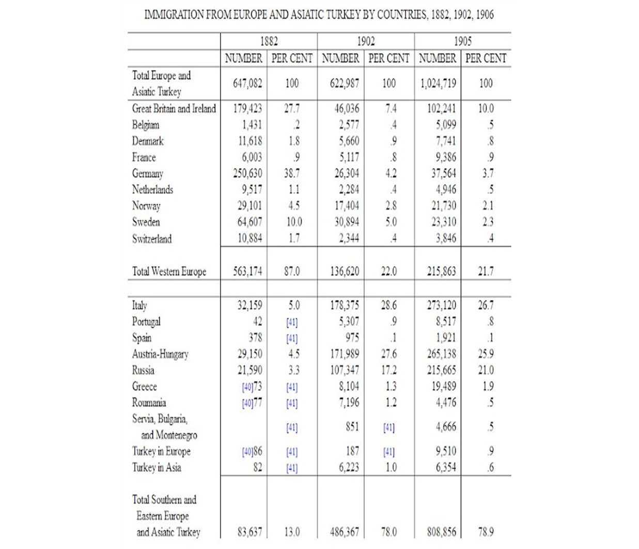
Q: Using the table, answer parts A, B, and C.
Discuss the impact of the data presented in the table with concern to TWO of the following:
  Urbanization
  Industrialization
  Political corruption
B. Discuss ONE reaction among the American population to data presented.
C. Discuss ONE policy enacted by the federal government between 1880-1925 in response to the data presented.

Slide 3
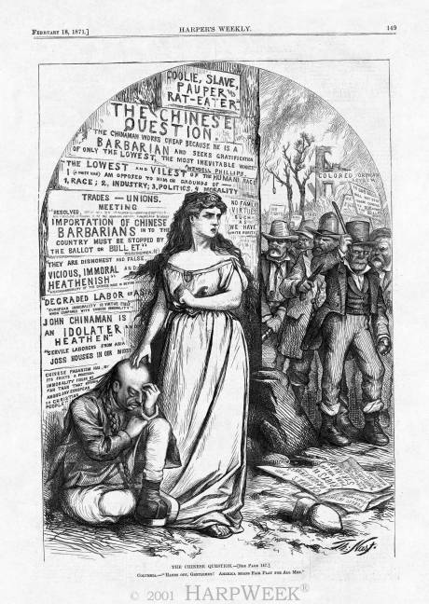
Q: Using the image, answer parts A, B, and C.
a. Briefly explain the point of view expressed by the cartoonist about ONE of the following:
  Immigration
  Nativism
  Democracy
b. Briefly explain ONE development from the period 1880-1920 that led to the point of view expressed by the cartoonist.
c. Briefly explain ONE way in which developments from 1880-1925 challenged or supported the point of view expressed by the cartoonist.
Columbia: “Hands off gentlemen! America
Means fair play for all men.”
Thomas Nast, Harper’s Weekly, 1871.

Slide 4
Q. Briefly explain the impact of industrialization and urbanization on THREE of the following.
    middle class
    working class
    working women
    consumers

Slide 5
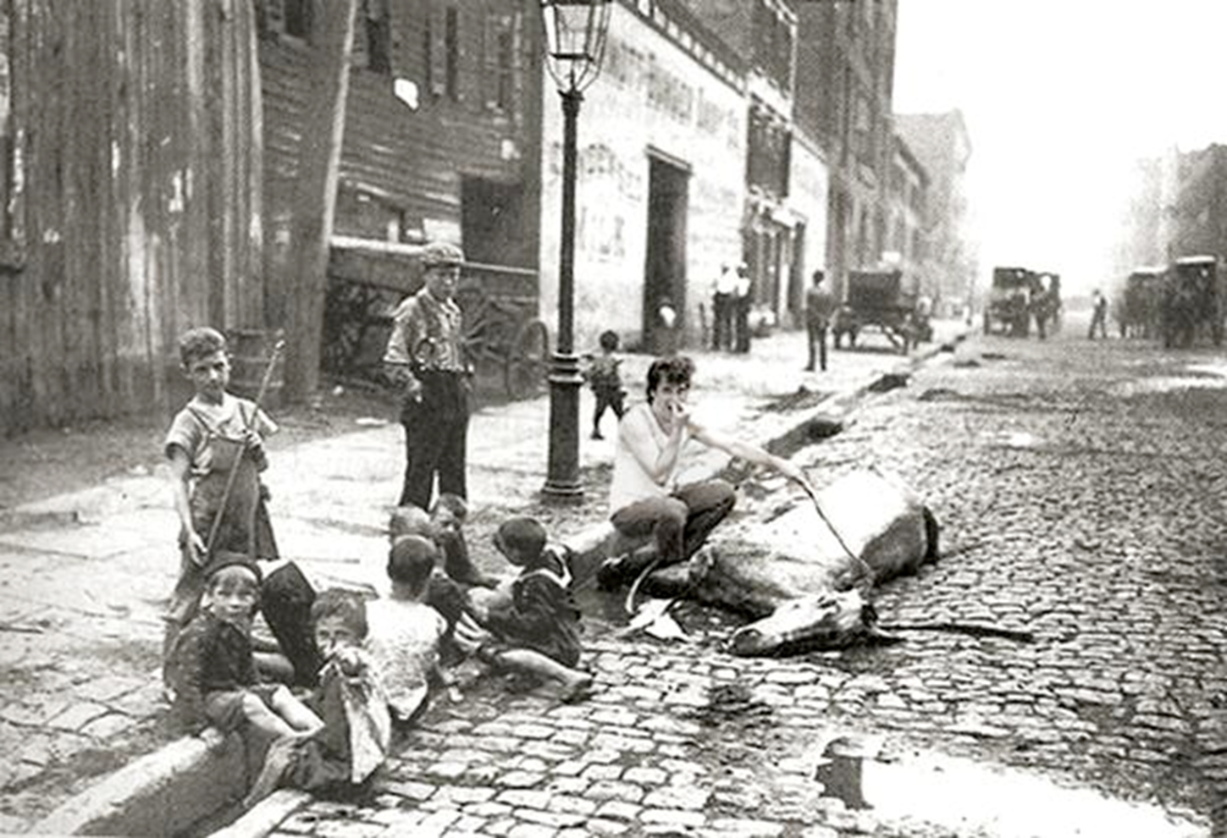
Q: Using the image, answer parts A, B, and C.
A. Briefly explain the point of view expressed by the photographer about ONE of the following:
Tenement Living
Infant Death Rate
Sanitation Codes
B. Briefly explain ONE development in the period 1865-1914 that led to the point of view expressed by the photographer.
C. Briefly explain ONE reform enacted from 1880-1918 which might have resulted from photographs such as this one.
Jacob Riis, How the Other Half Lives, Christmas 1889 edition of Scribner's Magazine

Slide 6
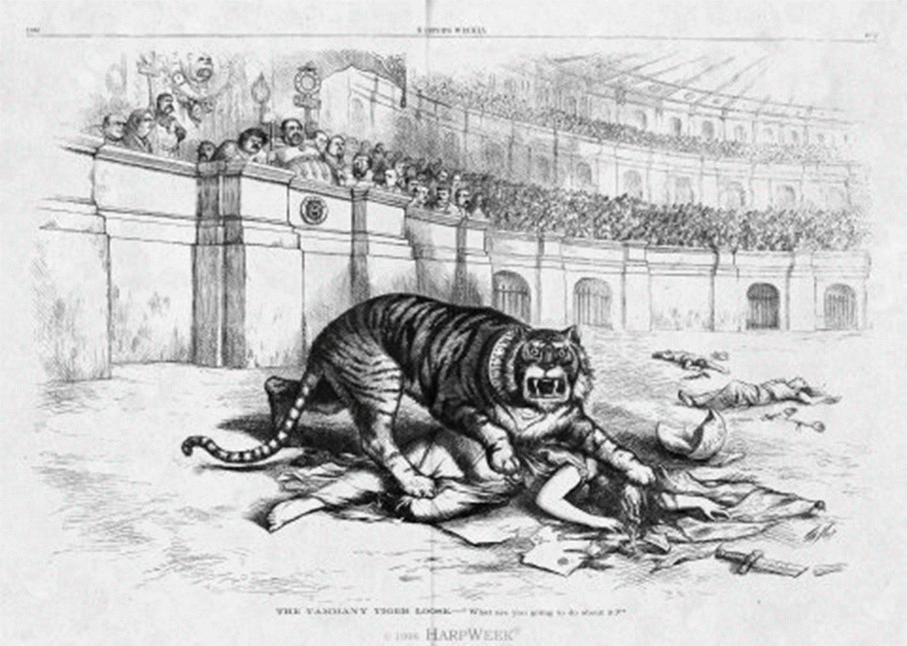
Q: Using the image, answer parts A, B, and C.
A. Briefly explain the point of view expressed by the photographer about ONE of the following
Graft
Voting Fraud
Democracy
B. Briefly explain one development in the period 1865-1900 that led to the point of view expressed by the cartoonist.
C. Briefly explain a second development in the period 1865-1900 that led to the point of view expressed by the cartoonist.
Caption says: “The Tammany Tiger Loose-What Are You Going to Do About It?”
Thomas Nast, November 1871

