Slide 1


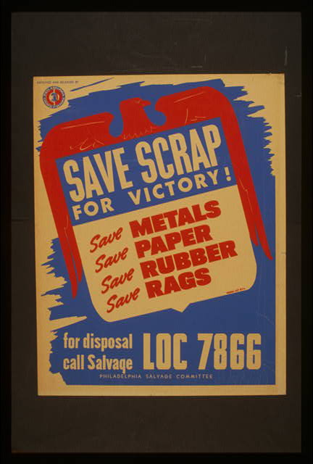

Set A
1
4
3
2
Notes:
Strategic Materials Collections

Slide 2
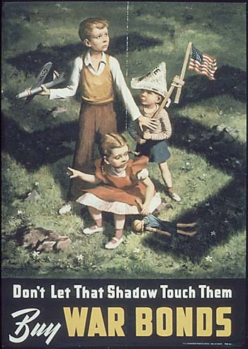



Set B
1
3
4
2
Notes:
Financing the War

Slide 3




Set C
3
1
4
2
Notes:
Grow extra Food

Slide 4


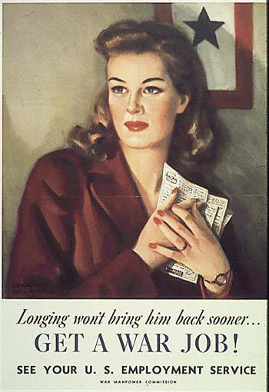

Set D
1
3
2
4
Notes:
Women Work in War Effort

Slide 5




Set E
1
3
2
4
Notes:
Civilian Domestic Defense

Slide 6
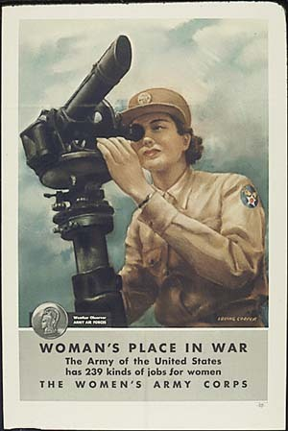



Set F
1
3
4
2
Notes:
Women Serve in the Military

Slide 7


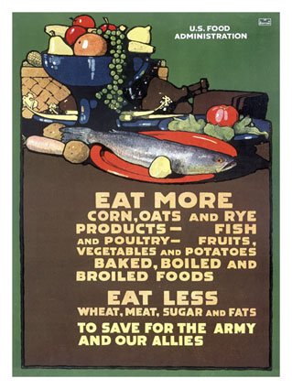
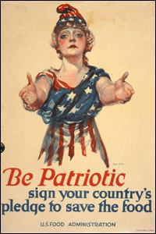
Set G
1
4
2
3
Notes:
Rationing

Slide 8



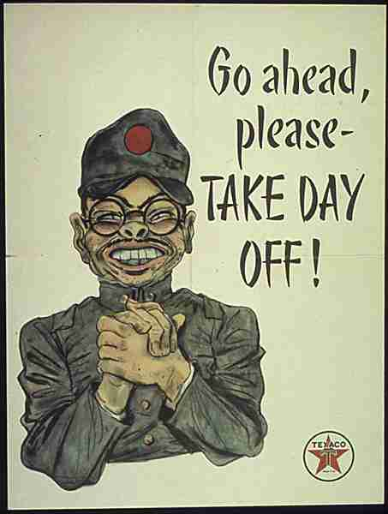
Set H
1
4
2
3
Notes:
Industrial Work & Efficiency

Slide 9

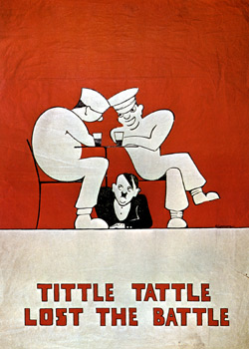


Set I
1
3
4
2
Notes:
Confidentiality & Secrecy

Slide 10


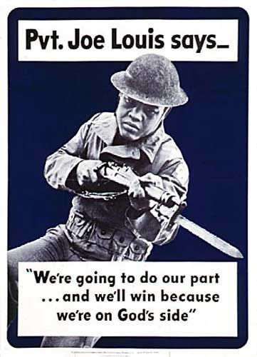

Set J
3
1
4
2
Notes:
Men Needed in the Military

Slide 11
Name ________________________________ Period ____ WWII Propaganda Posters
Poster Set | Main Idea | Most Effective Poster [Identify intended audience and purpose] | Govt Program(s) or Action | Main Idea Bank
A |  |  |  | Civilian Domestic Defense Men Needed in Military Strategic Materials Collections Confidentiality & Secrecy Women Work in War Effort Rationing Financing the War Industrial Work & Efficiency Grow Extra Food Women Serve in the Military
B
C
D
E
F
G
H
I
J

