Slide 1

Settling the Wild West

Slide 2
Main Ideas
Western settlement offered the promise of economic opportunity, but life in the west was filled with hardship.
With white settlement rapidly spreading westward, Plains Indians faced the harsh choice of resistance or assimilation.

Slide 3

Essential Questions
What motivated people to move west in the mid- to late-19th century?
How did life in the west change the lives of settlers themselves?
What was the impact of westward expansion on Native Americans and the natural environment?

Slide 4
Motivations for Settlement

Slide 5
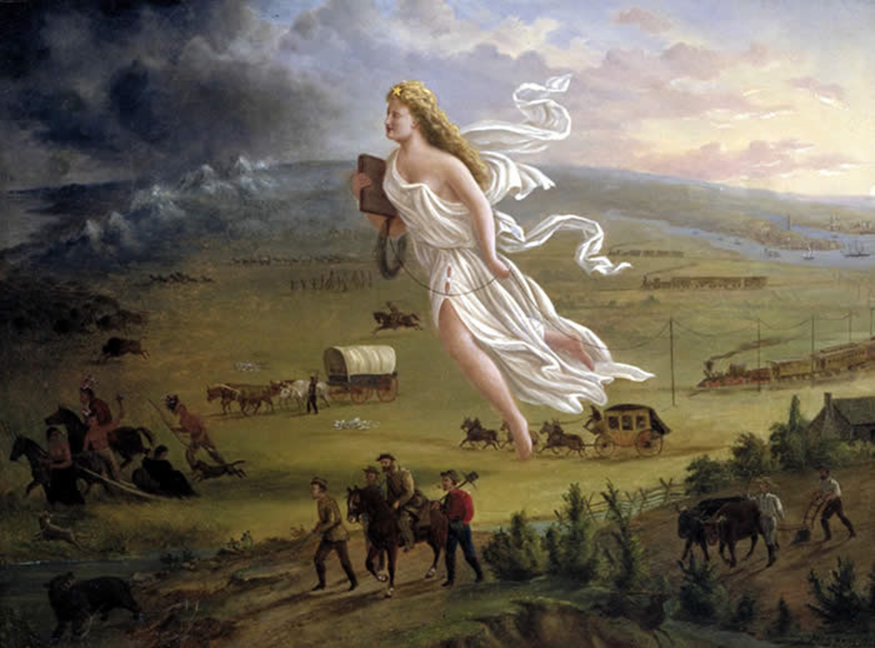
Manifest Destiny

Slide 6
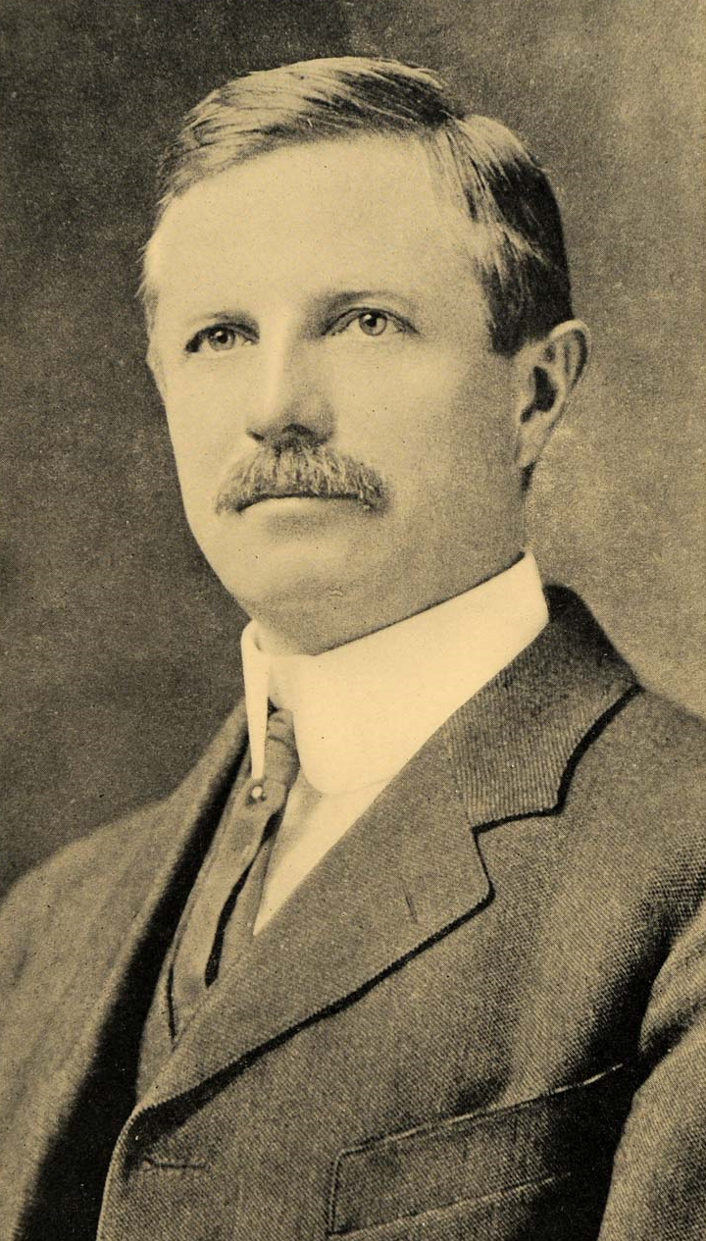
Frederick Jackson Turner
“Frontier Thesis”
Westward expansion defines the American character
  Economic opportunity
  Initiative
  Self-sufficiency

Slide 7
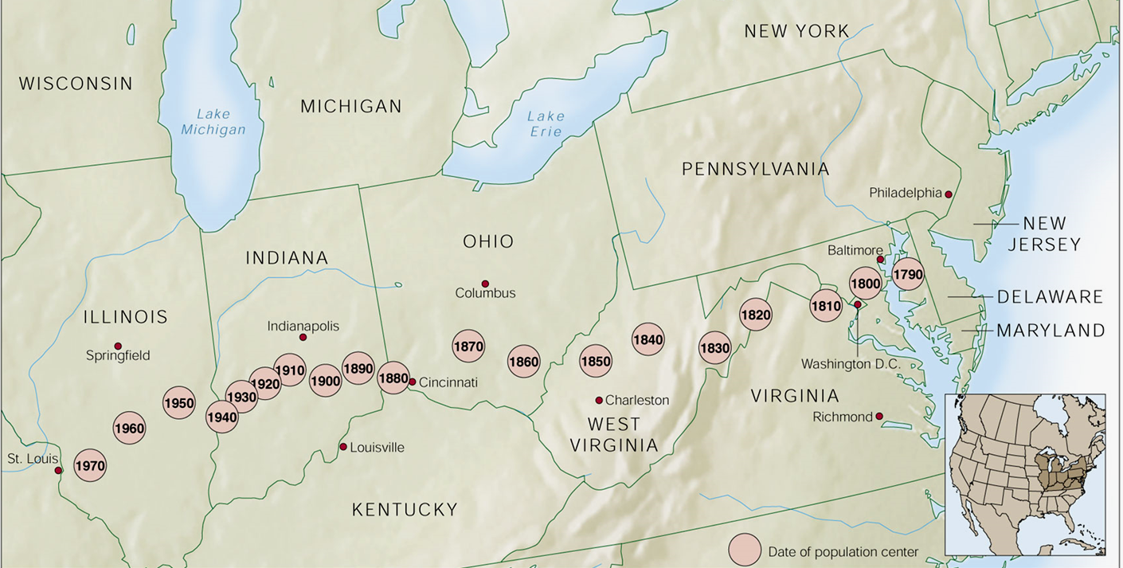
Population Center Moves West

Slide 8
The Settlers

Slide 9
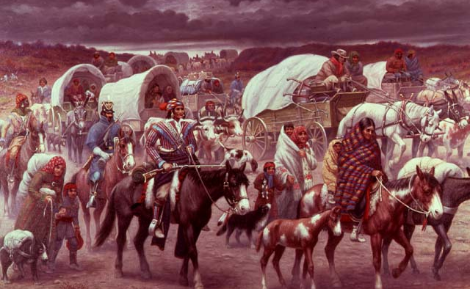
Indian Removal, 1830s

Slide 10
Southeastern Native Americans
Who? | Where? | Experience | Analysis
Southeastern Native Americans | Oklahoma (Indian Territory) | Jackson… Indian Removal Act… Trail of Tears | Reservation life Whites took more land in 1889 “Oklahoma Land Rush” (Sooners)

Slide 11
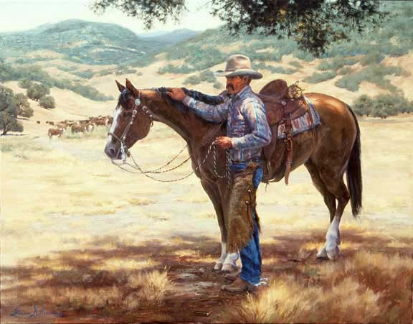
Vaqueros

Slide 12
Vaqueros
Who? | Where? | Experience | Analysis
Vaqueros | Southwest | Mexican cowboys & ranchers | Hispanic culture was well established in southwest at the time of the Mexican War & Mexican Cession

Slide 13
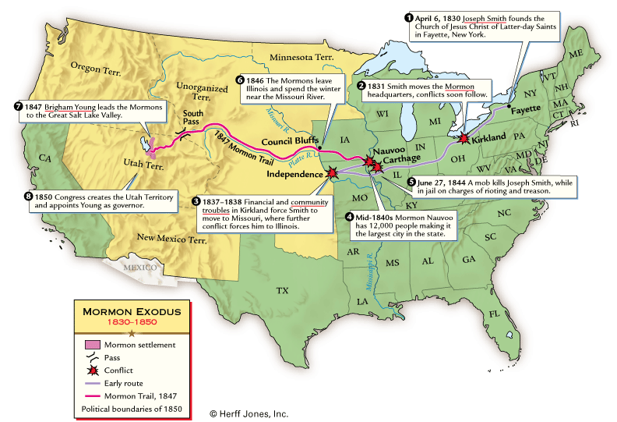
Mormon Exodus, 1840s

Slide 14
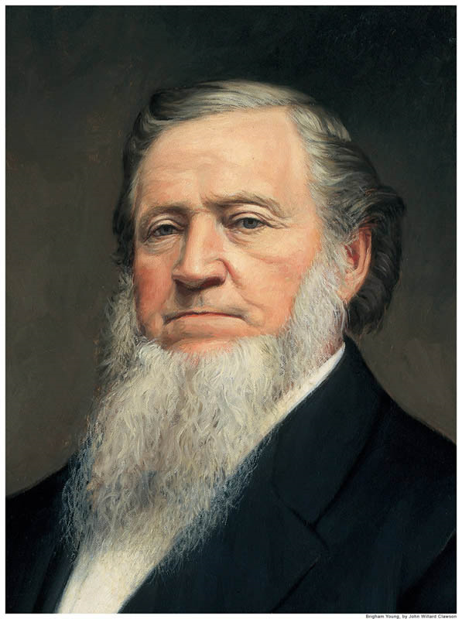

Brigham Young

Slide 15
Mormons
Who? | Where? | Experience | Analysis
Mormons | Utah (esp. Salt Lake City) | To escape religious persecution | Utopianism, polygamy and theocracy until Utah became a state in 1896

Slide 16
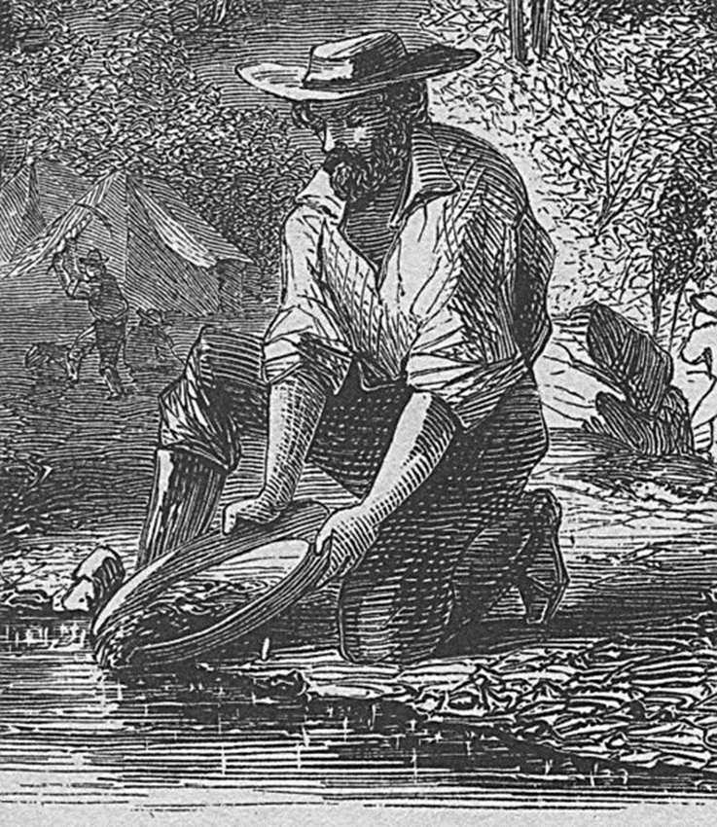

California Gold Rush & the 49ers

Slide 17
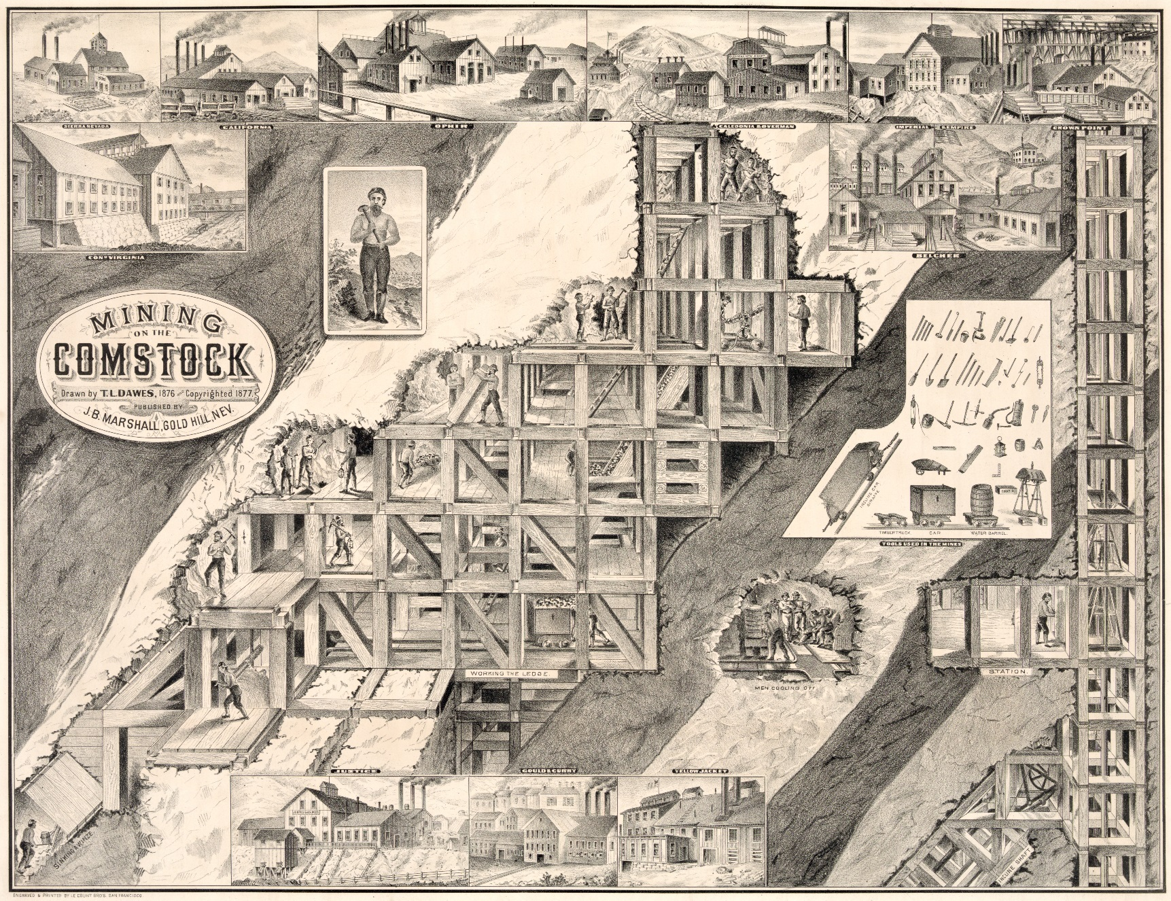
Comstock Lode & the 59ers

Slide 18
49ers & 59ers
Who? | Where? | Experience | Analysis
49ers & 59ers | California & Nevada | Gold rush in 1849 Silver rush in 1859 | California became a free state in the Compromise of 1850 Mining industry

Slide 19
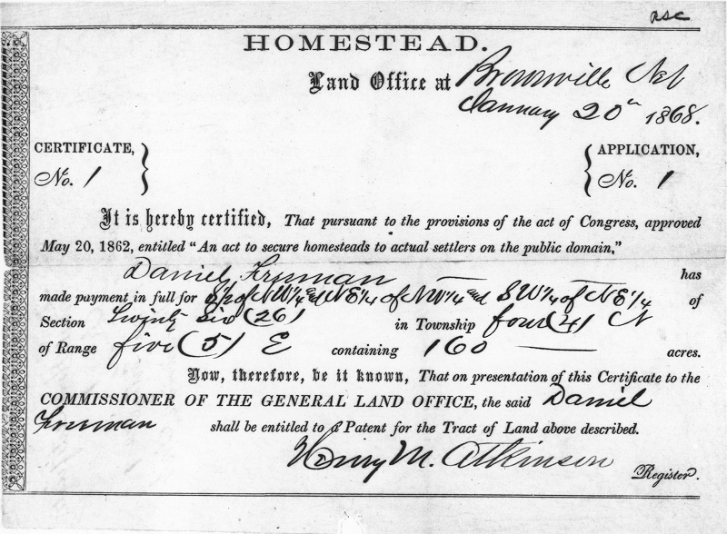
Homestead Act, 1862
160 acres
Small fee
Live there for five years and “improve” the land
Passed during Civil War
  Union control of the west
  Free-Soilers

Slide 20
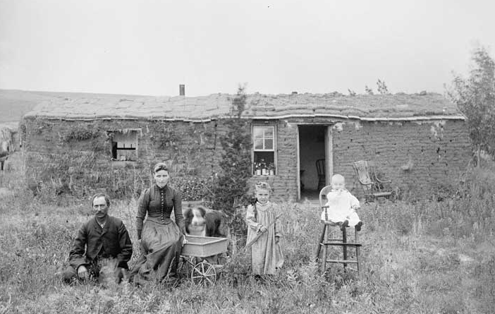
Homesteaders & Sod Houses

Slide 21
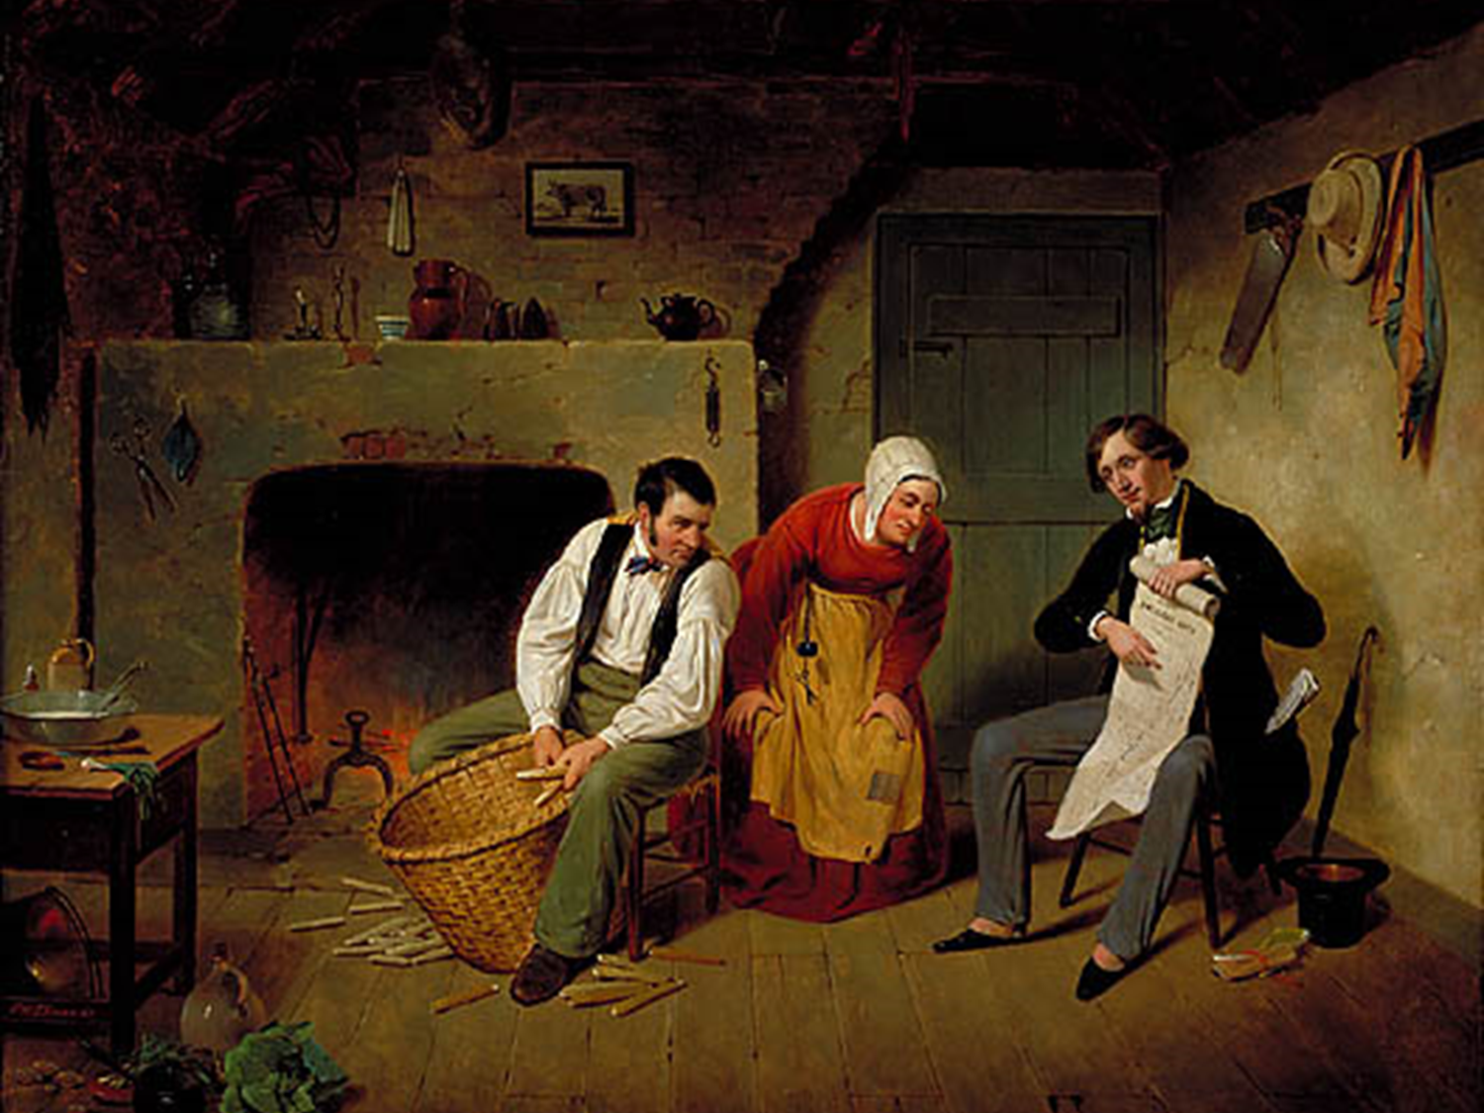
Speculators

Slide 22
Homesteaders & Speculators
Who? | Where? | Experience | Analysis
Homesteaders | All of the west | Homestead Act: pay small fee, “improve” the land, live there for 5 years… you own 160 acres | “Common man” & poor people had opportunities to improve their lives out west Satisfied Free-Soilers Helped Union control the west during Civil War
Speculators | All of the west | Speculators committed fraud and “land flipping” rather than settling | Big businesses (mining, RRs, ranchers) got much of the land out west, contrary to purpose of the Homestead Act

Slide 23
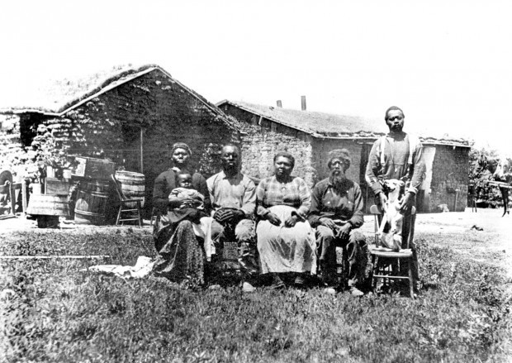
Exodusters

Slide 24
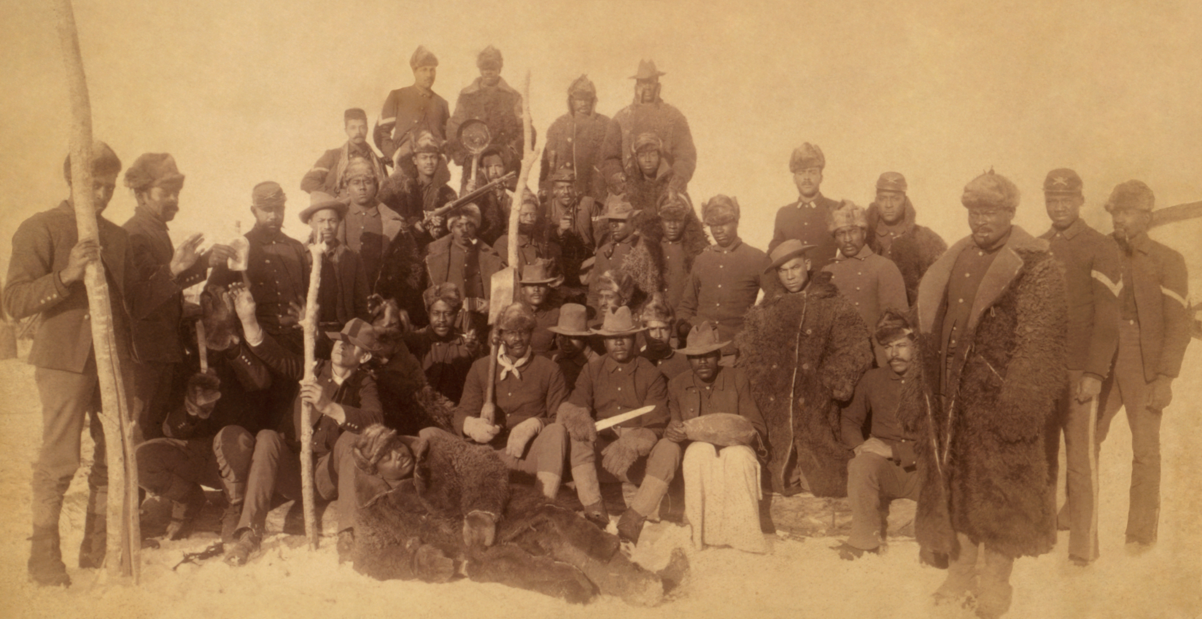
Buffalo Soldiers

Slide 25
Exodusters & Buffalo Soldiers
Who? | Where? | Experience | Analysis
Exodusters & Buffalo Soldiers | All of the west | African Americans who moved west to escape slavery, discrimination and sharecropping; Enlistment in army | Became homesteaders Fought in Plains Indians Wars

Slide 26
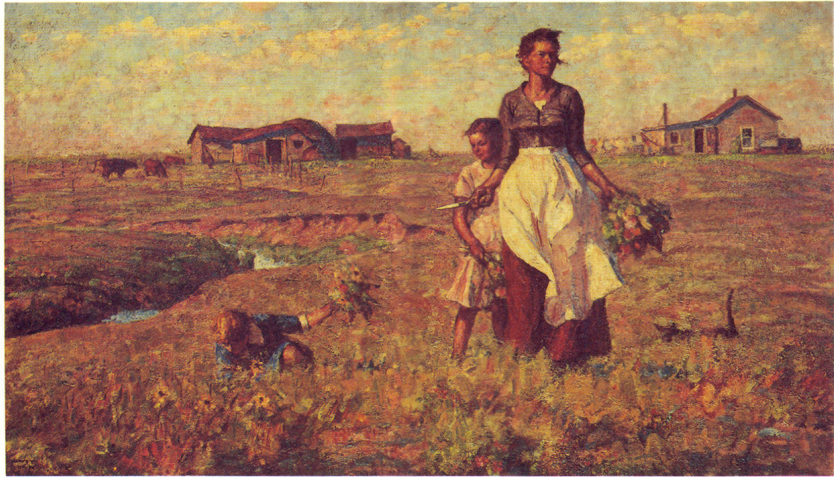
Women in the West

Slide 27
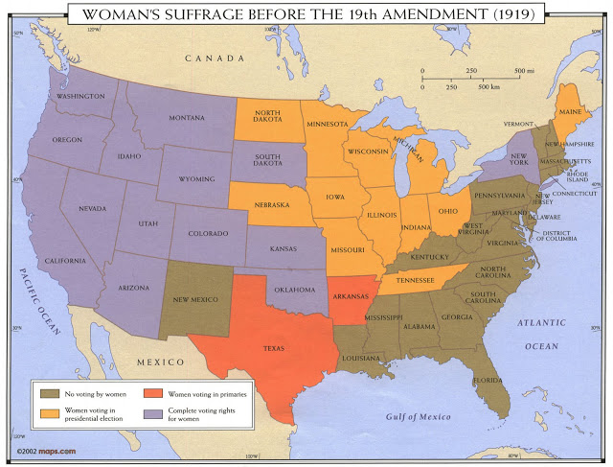
Women’s Suffrage in the West

Slide 28
Women
Who? | Where? | Experience | Analysis
Women | All of the west | Same reasons as men | Hardships of western life made men & women more equal Many western states gave women right to vote early on (before 19th Amendment)

Slide 29
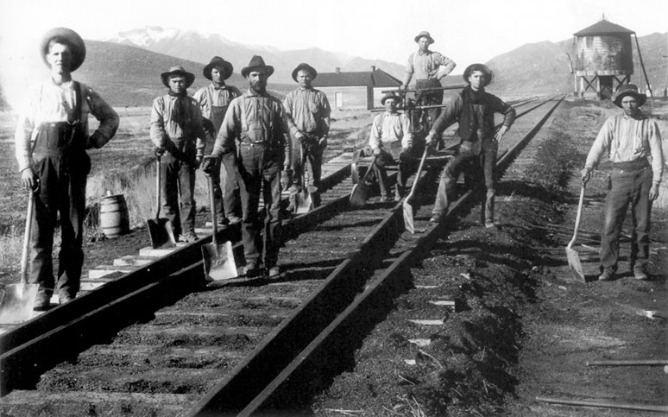
Irish Immigrant Labor

Slide 30
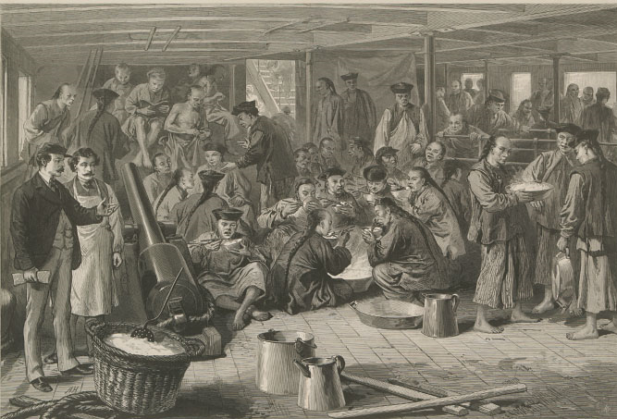
Chinese Immigrant Labor

Slide 31
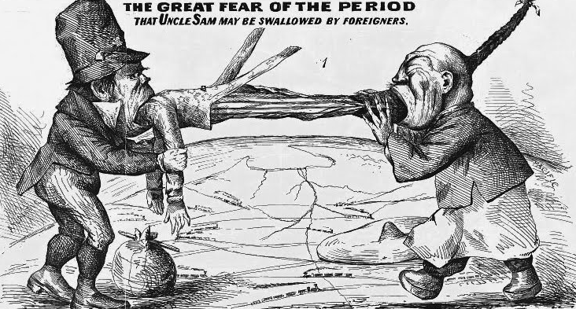
Nativism Against Irish & Chinese Laborers

Slide 32
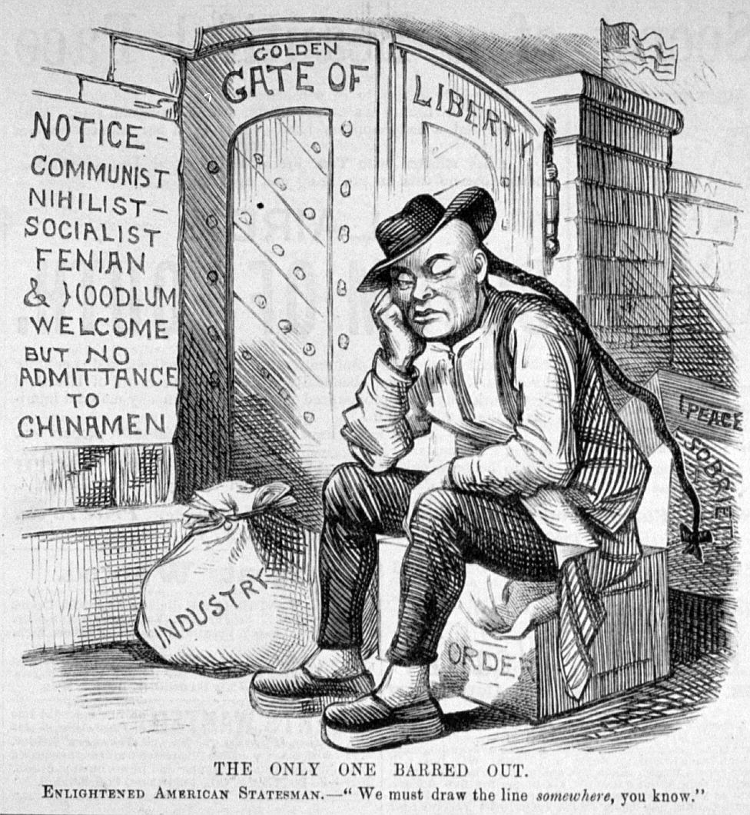
Chinese Exclusion Act, 1882

Slide 33
Chinese & Irish Immigrants
Who? | Where? | Experience | Analysis
Chinese immigrants | All of the west | Mining industry RR construction labor | Faced extreme racism/nativism Chinese Exclusion Act cut off any further immigration in 1882
Irish Immigrants | All of the west | Mining industry RR construction labor | Faced racism/nativism

Slide 34
Farming

Slide 35
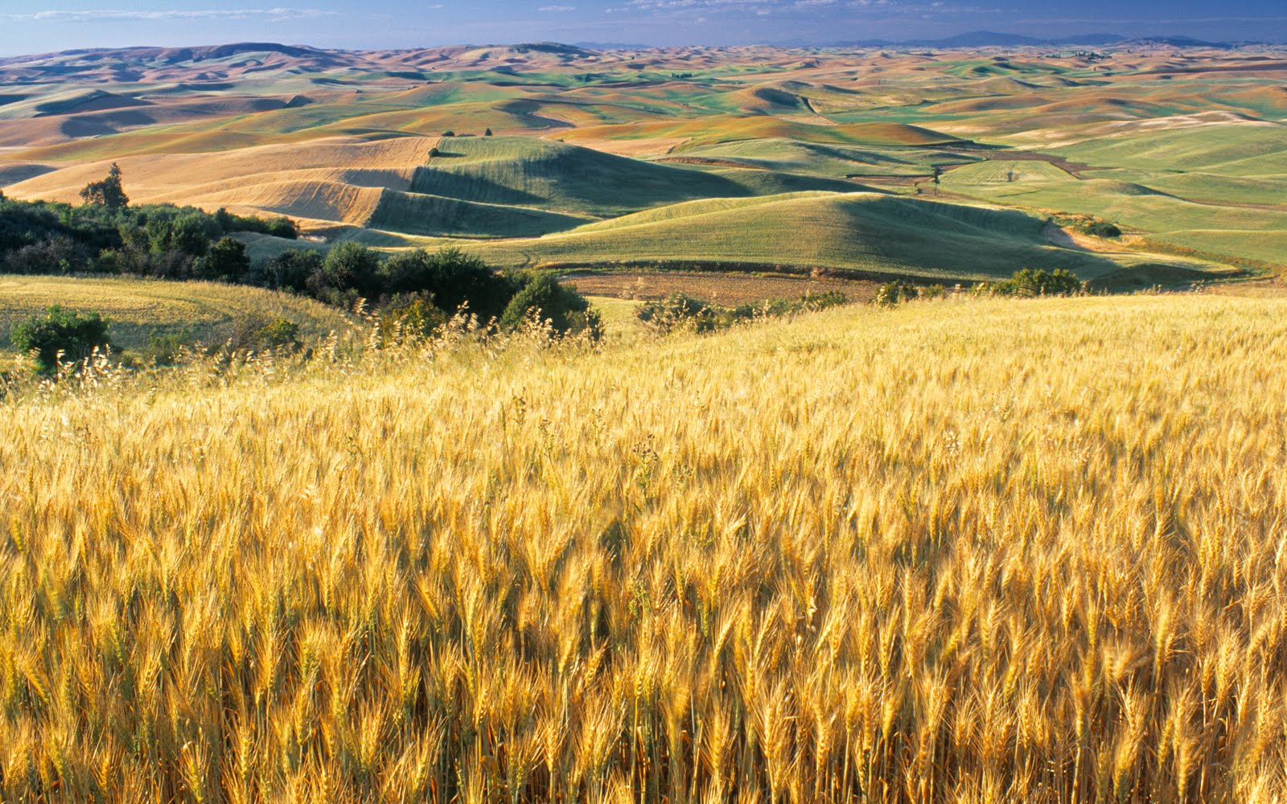
Farming

Slide 36
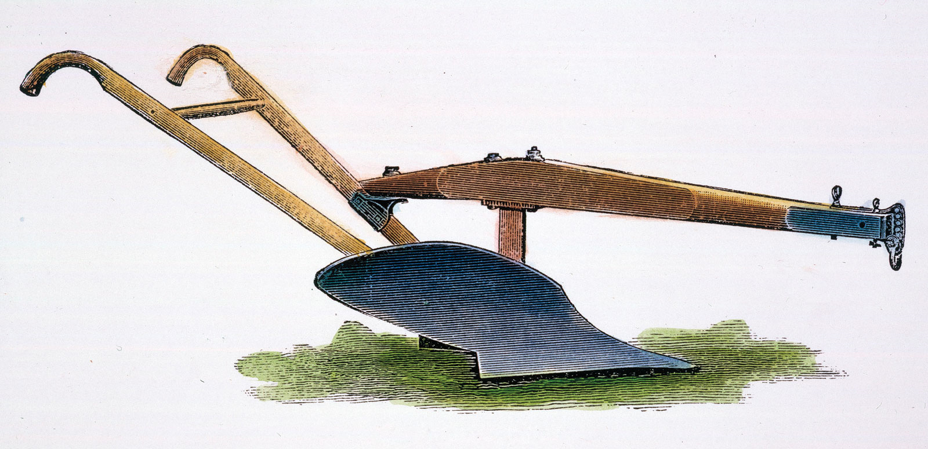

John Deere’s Steel Plow

Slide 37
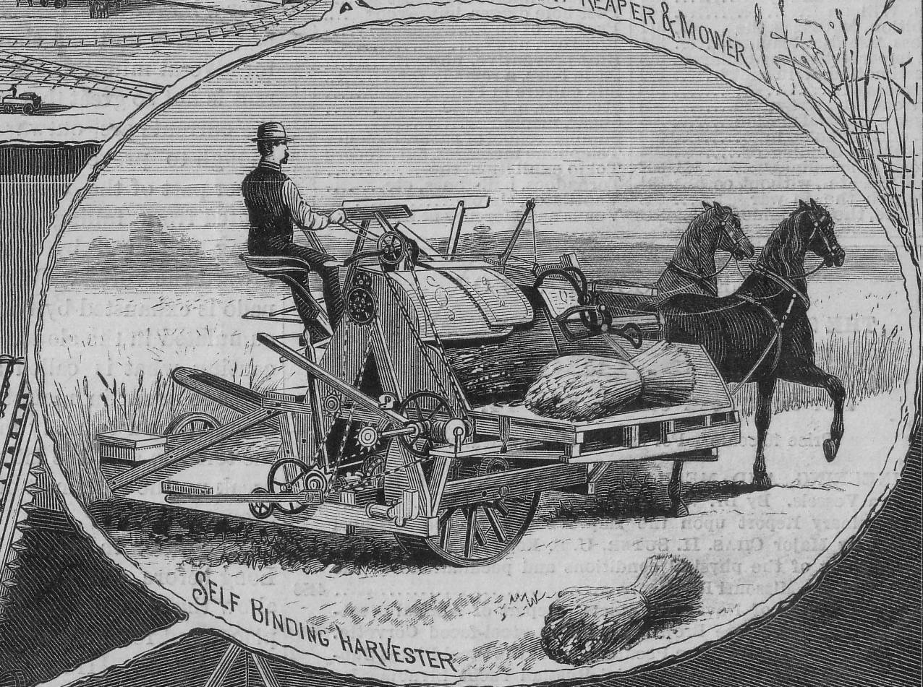
Cyrus McCormick’s Mechanized Reaper

Slide 38
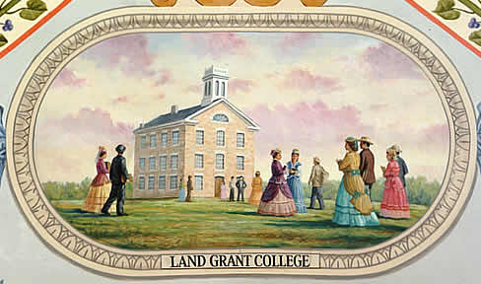
Morrill Land-Grant Act, 1862
Land grants to state colleges
  Agricultural
  Technical
  Mechanical
  A&T, A&M

Slide 39
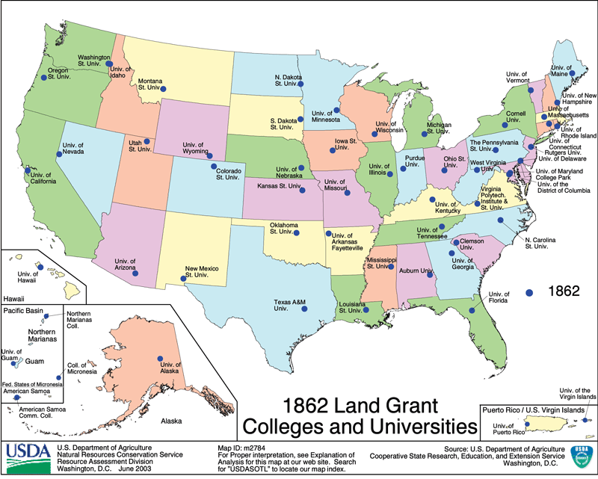
Morrill Land-Grant Act, 1862

Slide 40
Cattle Ranching

Slide 41
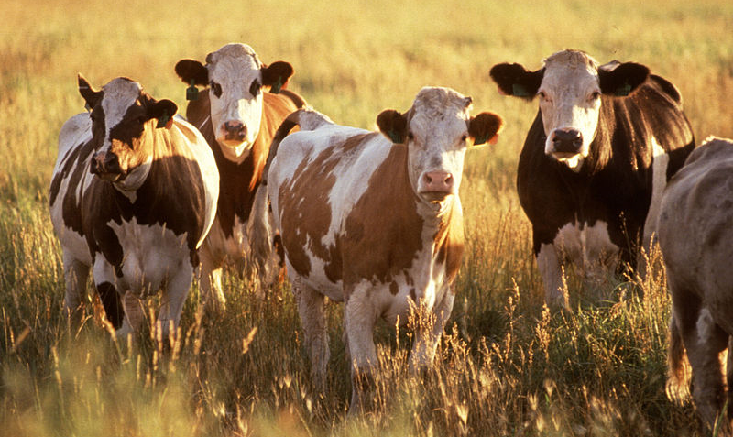
Cattle Ranching

Slide 42
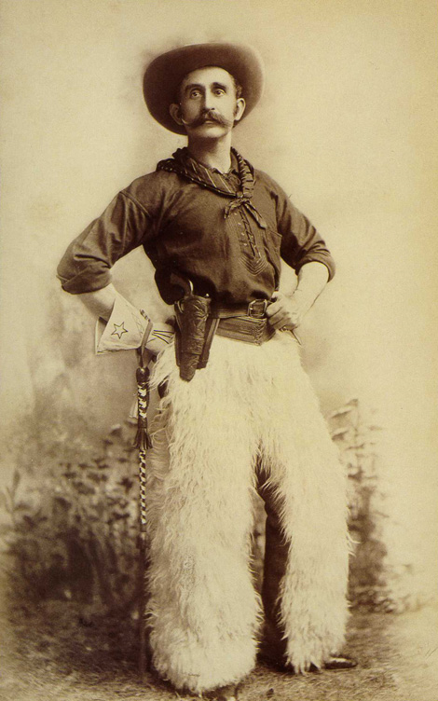
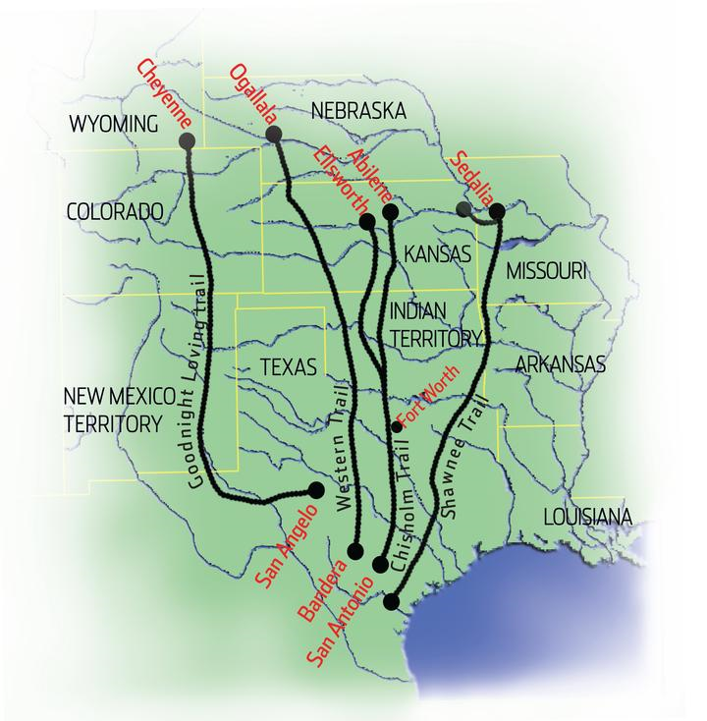
Cowboys & Cattle Drives

Slide 43

Joseph Glidden’s Barbed Wire

Slide 44
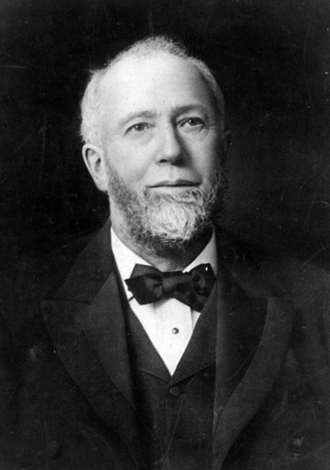
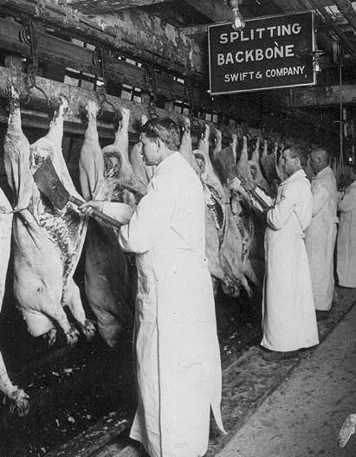
Gustavus Swift’s Meatpacking Industry

Slide 45
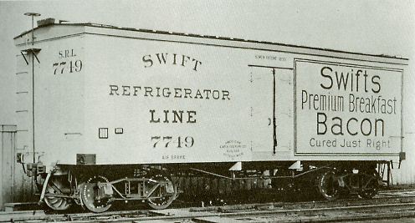
Refrigerator Car

Slide 46
Transcontinental Railroad

Slide 47
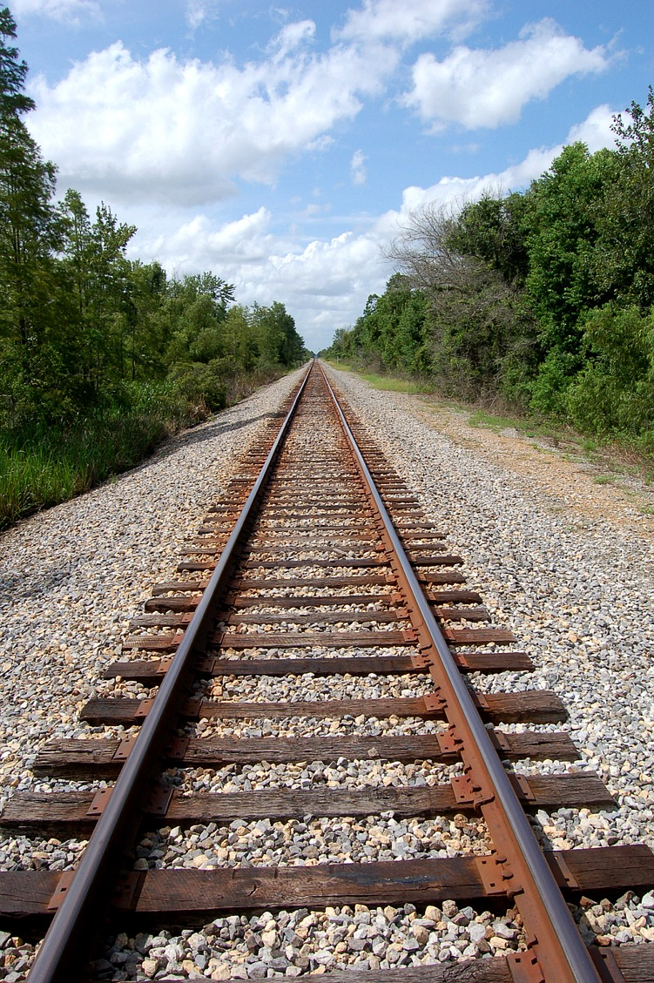
Railroads Begin the “Gilded Age”
Robber barons
Enormous capital investment
  Stockholders & corporations
Government support
  Direct aid & protective tariffs
Low-wage immigrant labor
Steam power
Impact on other industries
  Finance
  Steel
  Mining
  Agriculture
Interstate commerce… requires federal regulation

Slide 48
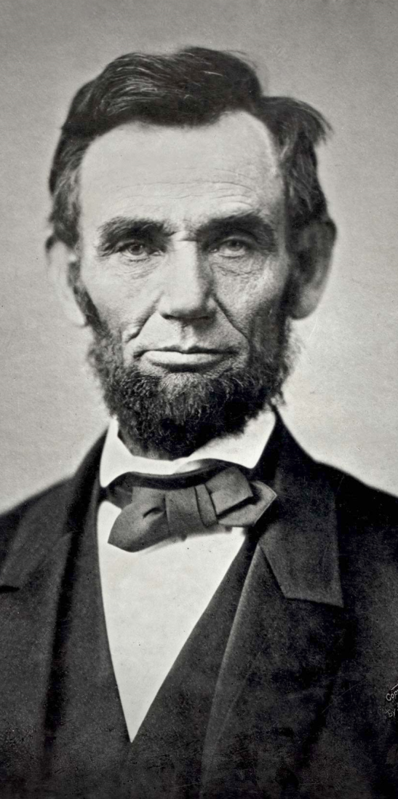
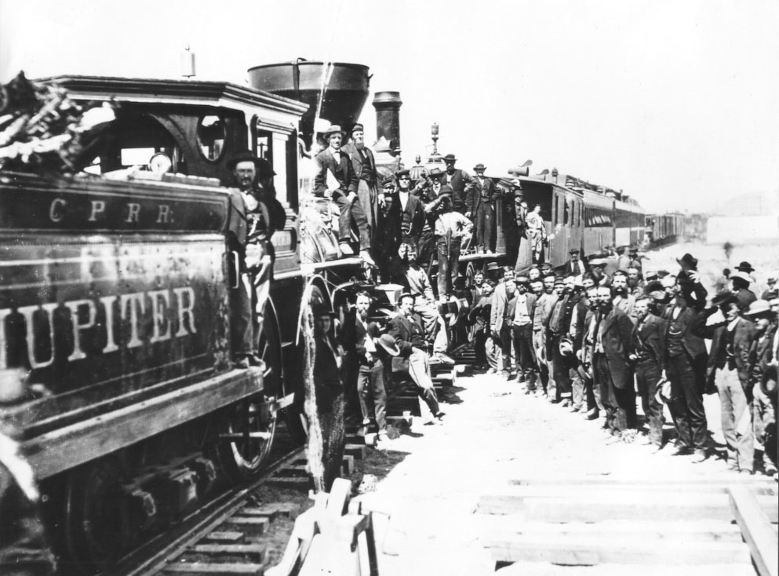
Pacific Railway Act, 1862

Slide 49
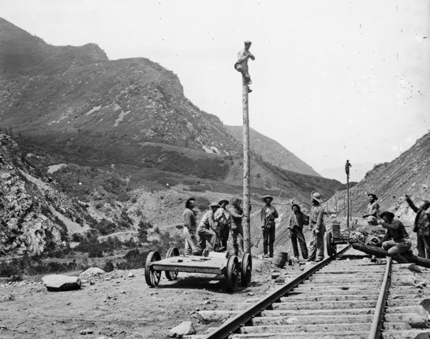
Railroads & Telegraphs

Slide 50
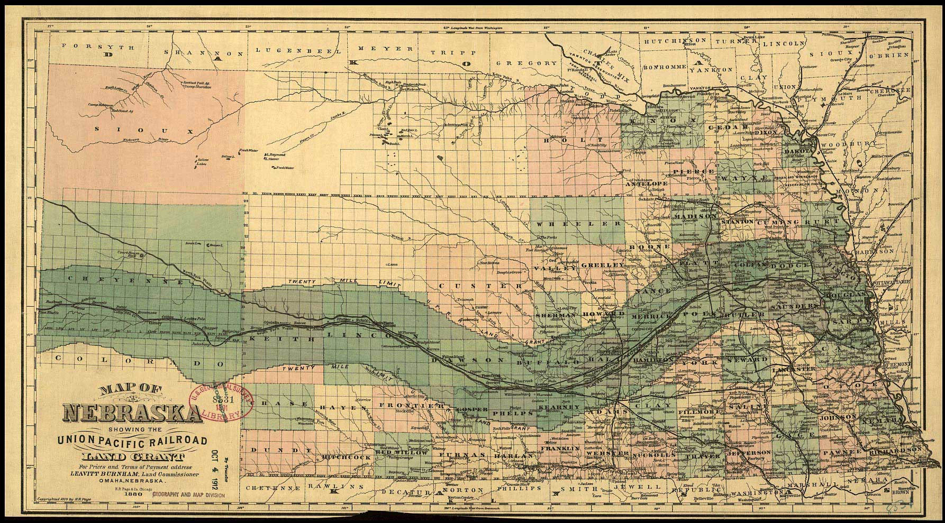
Rail Company Land Grants

Slide 51
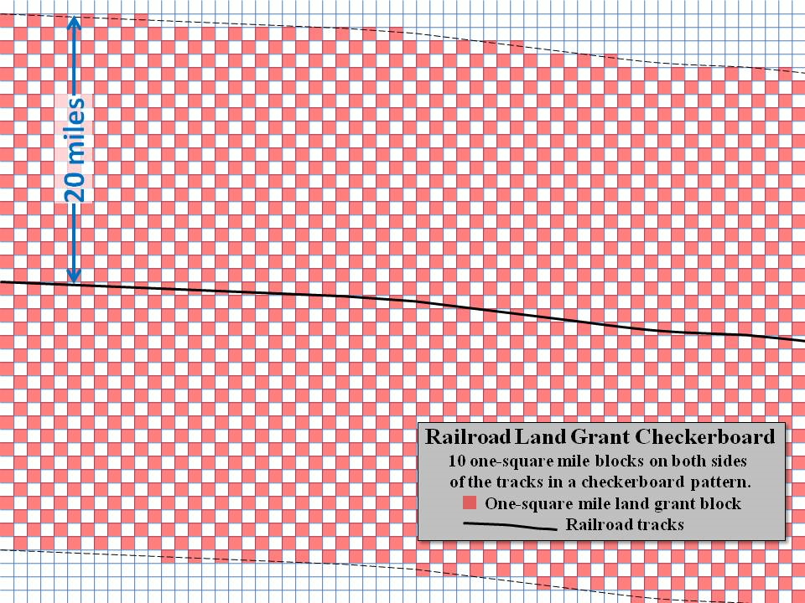
Rail Company Land Grants

Slide 52
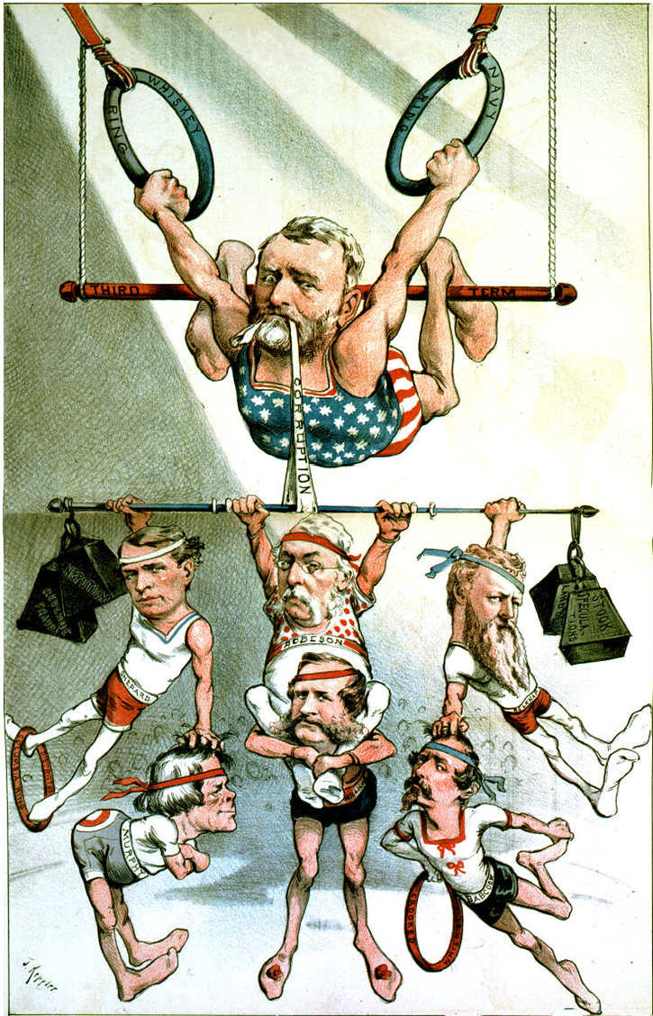
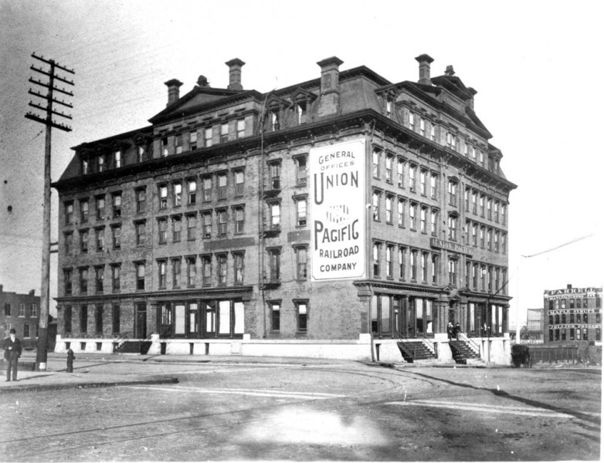
Credit Mobilier Scandal

Slide 53
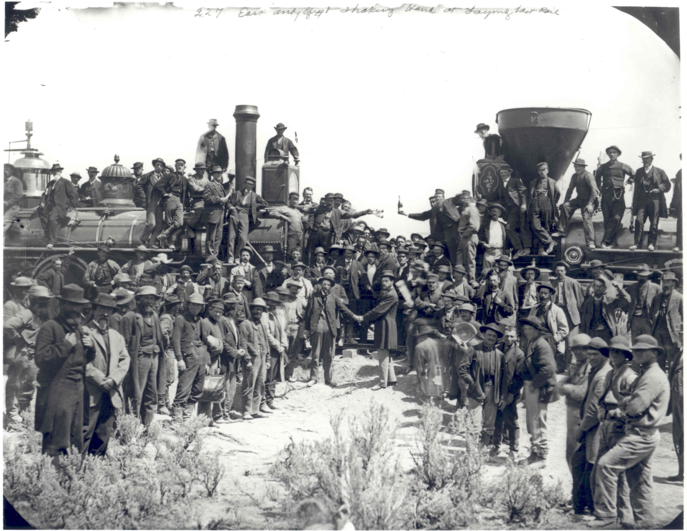
Promontory Point, Utah

Slide 54
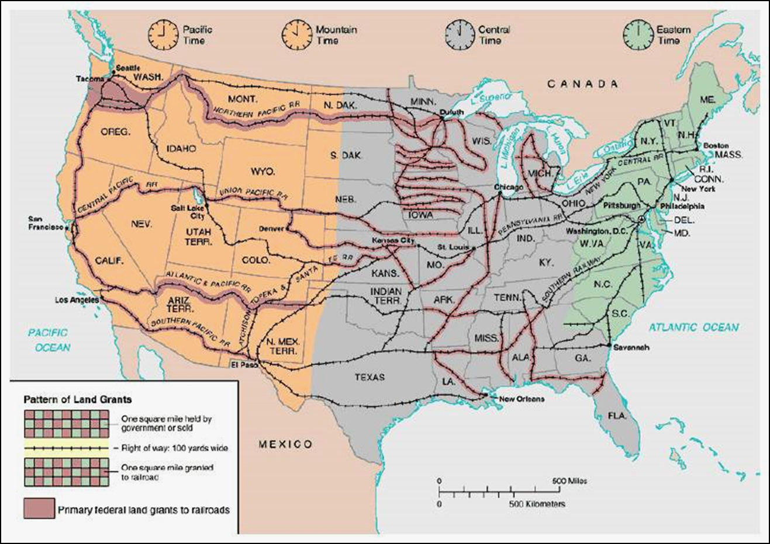
Transcontinental Railroad

Slide 55
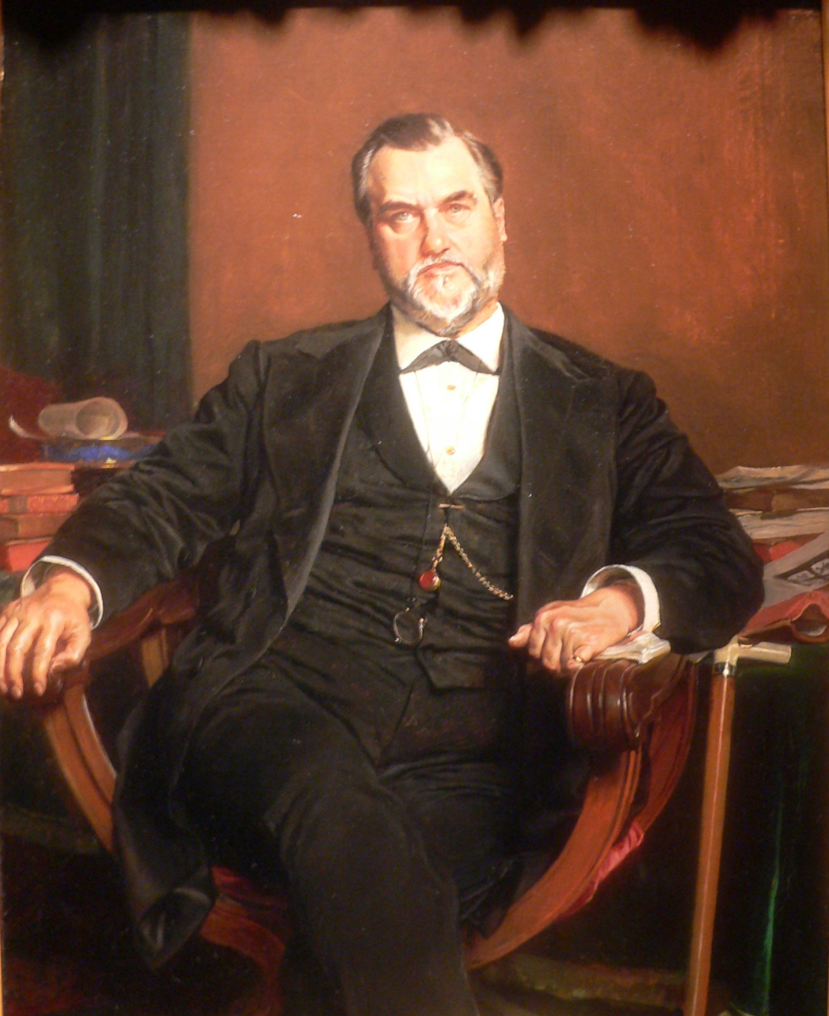
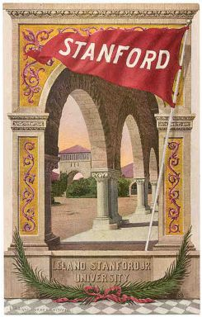
Leland Stanford

Slide 56
Irish Immigrant Labor

Slide 57
Chinese Immigrant Labor

Slide 58
Nativism

Slide 59
Chinese Exclusion Act, 1882

